Slide 1
ARTICULATIONS – SKELETAL JOINTS

Slide 2
Not All Articulations Allow Free Movement
There are THREE main categories of Articulations:
A) DIARTHROTIC/Synovial – Allows
the most amount movement
B) AMPHIARTHROTIC/Cartilaginous –
Allow fairly limited movement
C) SYNARTHROTIC/Fibrous – Allow little
To No Movement

Slide 3
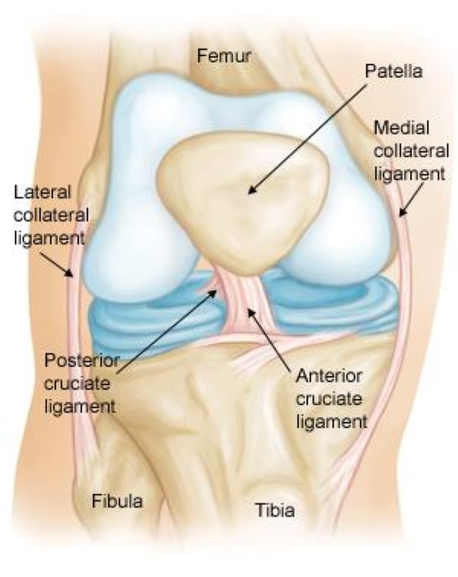
DIARTHROTIC/Synovial
“DIA” – Straight Through
Diarthrotic joints have two bones meet each other in a joint capsule. The joint capsule is lined with a synovial membrane that puts out a lubricating synovial fluid. Both bones are covered with smooth articular cartilage and there is a joint cavity/space between the bones.

Slide 4
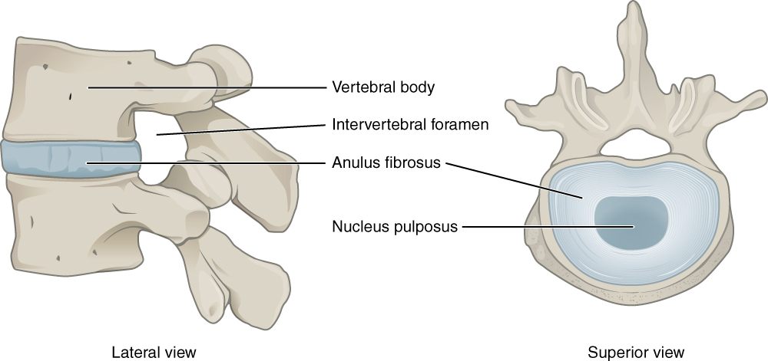
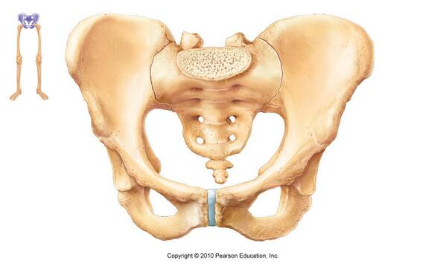
AMPHIARTHROTIC/Cartilaginous
“AMPHI” – Blend of categories – In between – probably heard of the word “AMPHIBIAN”
Amphiarthrotic joints have two bones connect together with cartilage

Slide 5
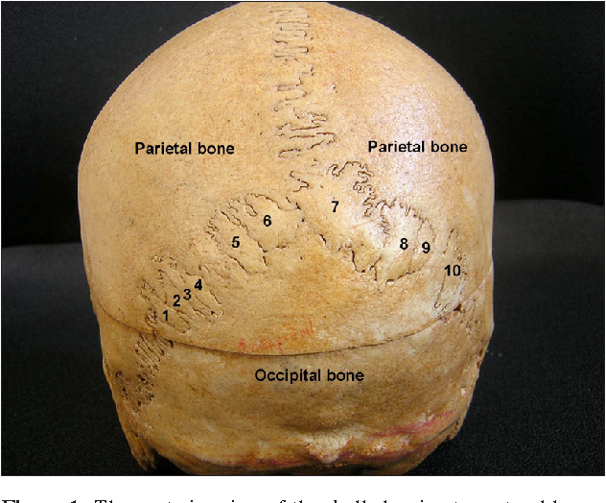
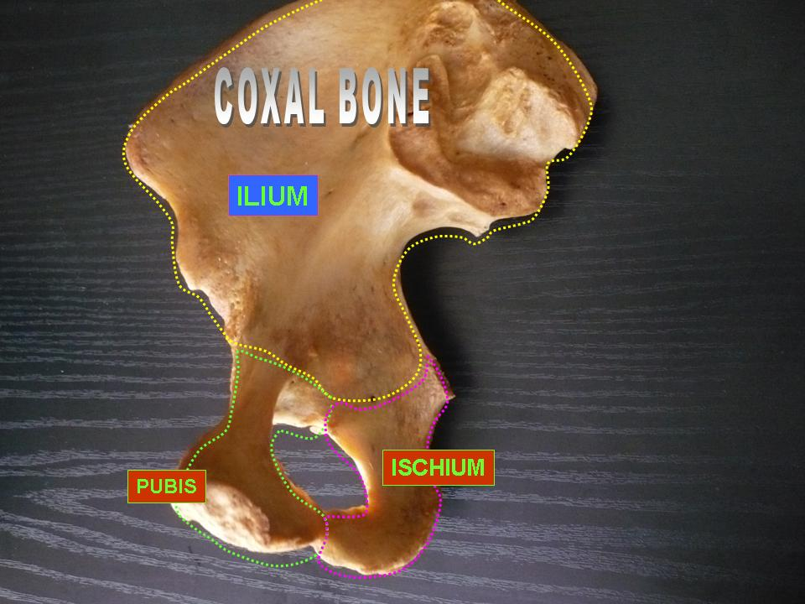
SYNARTHROTIC/Fibrous
“SYN” – to put together.
Synarthrotic joints are most often locked together with bony fibrous tissue. This allows the articulation a small amount of flex when pressure is applied.

Slide 6
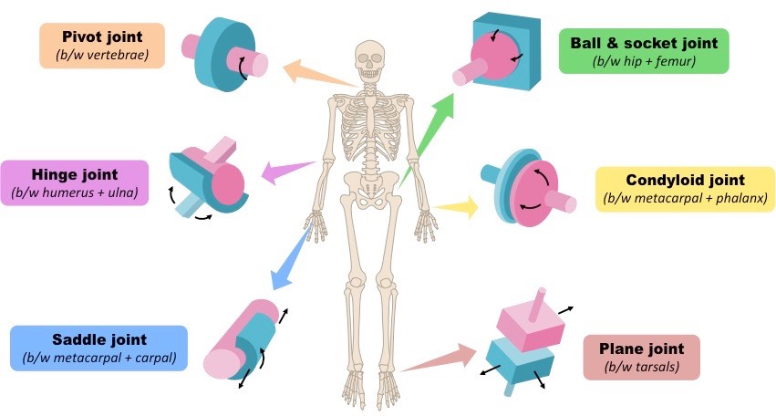
HUMAN KINETICS – our focus is mostly
on movement – therefore – DIARTHROTIC
JOINTS (Synovial Joints)
We will be looking at 6 specific types of Synovial Joints

Slide 7
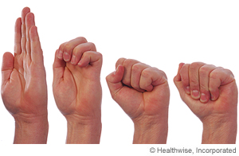
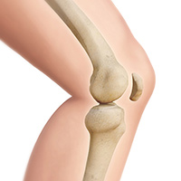
1. HINGE JOINT
A hinge joint allows the joint angle to open up –EXTENSION or the joint angle to close down - FLEXION

Slide 8
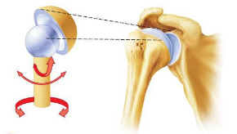
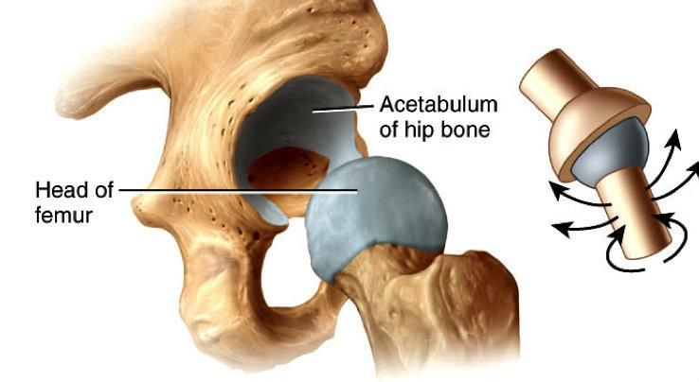
2. BALL AND SOCKET
- A Ball And Socket Joint has the greatest range of movement and types of movement. Types of joint movements include – Rotation, Circumduction, Abduction, Adduction, Flexion and Extension

Slide 9
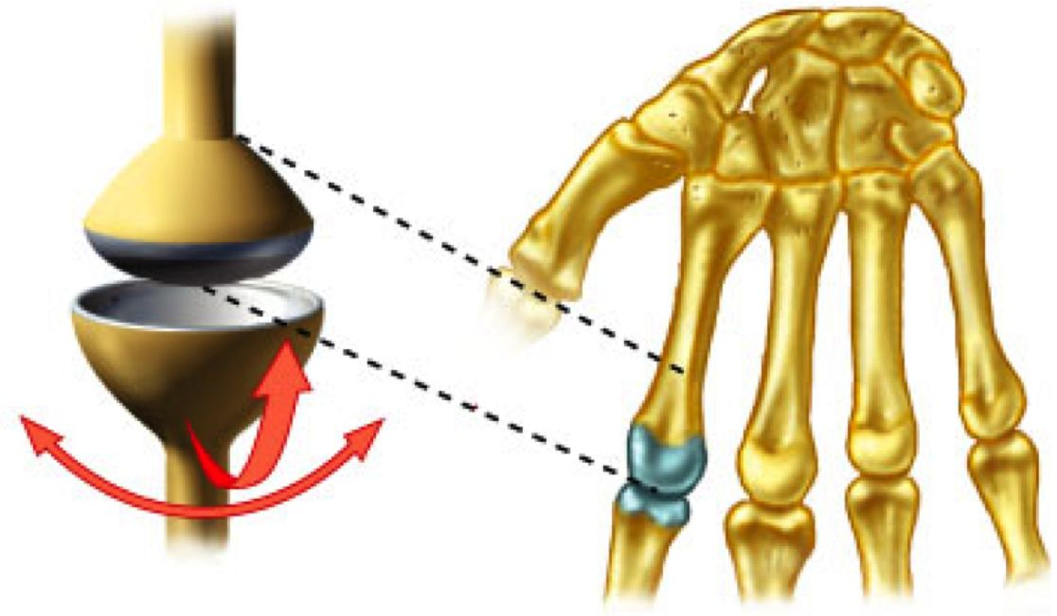
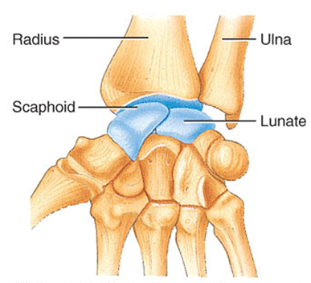
3. CONDYLOID/Elipsoid
- The condyloid (ellipsoid) joint is a little like a down-scaled ball-and-socket. One bone has an ovoid (oval) articular surface, or condyle that is received into an elliptical cavity. This permits movement in two planes, allowing flexion, extension, adduction, abduction, and some circumduction, but no rotation.
<iframe width="640" height="480" src="https://www.youtube.com/embed/NeqkKHYkzCA" frameborder="0" allow="accelerometer; autoplay; encrypted-media; gyroscope; picture-in-pi
cture" allowfullscreen></iframe>

Slide 10
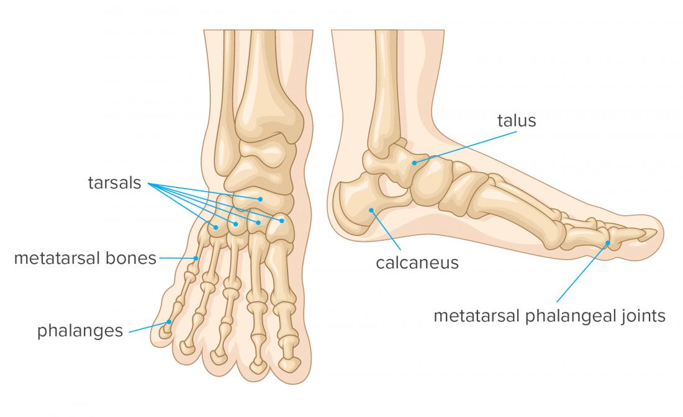
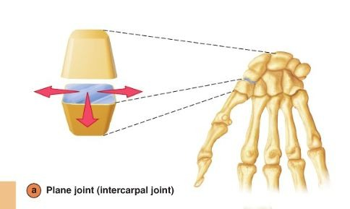
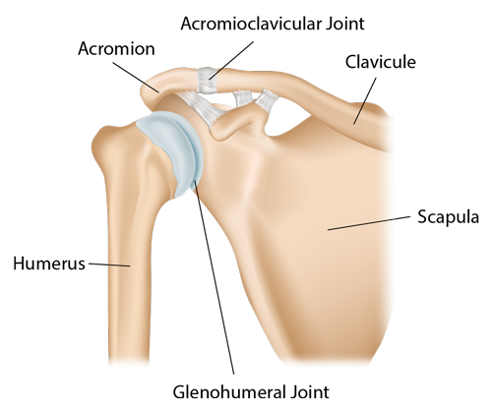
4. PLANE/Gliding
a synovial joint which, under physiological conditions, allows only gliding movement.

Slide 11
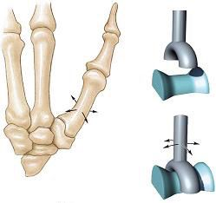
5. SADDLE
one of the bones forming the joint is shaped like a saddle with the other bone resting on it like a rider on a horse. Saddle joints provide stability to the bones while providing more flexibility than a hinge or gliding joint.

Slide 12
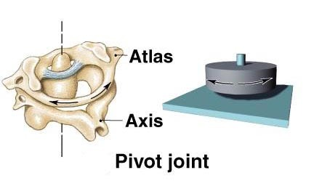
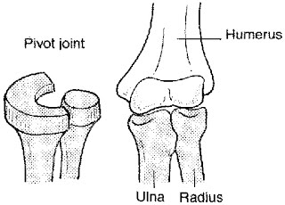
6. PIVOT
a joint that allows only rotary movement around a single axis. The moving bone rotates within a ring that is formed from a second bone and adjoining ligament. One bone usually has a knobby protrusion while the other bone has a slight cavity that can rotate on that knobby protrusion

