Slide 1
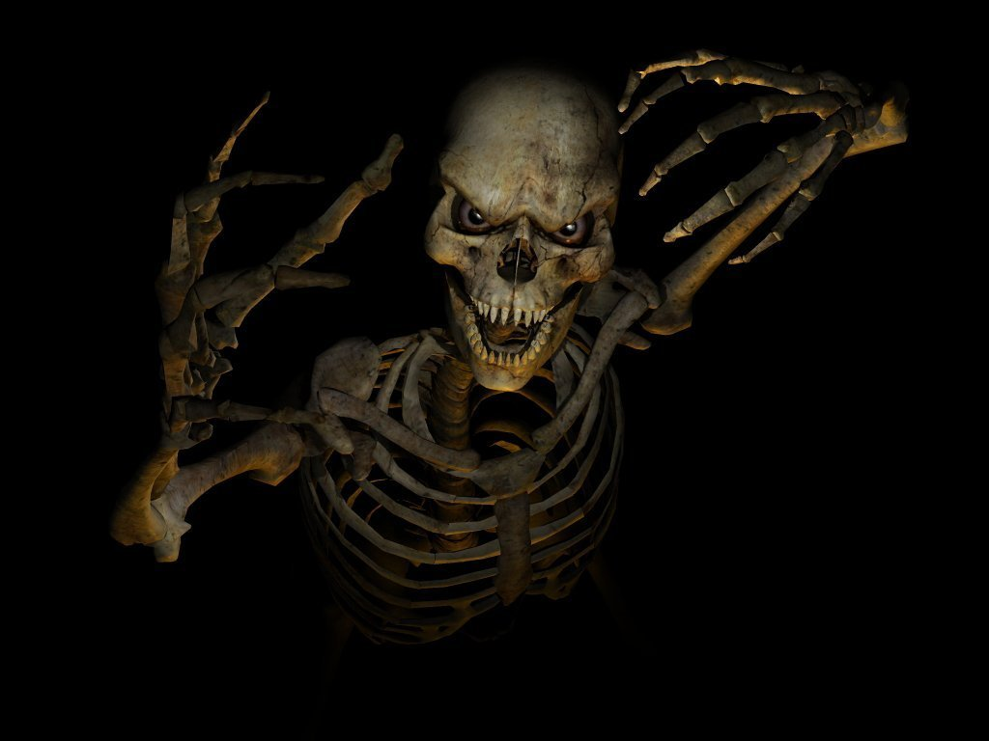
SKELETAL SYSTEM
BONE Identification

Slide 2
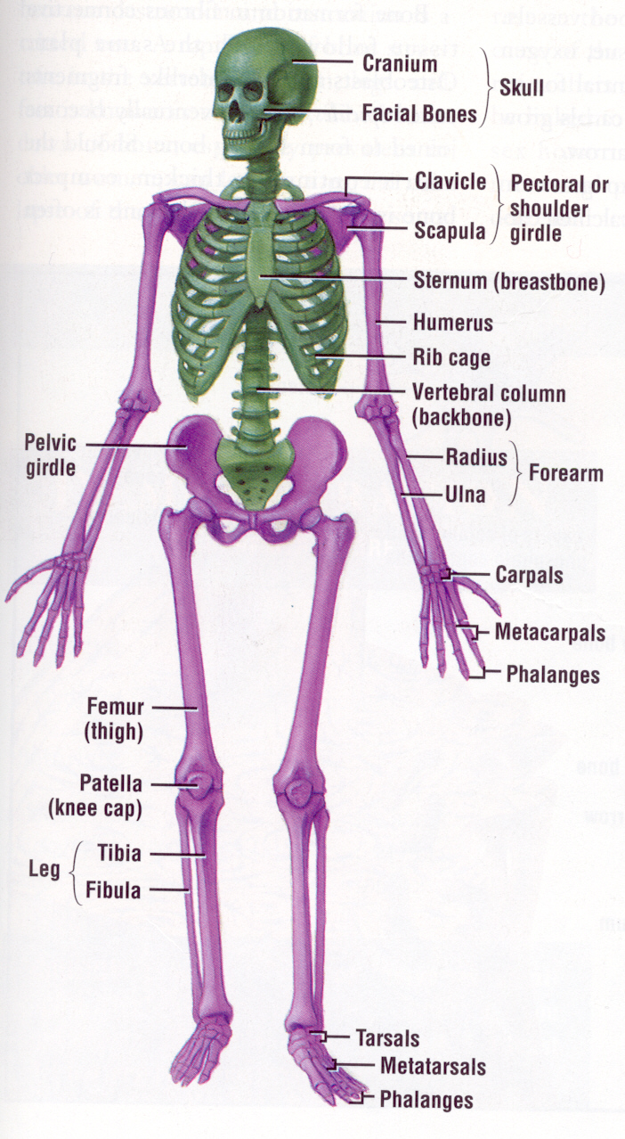
Divisions of the Skeleton
The body is divided into two major divisions. The AXIAL division (Head, Neck and Trunk) and the
APPENDICULAR division (Upper and Lower Extremities) –we call them arms and legs – but not anymore!

Slide 3
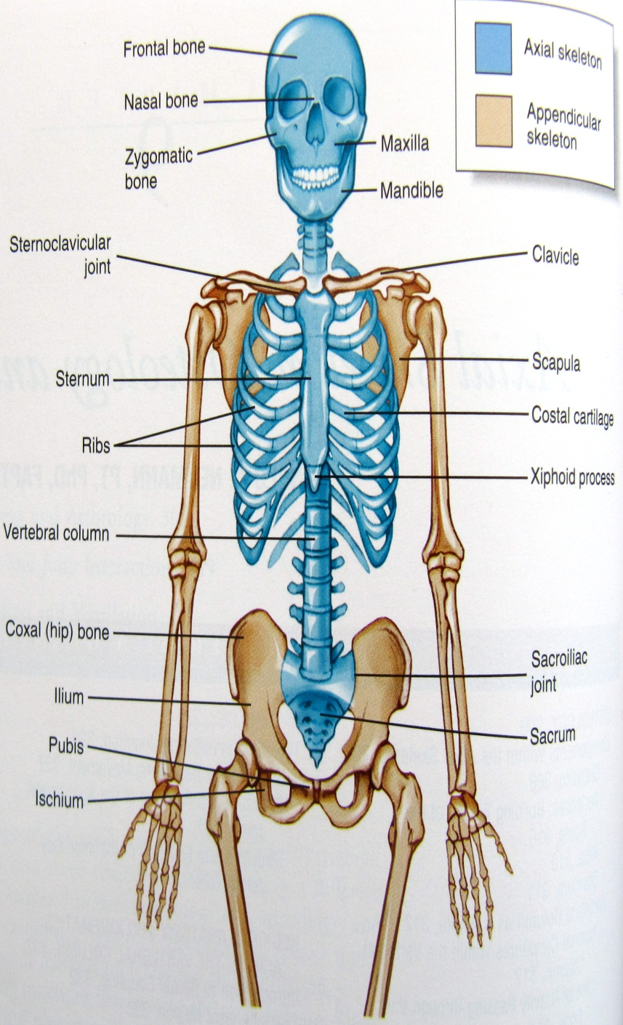
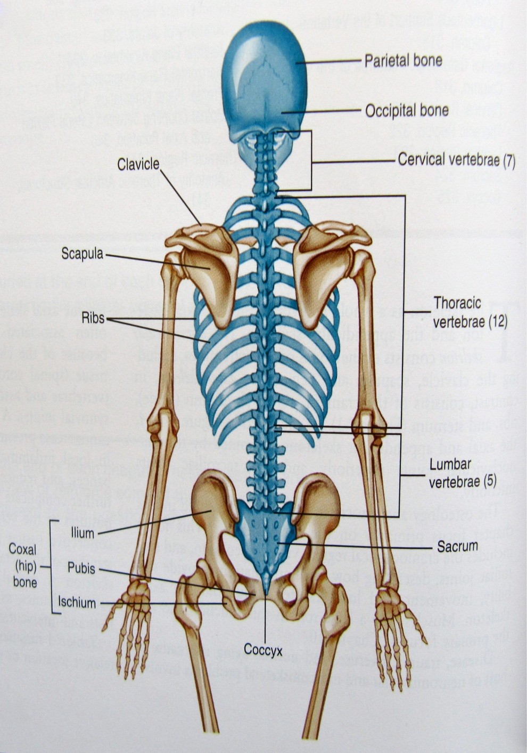
AXIAL DIVISION
Try to remember the word AXIS – a straight line through which something rotates
Need to
Know about
35 key bones, structures, terms

Slide 4
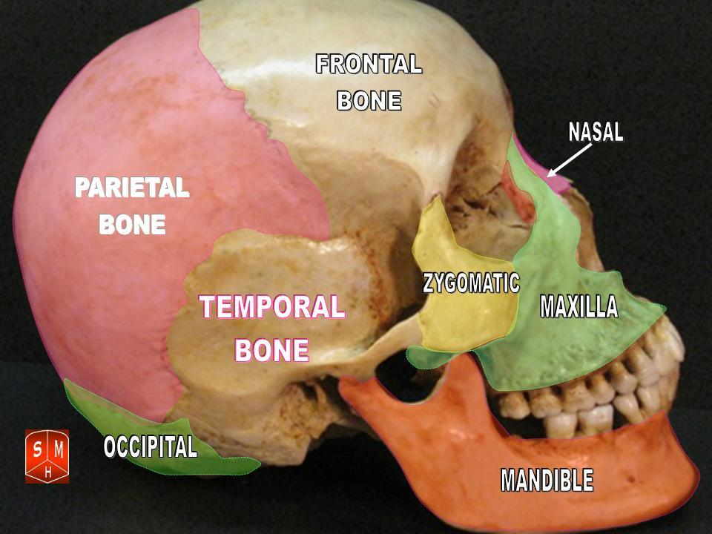
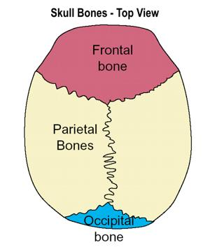
The AXIAL DIVISION
Let’s start with the SKULL.

Slide 5
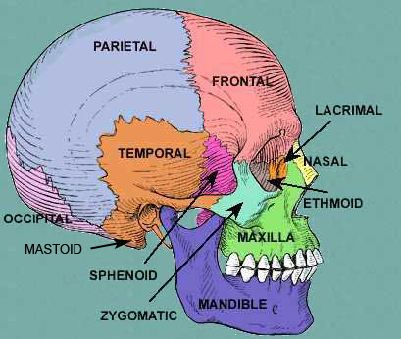
Skulls are so “IN” right now!

Slide 6
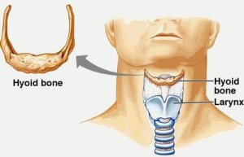
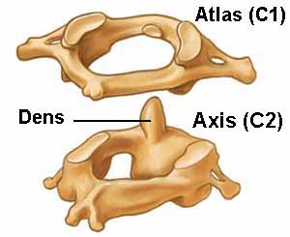
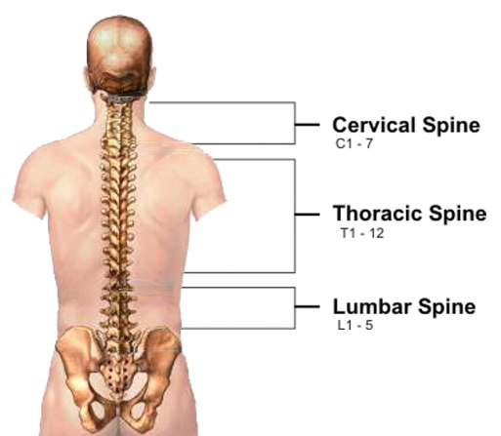
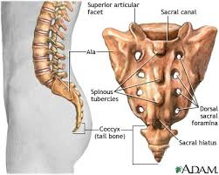
The SPINE

Slide 7
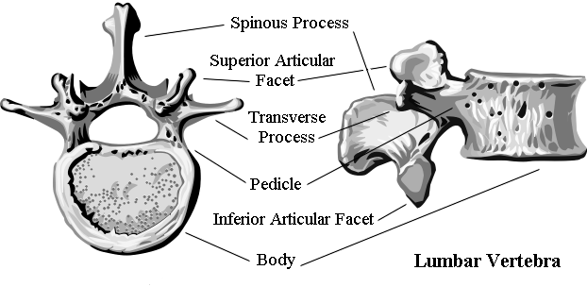
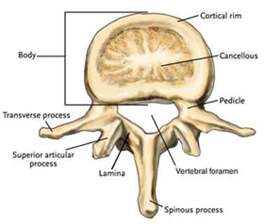
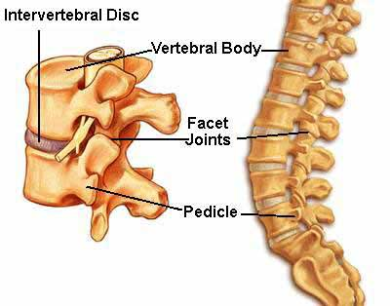
Typical Vertebra Anatomy

Slide 8
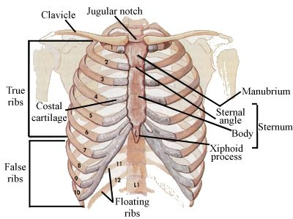
RIB CAGE and Breast Bone
The first 7 ribs (T1-T7) are TRUE ribs.
The next three ribs (T8-T10) are FALSE ribs. They still attach to Sternum, but piggy back their costal cartilage onto T7 ribs cartilage.
The last two ribs (T11-T12) are FLOATING ribs. They do not make an anterior attachment.

Slide 9
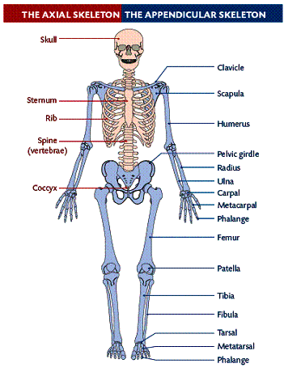
APPENDICULAR DIVISION
Try to remember the word “APPENDAGE” – A projected body part that is attached to the main region of a body
This will consist of the bones of the Upper Extremities (What amateurs call Arms), the Lower Extremities (What Novices call Legs) as well as the Shoulder and Pelvic Girdles.

Slide 10
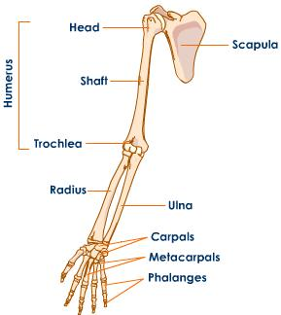
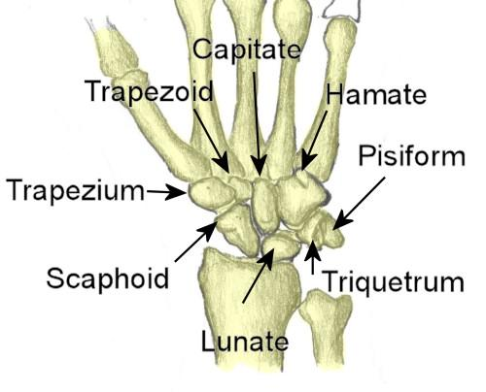
Let’s Start with the Upper Extremity
A bit of a struggle to remember how the Radius and Ulna are oriented. In the ANATOMICAL Position, the Radius is lateral to the Ulna. To RADIATE – means to travel outward from a central source. The distal epiphysis of the Radius is the primary support for the wrist bones.
Good News: Although there are 8 separate wrist bones we just need to know that these 8 bones are called CARPALS

Slide 11
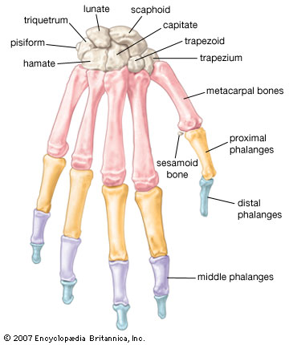
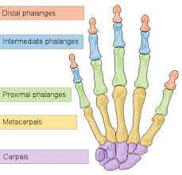
The HAND
Each finger bone is called a PHALANX, plural form, they are called PHALANGES
Recall words like “Metamorphosis” and “Metastasis”. META = To Go Beyond/Afterward – So Metacarpal makes good sense

Slide 12
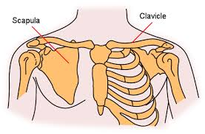
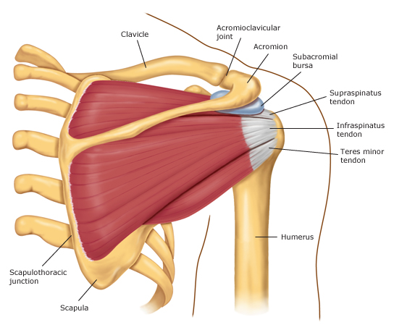
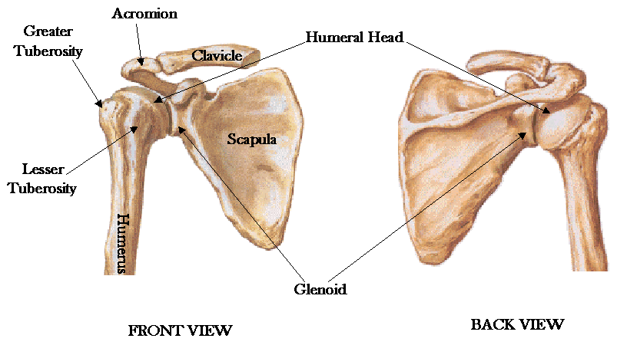
The Shoulder GIRDLE

Slide 13
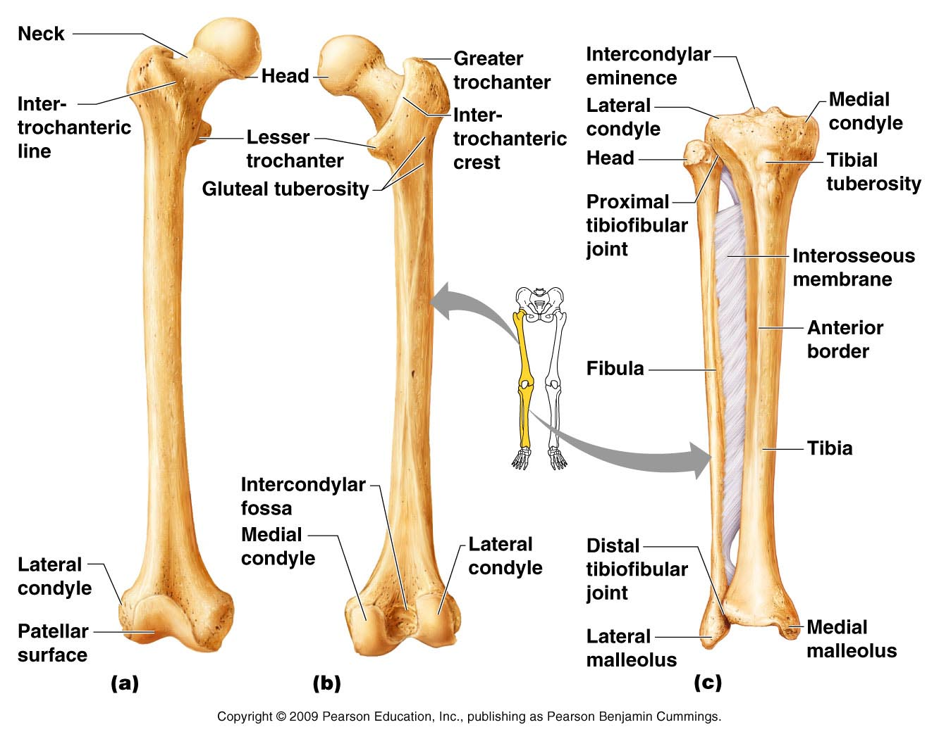
NOW for the Lower Extremity

Slide 14
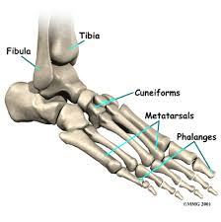
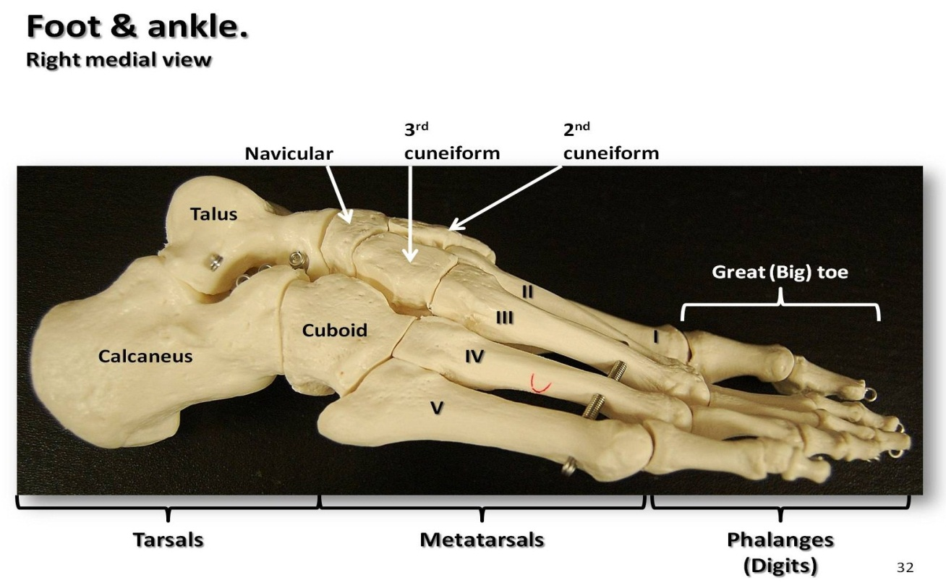
The FOOT
The FOOT is very homologous to the HAND. Instead of 8 wrist bones (CARPALS) it possesses 7 ankle/heel bones collectively known as TARSALS. We need to know the name for two of these specific Tarsals. The biggest heel bone is the CALCANEOUS, another fairly large Tarsal is the TALUS.

Slide 15
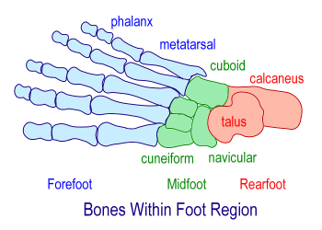
FOOT Anatomy

Slide 16
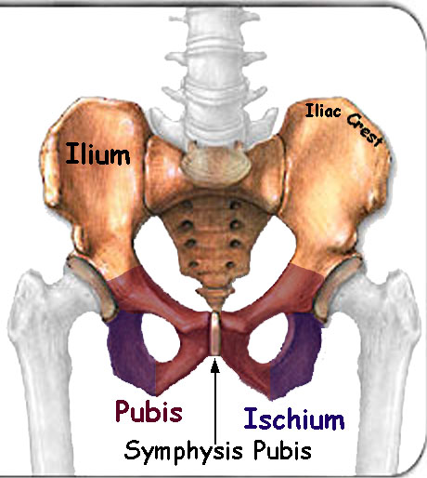
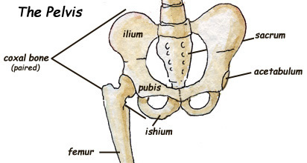
The PELVIC GIRDLE
The hip bone properly termed the COXAL bone, actually consists of three smaller bones fused together

