Slide 1
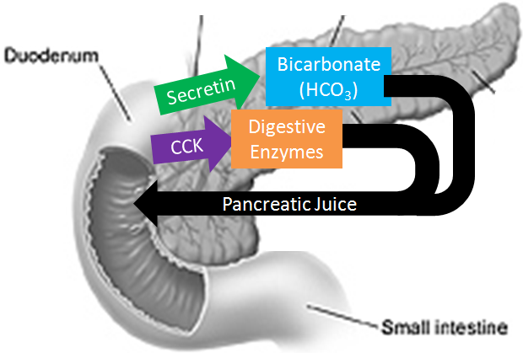
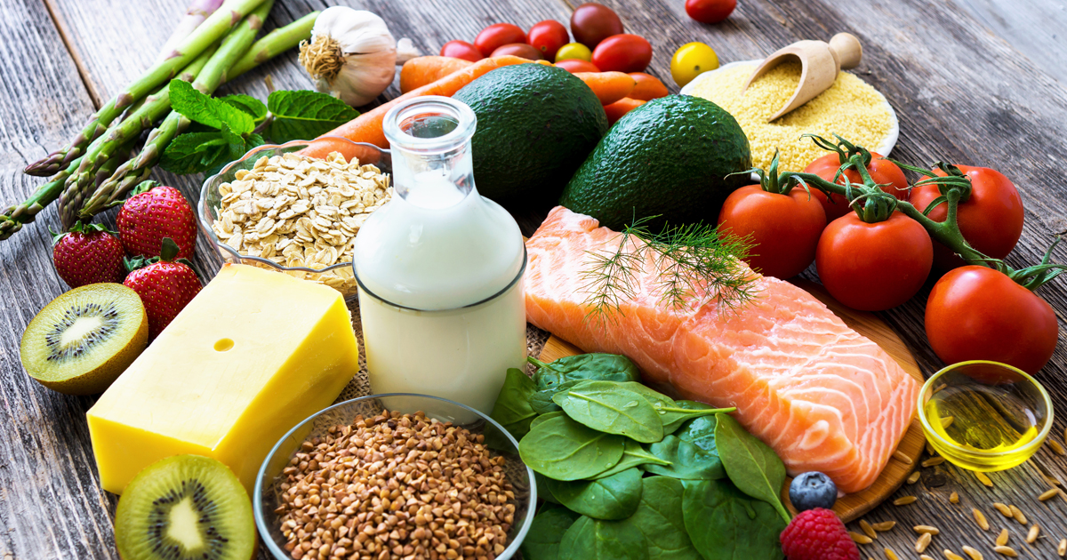
DIGESTIVE ENZYMES & HORMONES

Slide 2
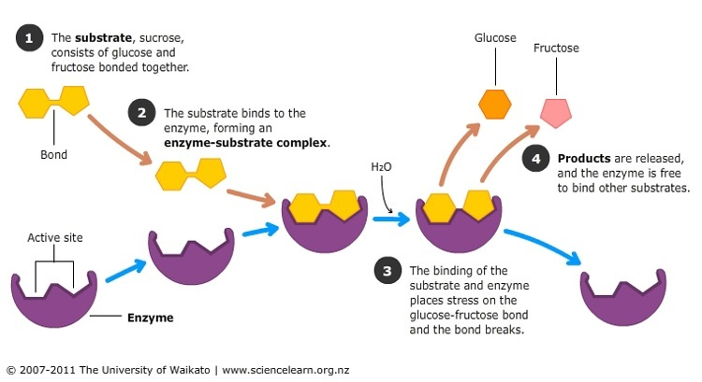
DIGESTIVE ENZYMES
“The GNARLY 9”

Slide 3
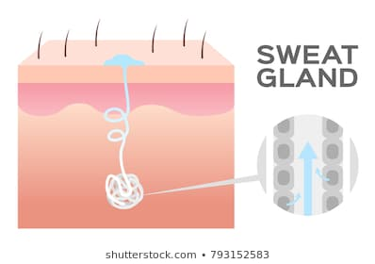
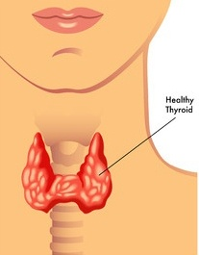
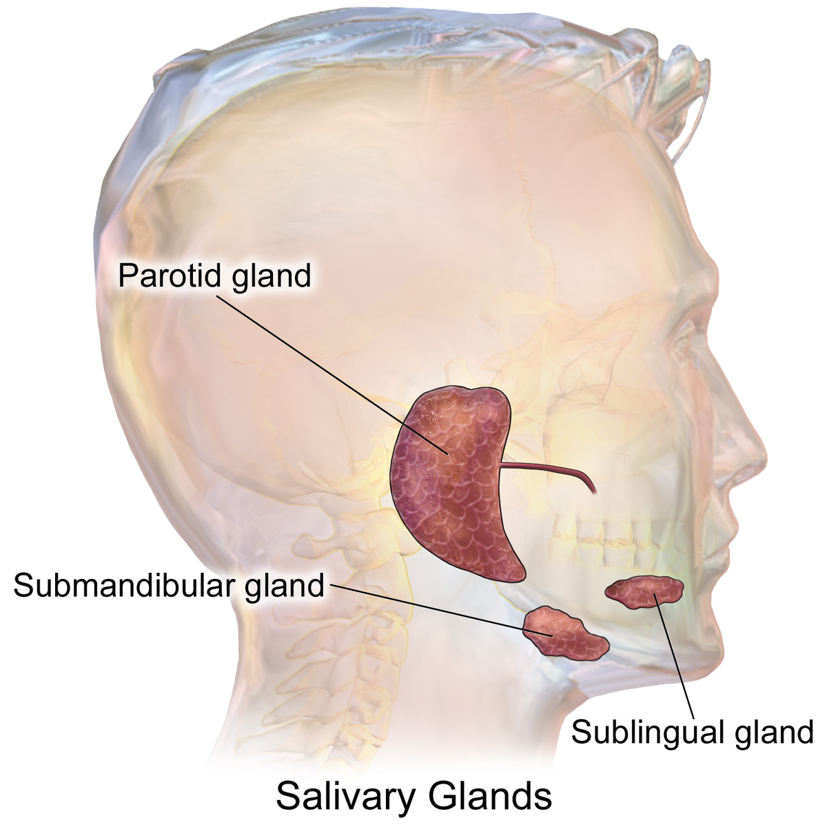
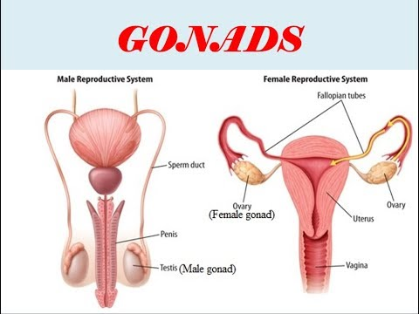
GLANDS
EXOCRINE
VS.
ENDOCRINE
Glands that produce and secrete substances down ducts, the substance either quickly or gradually EXITS the body. The GNARLY 9 are released from Exocrine glands
Glands that produce and secrete substances directly into the bloodstream, these substance (usually hormones) stay INSIDE the body

Slide 4
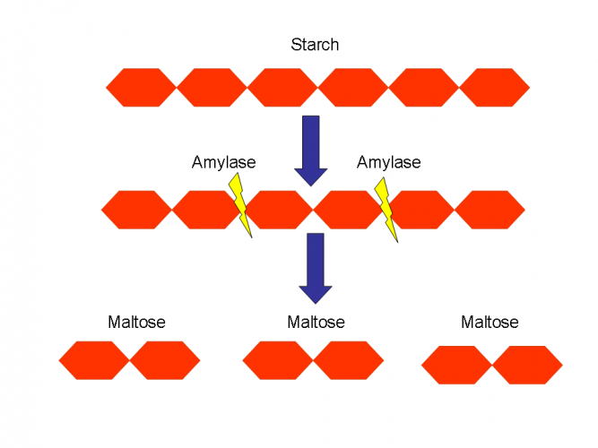
CARBOHYDRATE DIGESTION
Salivary Amylase
And Pancreatic Amylase
Break Starch into a
Disaccharide called
MALTOSE
Then Maltose
to Glucose

Slide 5
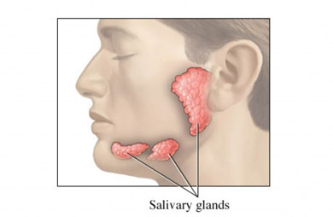
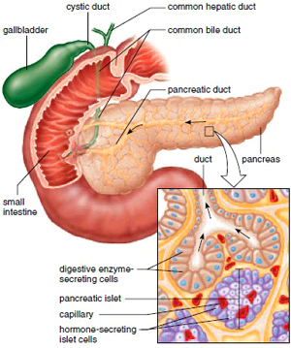
1. Salivary Amylase
Made in Salivary Glands
Works in Mouth
Likes pH = 7.0
2. Pancreatic Amylase
Made in Pancreas
Works in Small Intestine
Likes a pH = 8.0

Slide 6
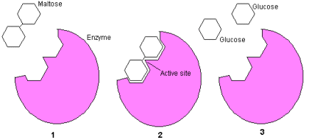
3. MALTASE (MalDase)
Made in the Duodenal Exocrine Glands
Works in the small intestine
Likes a pH of 8.0

Slide 7
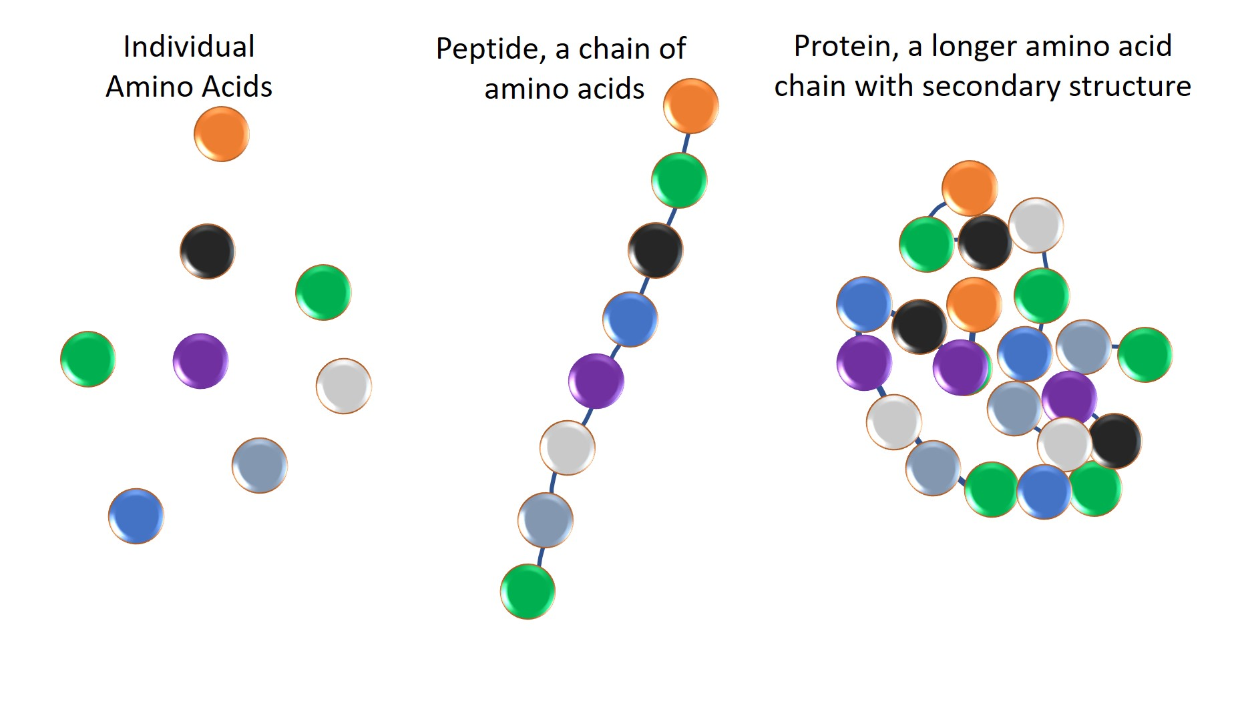
PROTEIN DIGESTION
Proteins → Small Peptide Chains
Small Peptide Chains →
Individual Amino Acids

Slide 8
PROTEIN DIGESTION
4. PEPSIN and 5. TRYPSIN - Break Proteins
into shorter and shorter Peptide Chains

Slide 9
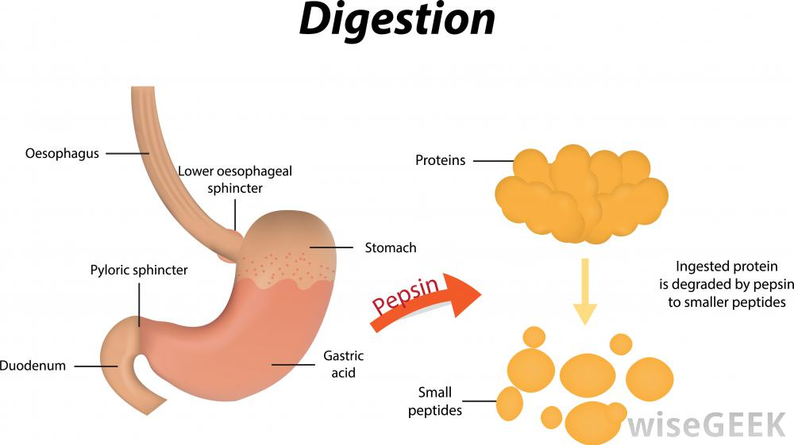
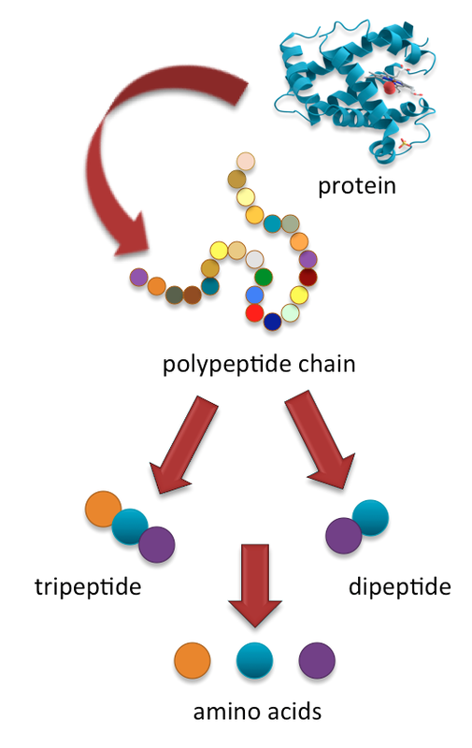
4. PEPSIN
Made in Stomach
Works in Stomach
Likes pH = 2.0
5. TRYPSIN
Made in Pancreas
Works in Small Intestine
Likes a pH = 8.0

Slide 10
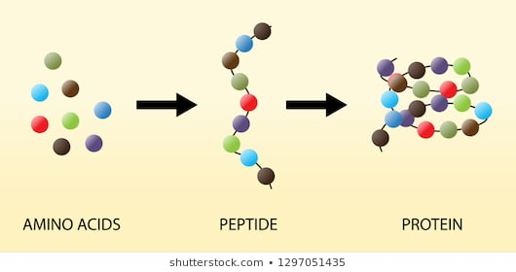
6. PEPTIDASES
Most are made by Duodenal Glands
Work in Small Intestine
Like a pH = 8.0
Break Peptide Chains down to free up Amino Acids

Slide 11
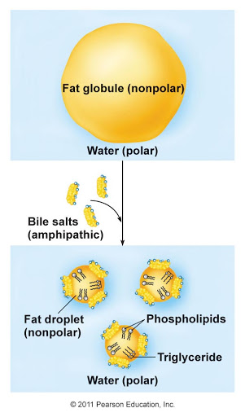
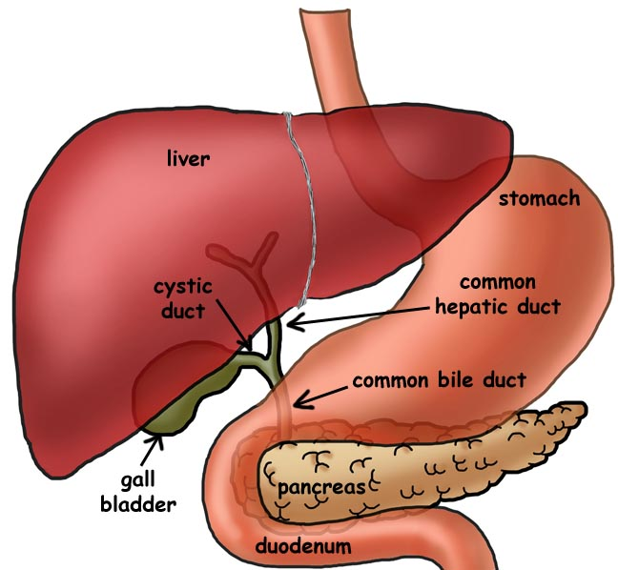
FAT DIGESTION
Prior to chemically breaking
Down fat molecules, fats must be emulsified (spread out) by BILE
BILE is NOT an ENZYME
No new molecules form
Bile is produced by the LIVER

Slide 12
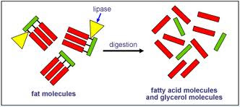
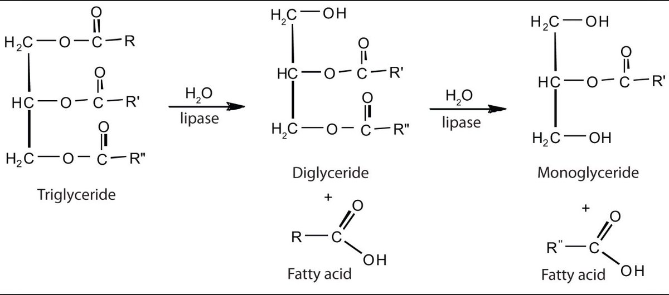
7. LIPASES
Break Triglycerides into
Glycerol and Fatty Acids
LIPASE
Made in Pancreas
Works in Small Intestine
Likes a pH of 8.0

Slide 13
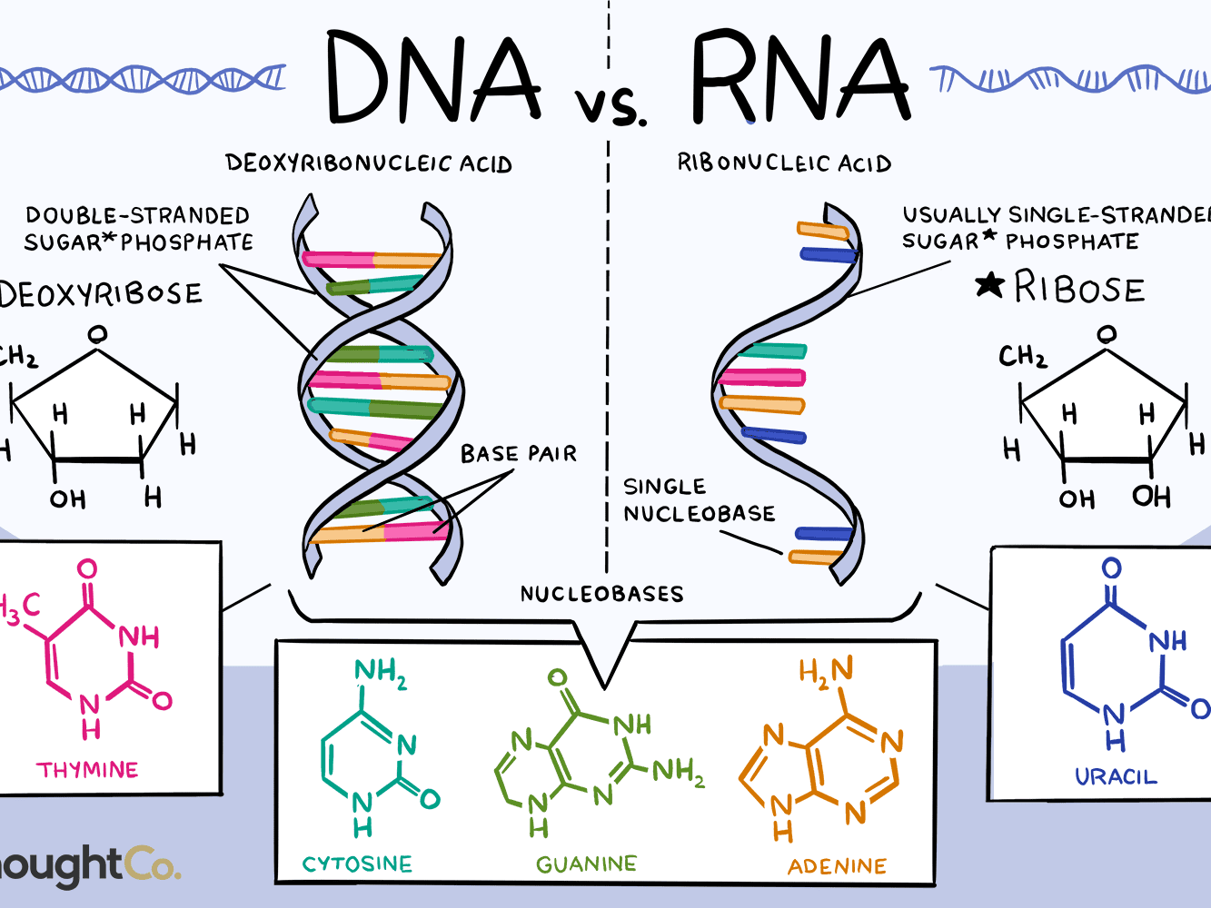
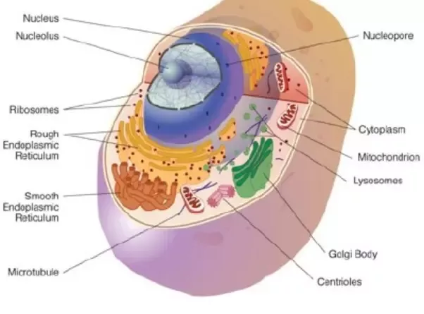
NUCLEIC ACID DIGESTION
We Eat Cells

Slide 14
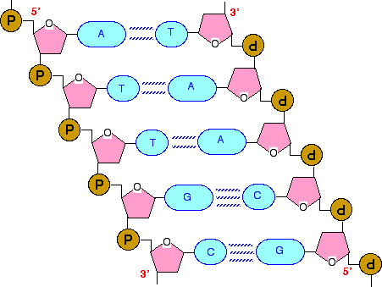
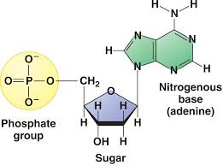
8. NUCLEASES
Made in Pancreas
Work in Small Intestine
Like a pH = 8.0
Break Nucleic Acid into
Free Nucleotides

Slide 15
9. NUCLEOSIDASES
Made in Duodenal Glands
Work in Small Intestine
Like a pH = 8.0
Break Nucleotide
Down into free Phosphate,
Free Pentose Sugar
And Free Nitrogenous base

Slide 16
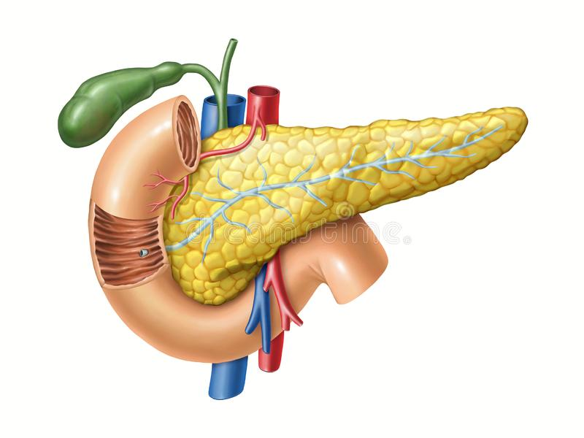
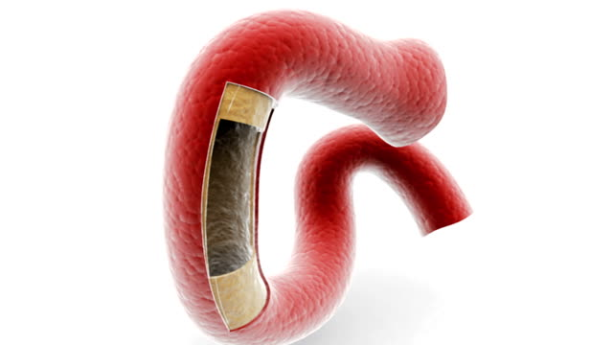
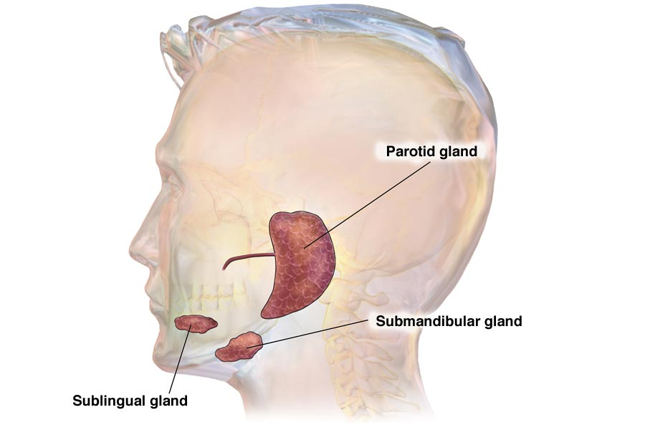
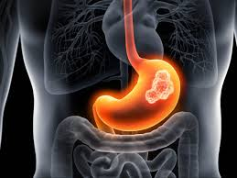
MOUTH
STOMACH
PANCREAS
DUODENUM
“THE GNARLY NINE”
LIPASE
Pancreatic AMYLASE
TRYPSIN
NUCLEASE
MALT(D)ASE
PEPTIDASE
NUCLEOSIDASE
SALIVARY
AMYLASE
PEPSIN
Proteins → Shorter Peptide
Chains
Starch →
Maltose
Triglycerides → Glycerol & Fatty Acids
Starch → Maltose
Proteins → Shorter Peptide Chains
Nucleic Acids → Nucleotides
Maltose → 2 Glucose
Peptide Chains → Amino Acids
Nucleotides → Phosphate
Sugar
Base

Slide 17
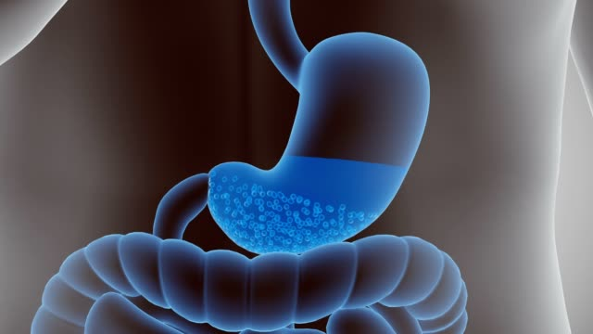
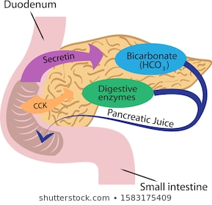
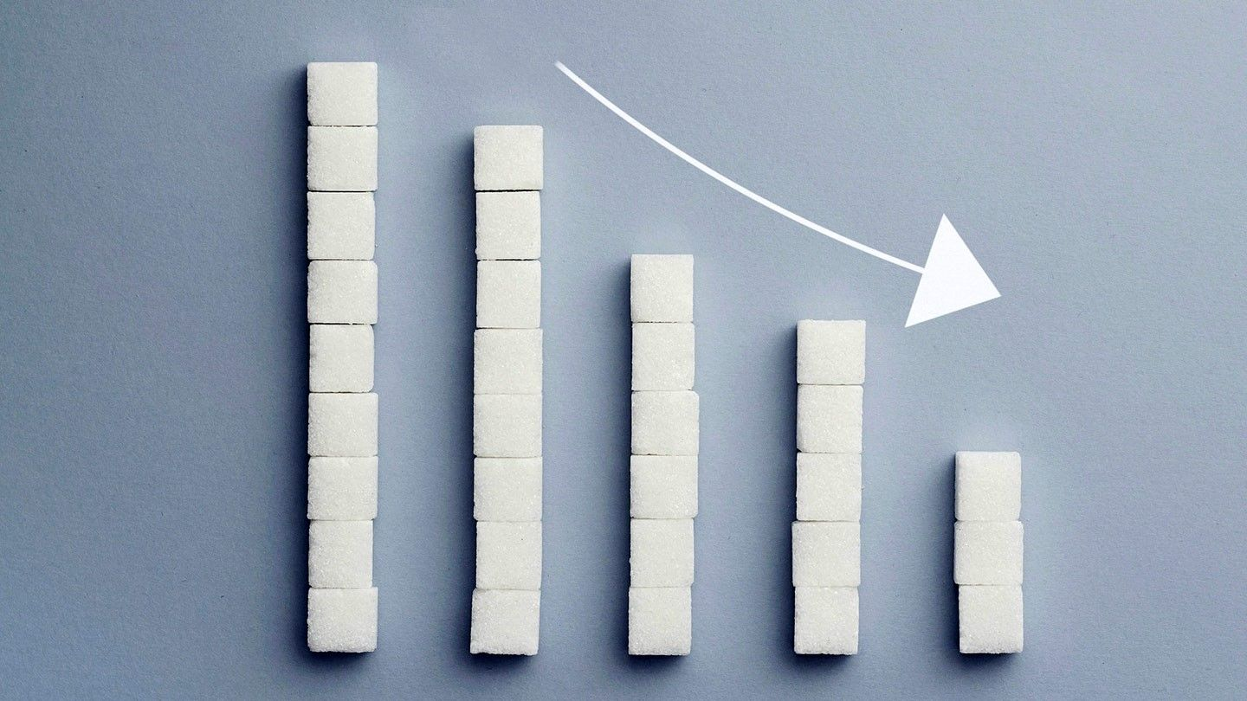
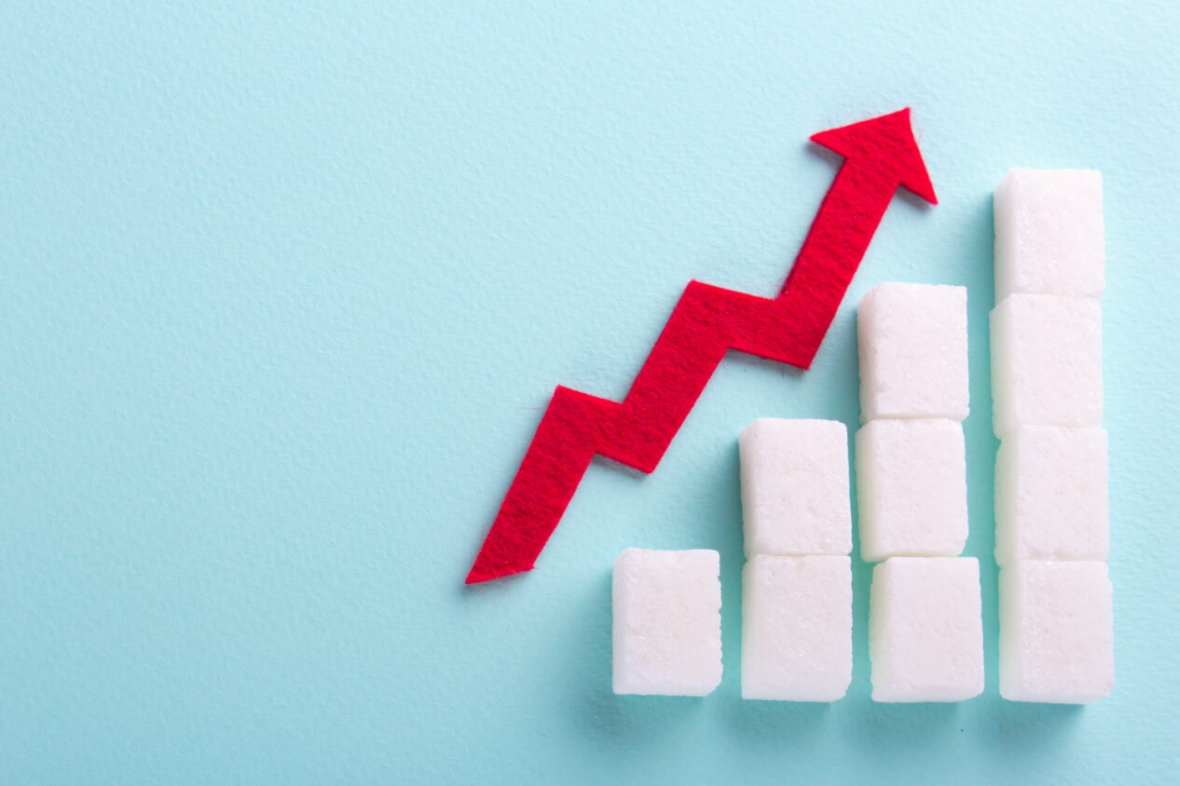
HORMONES – “The Slick SIX”
EFFECT
NAME
SOURCE
TARGET
GASTRIN STOMACH EXOCRINE GLANDS of STOMACH
2. SECRETIN DUODENUM PANCREAS EXOCRINE GLANDS
3. CCK DUODENUM GALLBLADDER/LIVER
(and Pancreas too)
4. GASTRIC DUODENUM STOMACH
INHIBITORY PEPTIDE (GIP)
5. INSULIN PANCREAS MUSCLE & LIVER CELLS
6. GLUCAGON PANCREAS MUSCLE & LIVER CELLS

Slide 18
HORMONES – “The Slick SIX”
EFFECT
NAME
SOURCE
TARGET
GASTRIN
SECRETIN
CCK
GASTRIC
INHIBITORY
PEPTIDE
5. INSULIN
6. GLUCAGON
STOMACH
DUODENUM
DUODENUM
DUODENUM
PANCREAS
PANCREAS
STOMACH Exocrine Glands
PANCREAS Exocrine Glands
LIVER & Gallbladder muscle tissue (Pancreas too)
STOMACH Exocrine Glands
MUSCLE AND LIVER CELLS
MUSCLE AND LIVER CELLS

