Slide 1
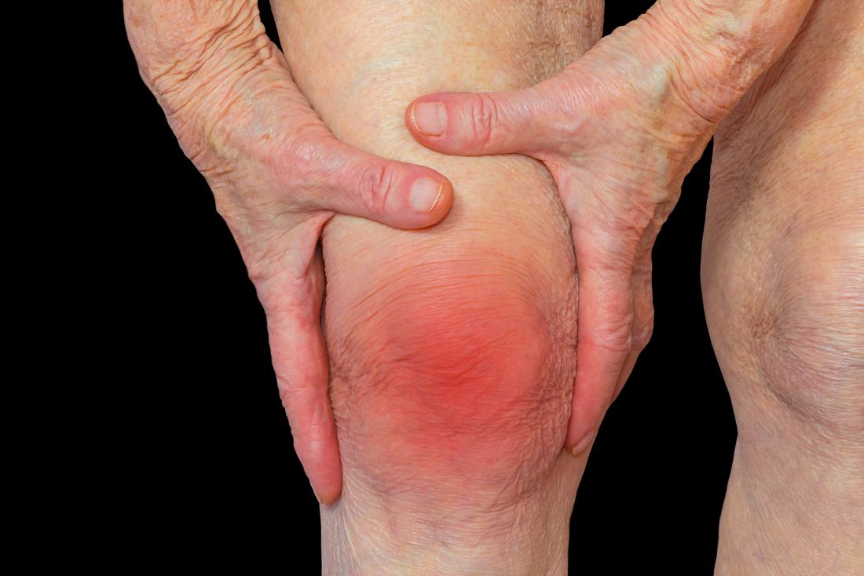
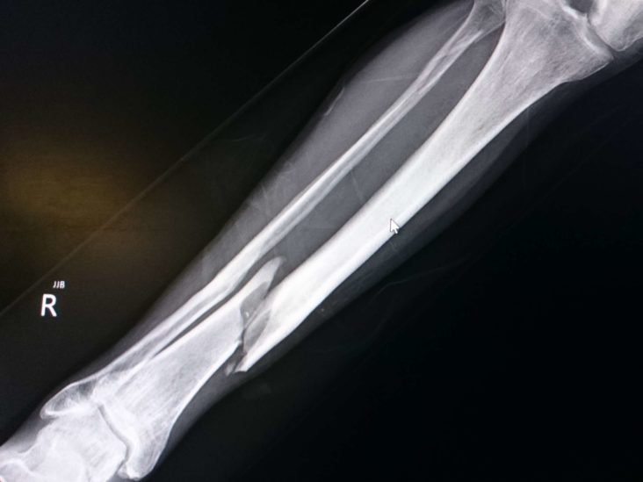
SKELETAL SYSTEM DISORDERS/INJURIES

Slide 2
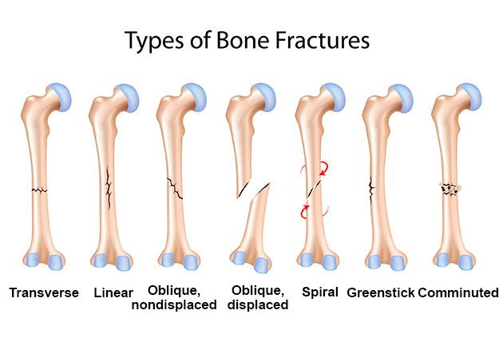
BONE FRACTURES

Slide 3
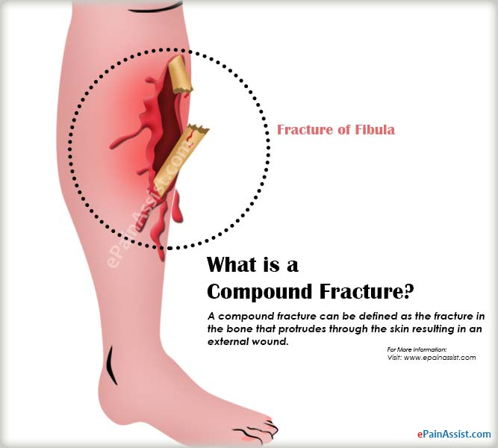
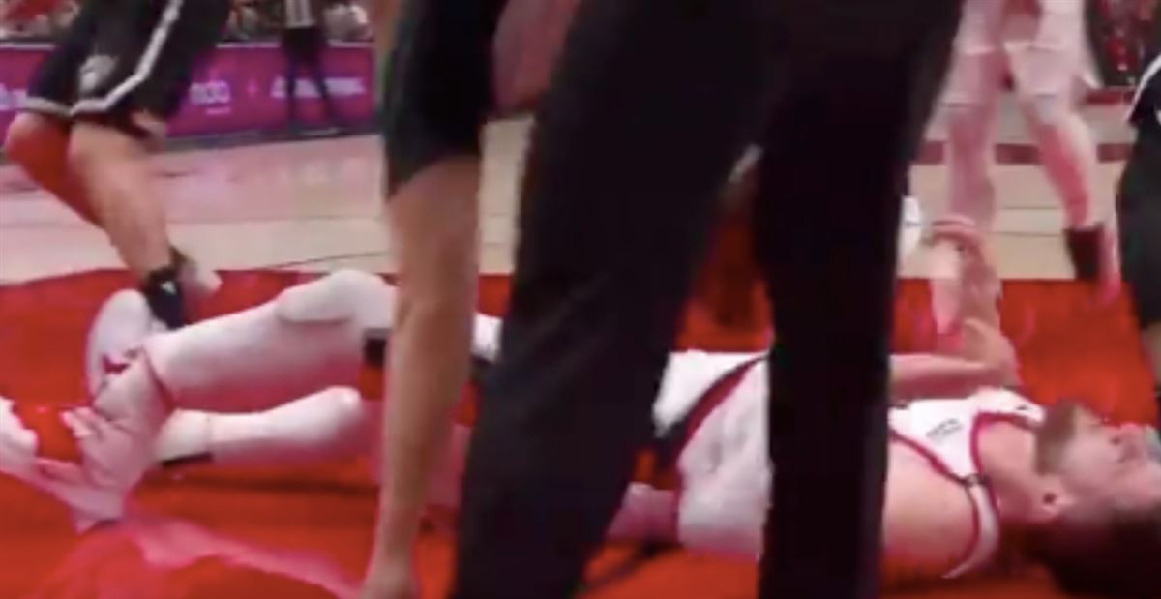
TWO MAIN CATEGORIES:
A) OPEN/Compound
- When a bone breaks/fractures and the displacement causes the bone to rupture through the skin

Slide 4
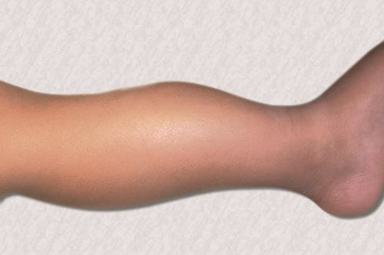
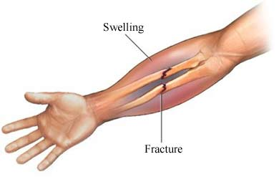
B) CLOSED/Simple
Fractures
- When a bone breaks/fractures but the displacement does not cause the bone to rupture through the skin

Slide 5
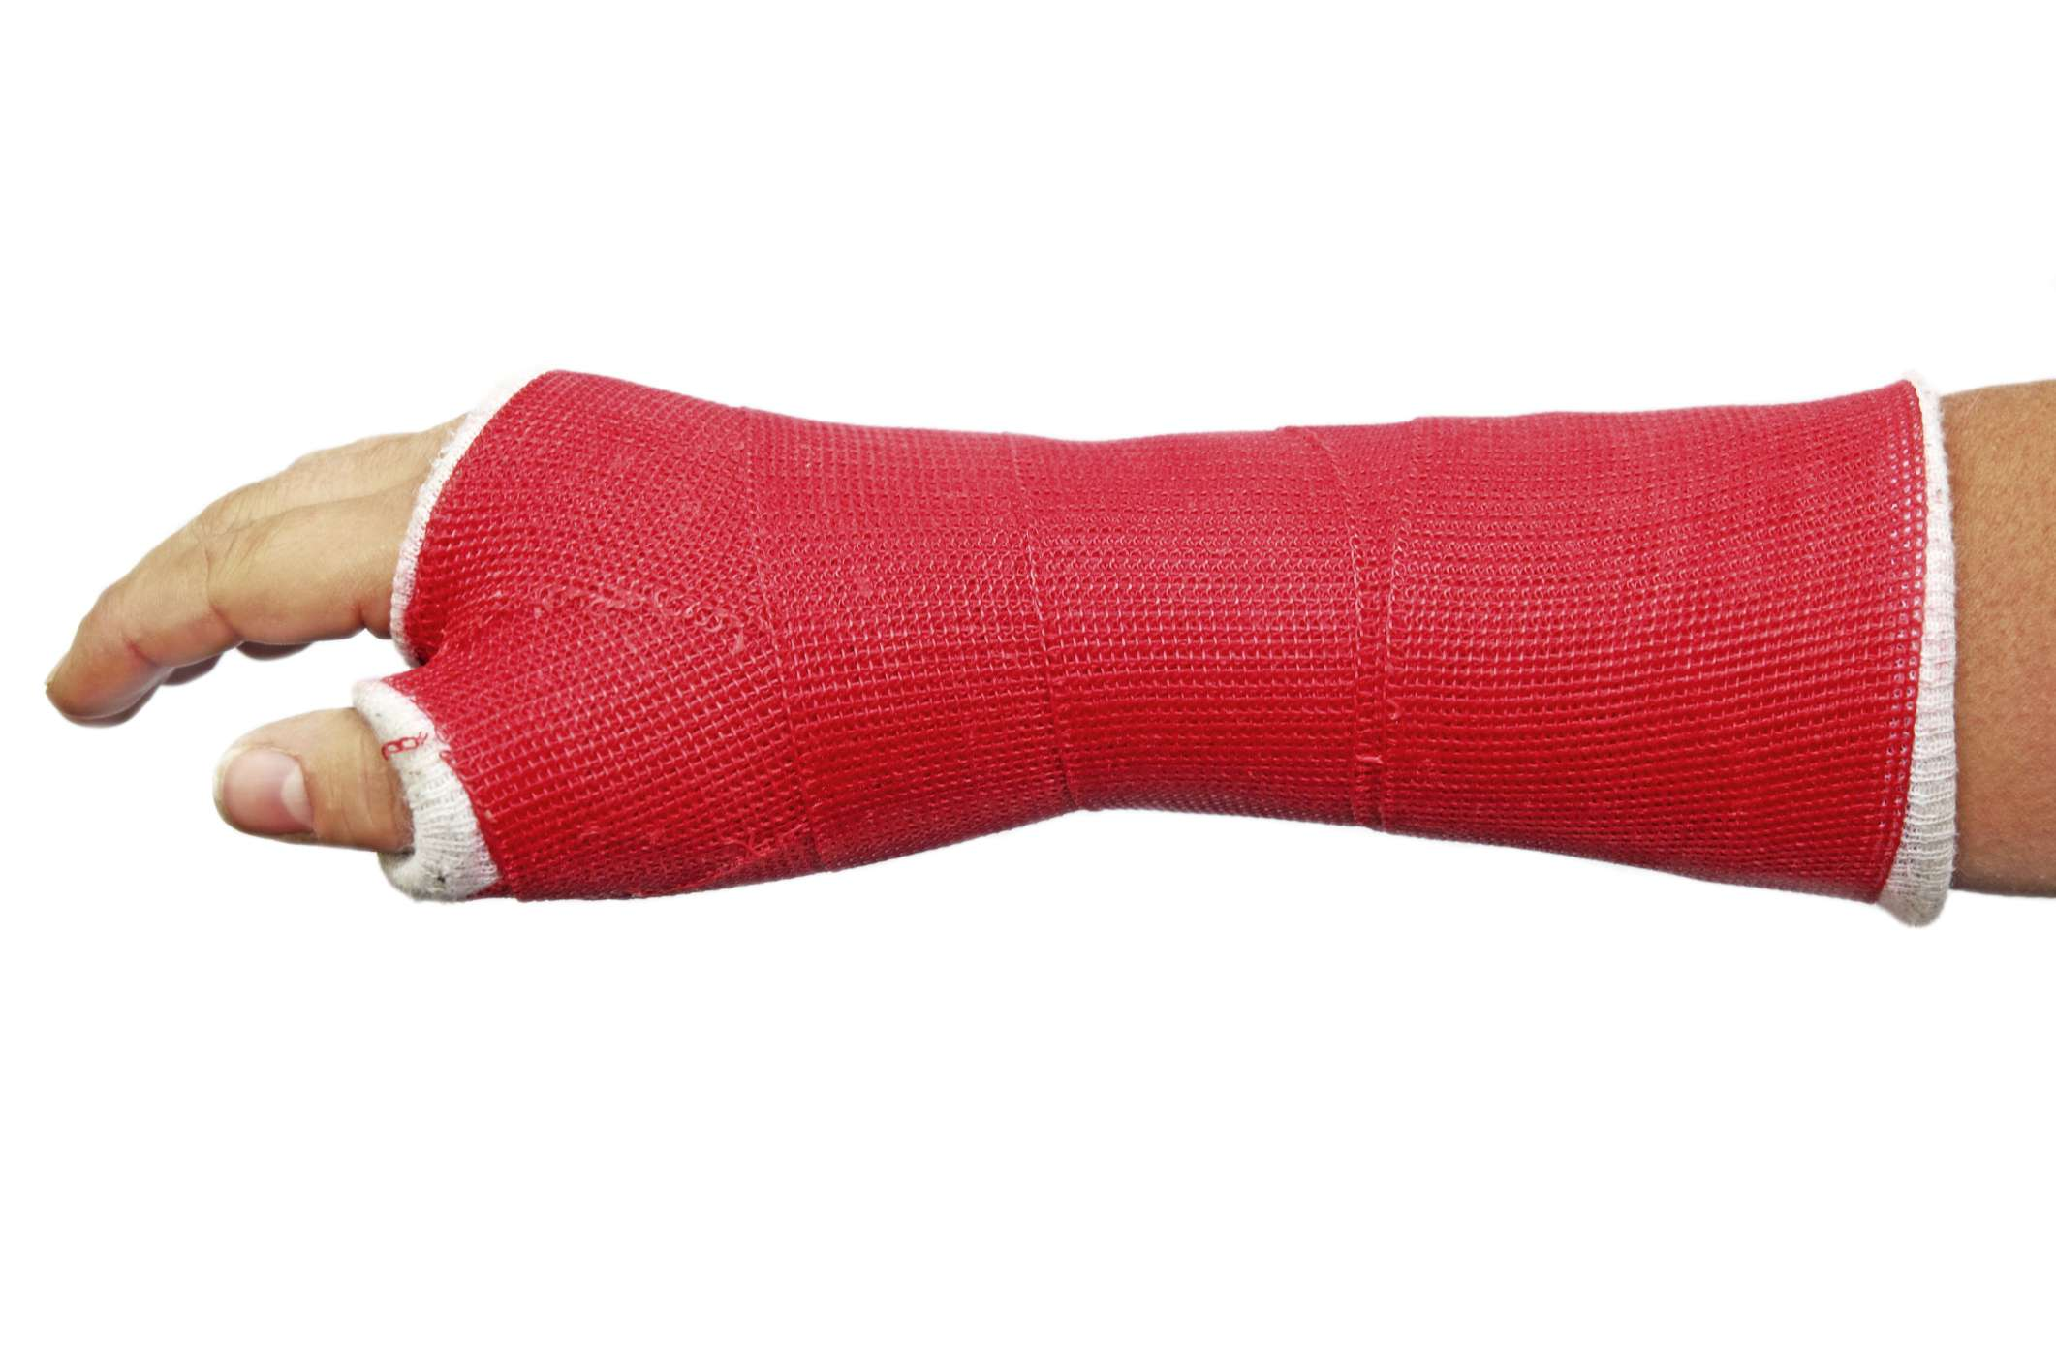
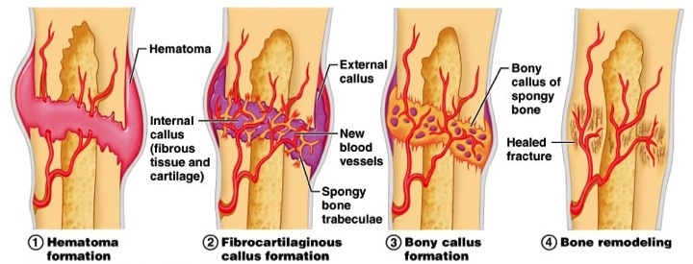
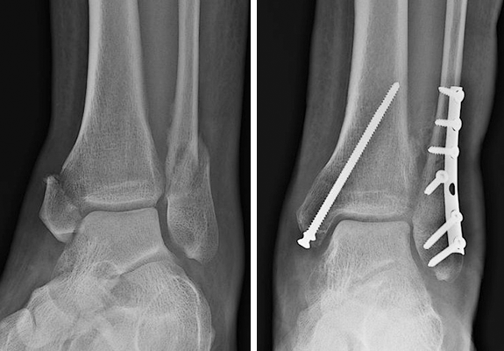
FRACTURE HEALING PROCESS

Slide 6
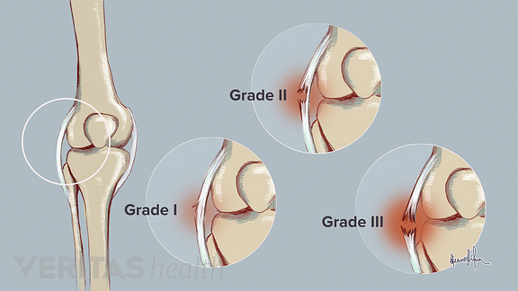
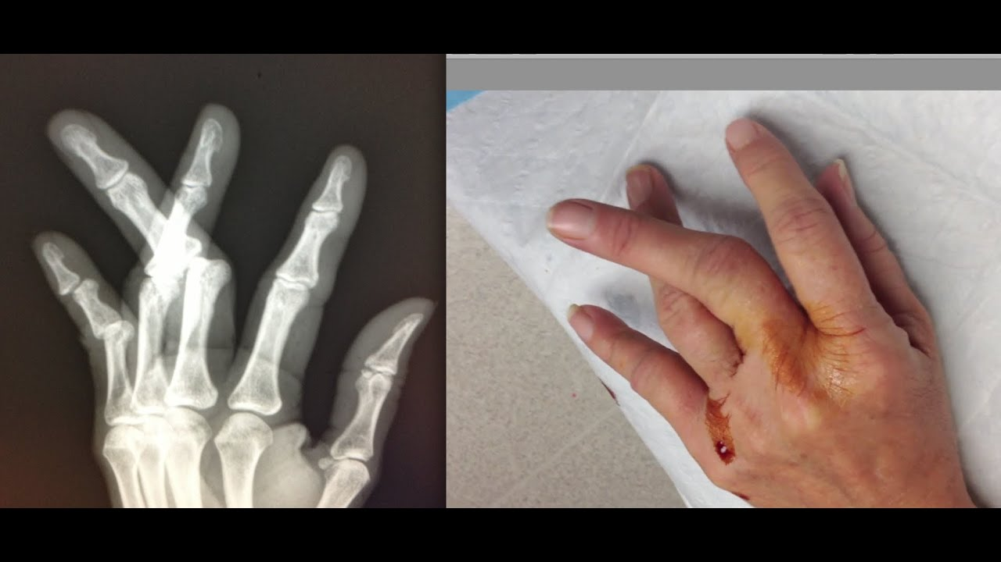
Other Common Injuries
SPRAINS
DISLOCATIONS
- When a LIGAMENT around a joint gets partially torn or fully ruptured.
- When a bone gets displaced from its normal position in its joint/articulation

Slide 7
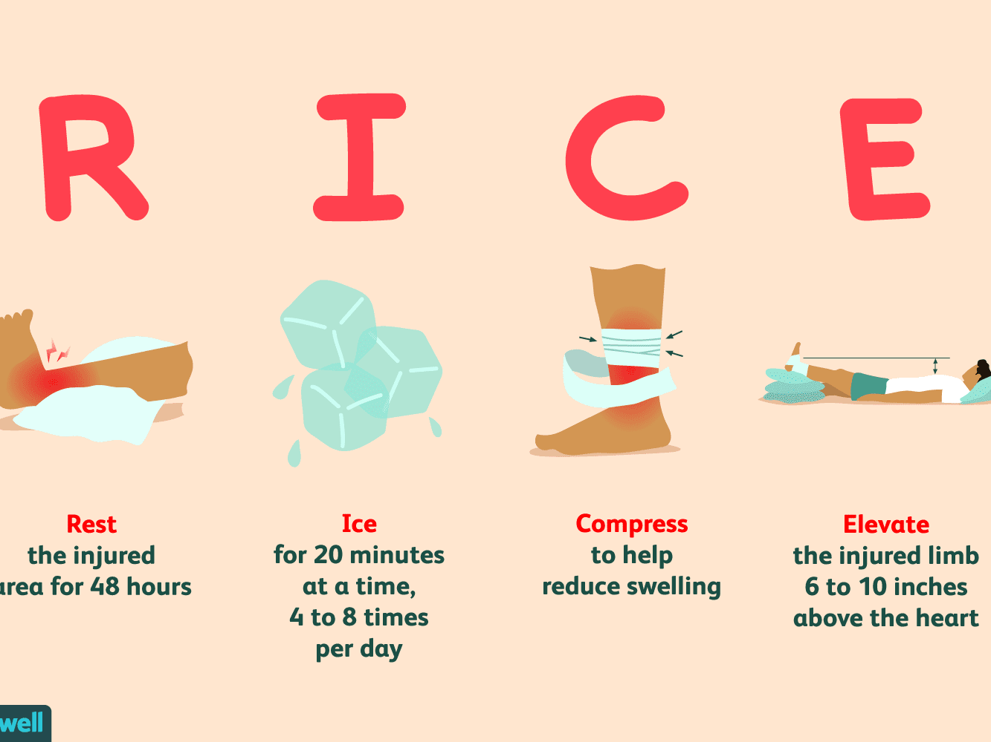
Typical First Aid Treatment
For many of the injuries covered so far involves the following:

Slide 8
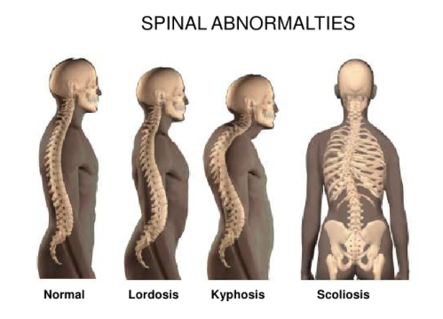
ABNORMAL SPINAL CURVATURES

Slide 9
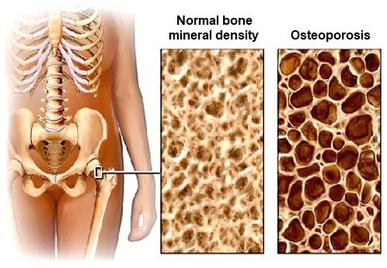
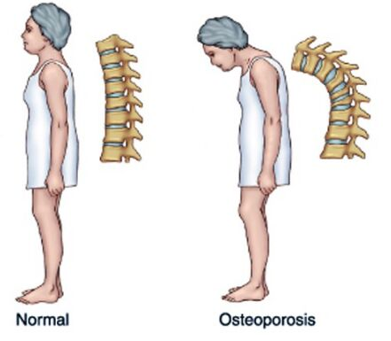
OSTEOPOROSIS

Slide 10
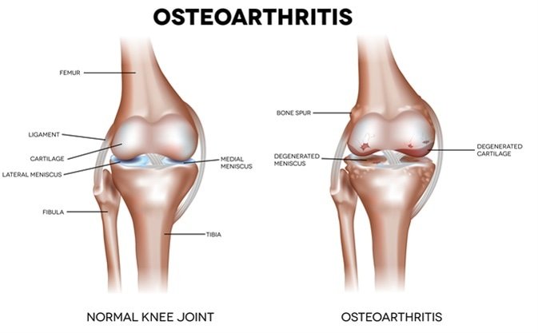

Slide 11
