Slide 1
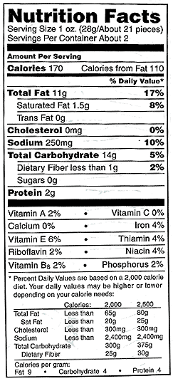
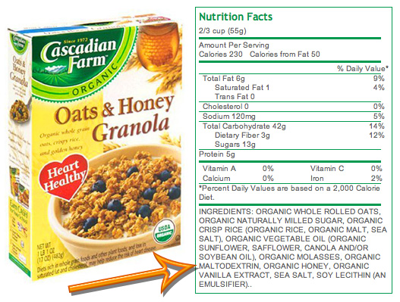
How to Read A
Food Facts Label

Slide 2
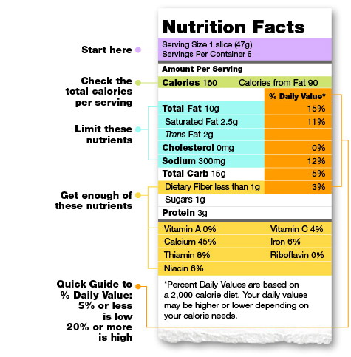
Take Note of Serving Size
If the information is for 1 Slice and you eat 3 Slices, obviously you need to triple all of the values
In this case here, eating 3 slices will provide how many calories? Rather than the 160 Calories that the Food Fact Label is stating
Even large chocolate bars may state their caloric values per “X #” of squares rather than per the whole bar.

Slide 3
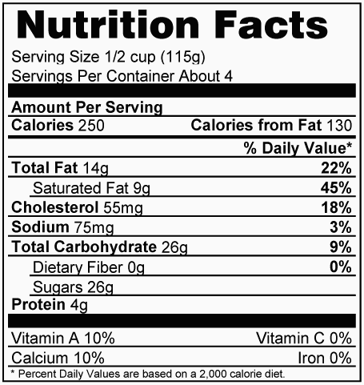
Percentage Daily recommendation
Or percentage dietary allowance
These Daily Percentage Values are not the percentage of that component in the food, but rather the percentage of your daily requirement or allowance for that component.
For good healthy components the percent is for what is recommended you get. For Unhealthy components the percent is for what you are allowed for a ceiling amount.
It is very important that you recognize that the percentage values are based off of a specific average person’s requirement. However a 55 year old sedentary women will have very different allowances and recommendations per serving than a 20 year old muscular male athlete.

Slide 4
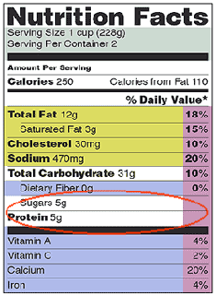
Certain Information is MANDATORY
Calories per serving and Calories from Fat per serving
Macronutrient Categories must be listed: PROTEINS, FATS and CARBS
Also bad fats and bad carbs are also further listed. Example – Saturated Fats, Trans Fats and Cholesterol as well As Sugar will be listed if present.
There is often an account of Specific Minerals like Iron and Calcium along with a break down of key vitamins

Slide 5
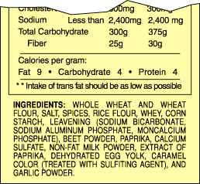
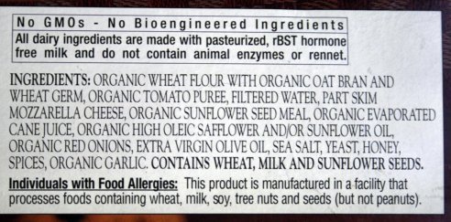
INGREDIENT LIST
Although Food Fact Labels have a very important Nutrition Facts Table, they also have a list of ingredients.
Almost everybody knows that the ingredients are listed from most abundant to least abundant.

Slide 6
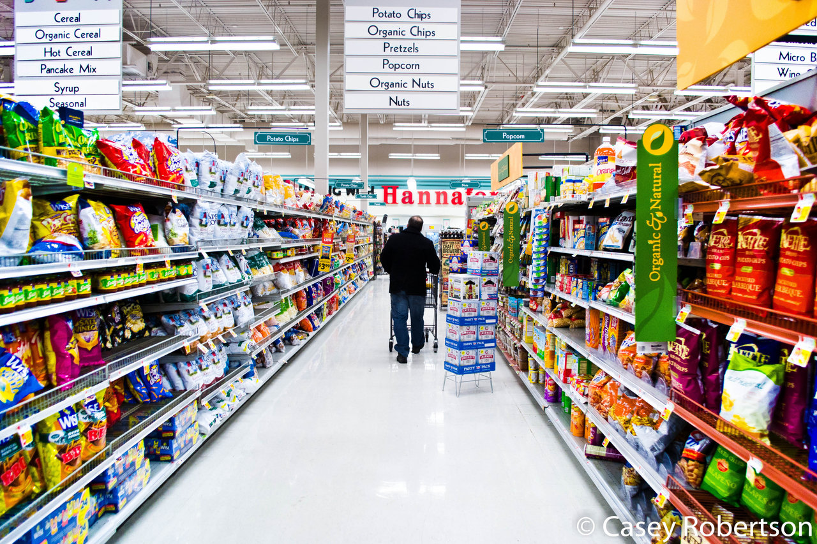

Slide 7
