Slide 1
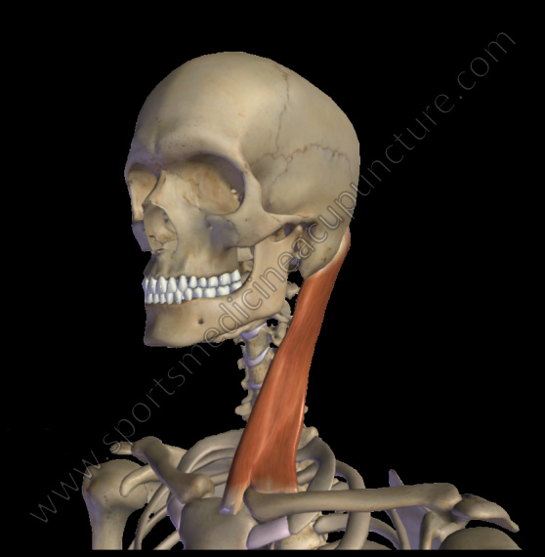
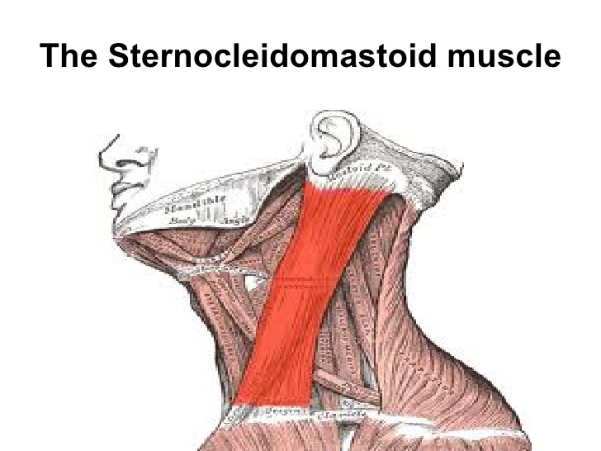
Practice Quiz _____/19
When you contract the Sternocleidomastoid muscles, which bone is considered the bone that has the insertion tendon attached onto it?
Manubrium of Sternum
Ileum of Coxal bone
Radius of the forearm
Mastoid process of Temporal Bone
Answer : D

Slide 2
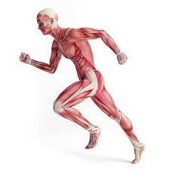
2. Other Than
Movement/Locomotion
List at least 3 other key
Functions of Skeletal
Muscle Tissue
Thermogenesis – heat production
Protection – by burying arteries and vital deep to muscle tissue
Posture – tonic contraction in muscle to hold body up against gravity

Slide 3
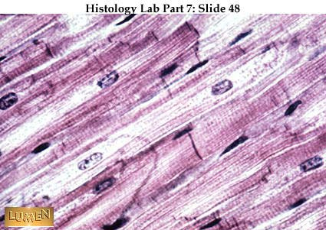
Answer – CARDIAC
3. The picture below represents what type of muscle TISSUE?
4. What is the proper name for the structure that the arrow is pointing to?
Answer – INTERCALATED DISCS

Slide 4
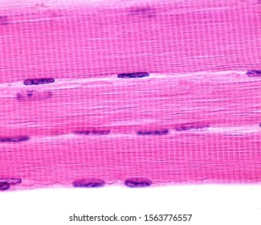
5. Give THREE different names for
The specific type of Muscle
Tissue shown here
SKELETAL Muscle Tissue
VOLUNTARY Muscle Tissue
STRIATED Muscle Tissue

Slide 5
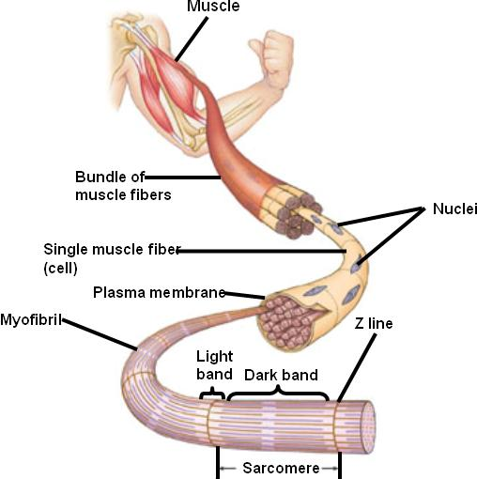
6. Which structure below (A, B, C or D) would be considered a Myofibril ?
A
ANSWER : D
B
C
D

Slide 6
7. Which structure below (either A, B, C, or D) would be considered the Muscle Bundle (Fascicle)?
A
B
C
D
Answer : B

Slide 7
8. Which structure (A, B, C or D) below would be considered a Muscle Fiber?
A
B
C
D
ANSWER : C

Slide 8
9. What is the specific scientific name for the FASCIA that is found around Structure B ?
A
B
C
ANSWER : PERIMYSIUM
D

Slide 9
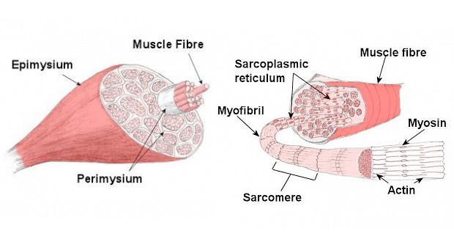
Place these structures in order from LARGEST structure to SMALLEST:
A) Myofibril
B) Myofilament (MYOSIN)
C) Muscle Body
D) Muscle Bundle (Fascicle)
E) Muscle Fiber
F) Myofilament (ACTIN)
ANSWER : C →D → E → A → B → F

Slide 10
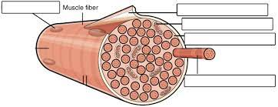
Muscle Fiber (Cell) Anatomy
LABEL STRUCTURES A, B & C
A) Special Membrane
B) – Enlarged Mitochondrion
C) –Cylindrical Structure
A- SARCOLEMMA
B- SARCOSOME
C - MYOFIBRIL

Slide 11
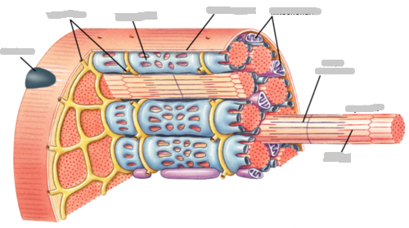
MUSCLE FIBER ANATOMY
A
B
A- TRANSVERSE TUBULES – That relay nerve impulse from Sarcolemma down into the cell
B- SARCOPLASMIC RETICULUM – Type of Endoplasmic Reticulum that stores and releases Calcium Ions

