Slide 1
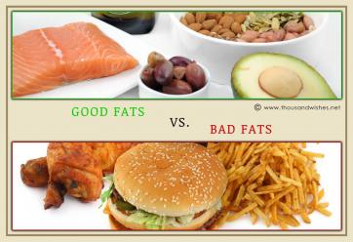
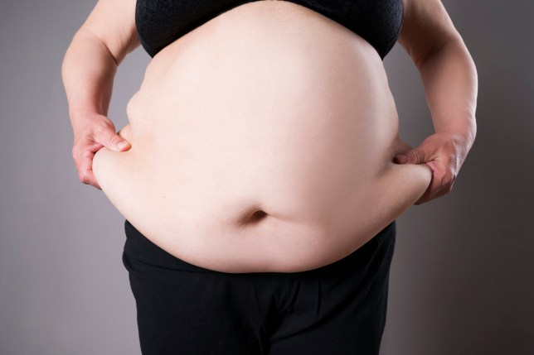
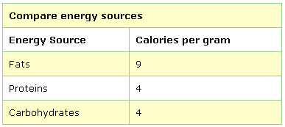
Macronutrients – PART II – Fats and Proteins
A) FATS
Primary function of dietary fats is to provide the body with calorie-rich molecules. These molecules can be burned for energy, but they can also be stored long-term in our fat tissue.

Slide 2
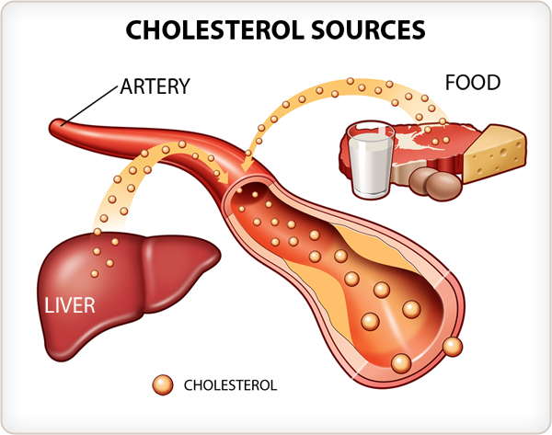
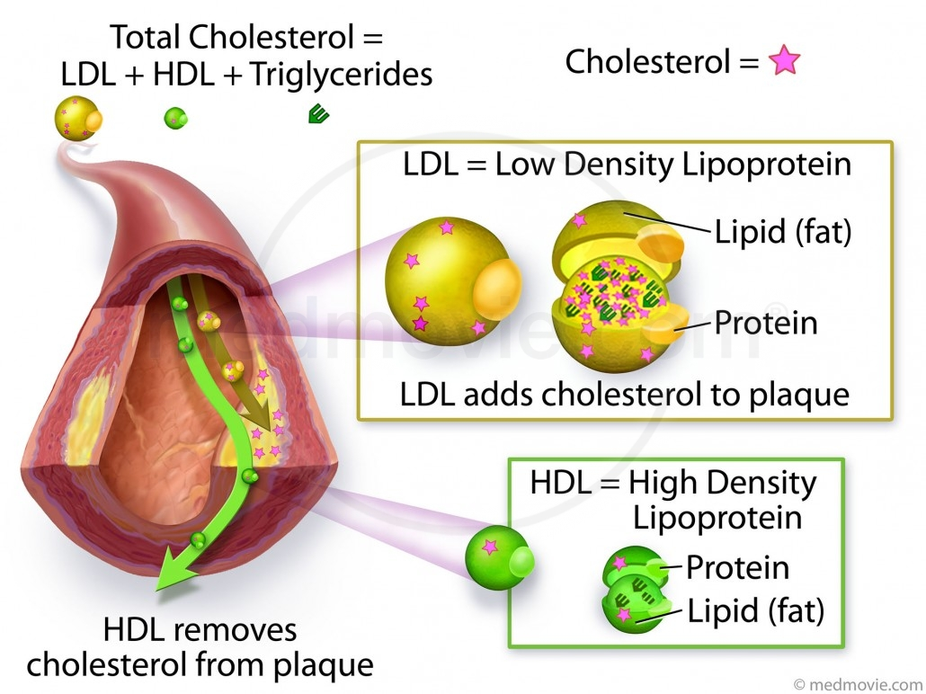
GOOD FATS vs. BAD FATS
What effect does a specific dietary FAT have on your Blood Cholesterol & Triglycerides levels?
The main factors that influence your LDL vs HDL ratio in the blood are:
GENETICS, DIET (plant-based foods do not contain any cholesterol) and EXERCISE

Slide 4
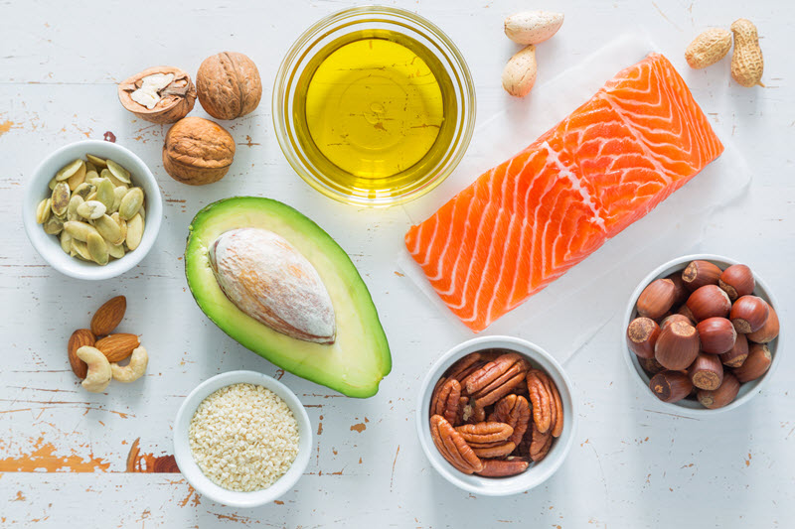
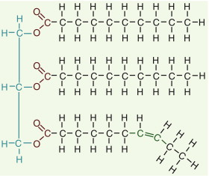
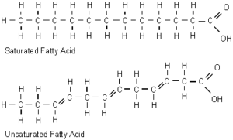
FATS – The GOOD, the BAD and the UGLY
GOOD FATS: (oily fats)
TRIGLYCERIDE molecule
Polyunsaturated and
Monounsaturated fatty acids
LOWER your LDL
Blood Cholesterol Levels

Slide 5
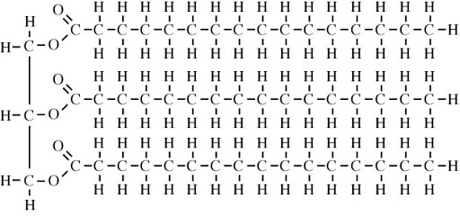
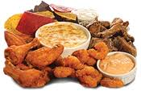
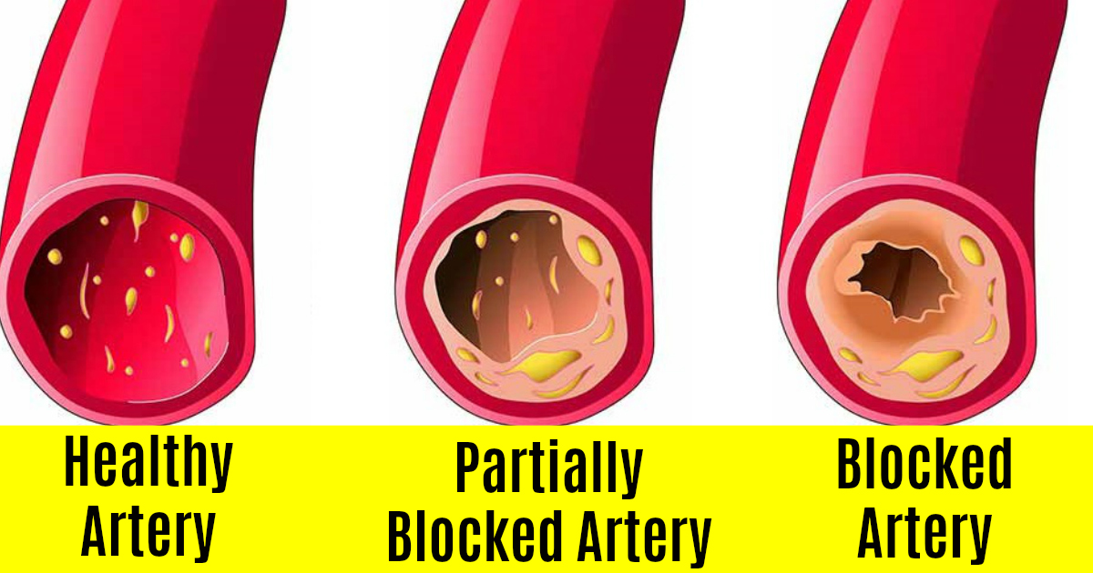
FATS – The GOOD, the BAD and the UGLY
BAD FATS: (solid fats)
SATURATED fatty acids RAISE your LDL
Blood Cholesterol Levels

Slide 6
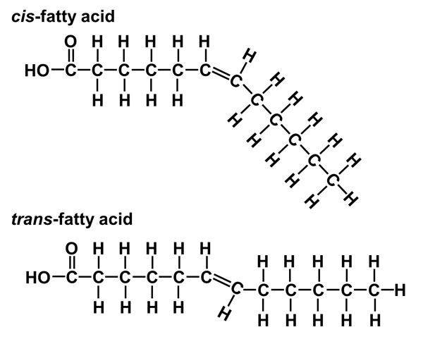
FATS – The GOOD, the BAD and the UGLY
UGLY FATS: (TRANS fats)
In nature, when plants and animals build triglycerides, they tend to build saturated fatty acids or CIS form unsaturated fatty acids to bond onto a glycerol

Slide 7
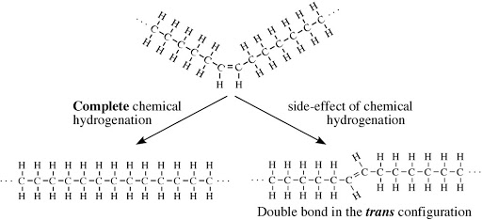
The food industry started to HYDROGENATE healthy cheaper unsaturated fats (oils) to raise their melting point so that they would have a solid texture in the processed food product
Healthy UNSATURATED fat in CIS formation may have Melting Point of 12 ⁰ Celsius
New SATURATED fat may have Melting Point of 47 ⁰ Celsius
New TRANS fat may have
Melting Point of 42 ⁰ Celsius

Slide 8
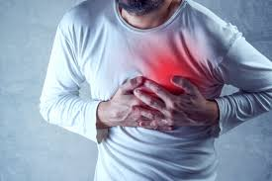
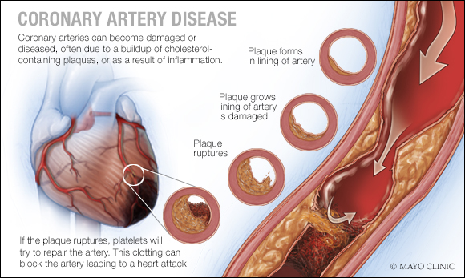
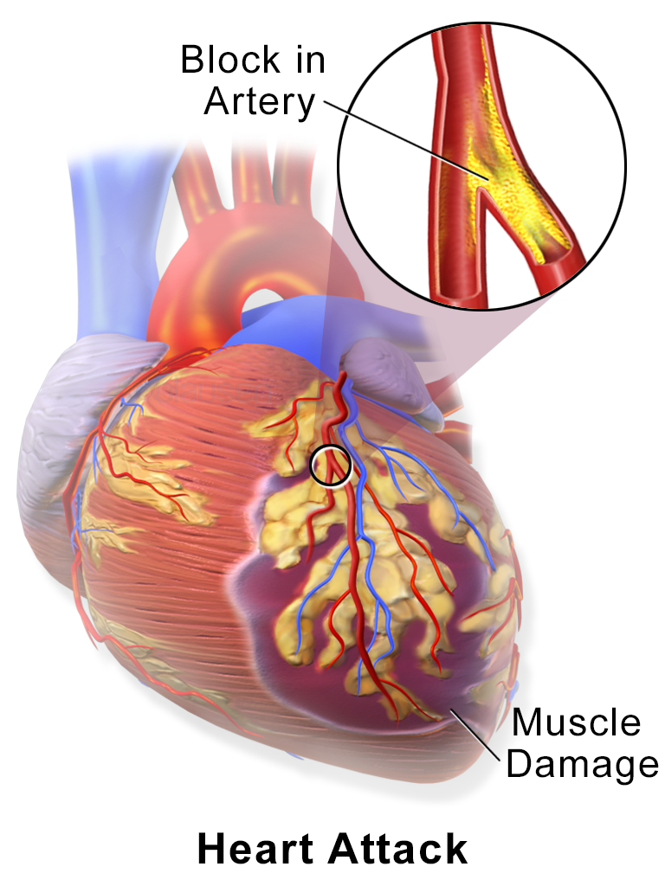
TRANS Fats – The UGLY
Trans-Fats are a double whammy –
They LOWER your good HDL and RAISE your bad LDL = HEART DISEASE
Myocardial Infarction

Slide 9
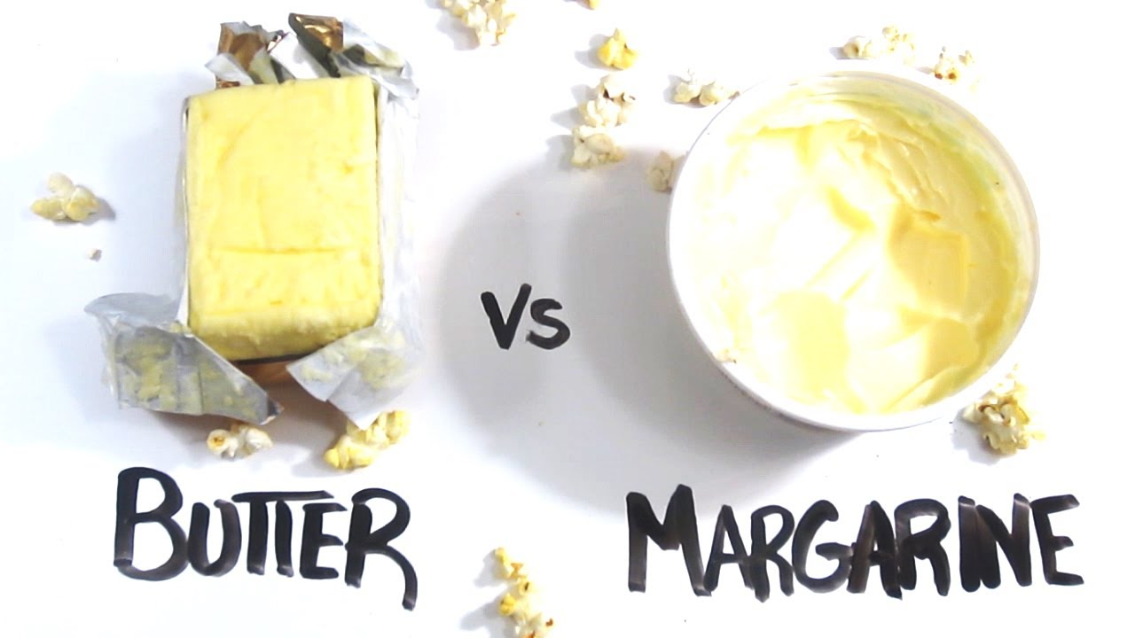
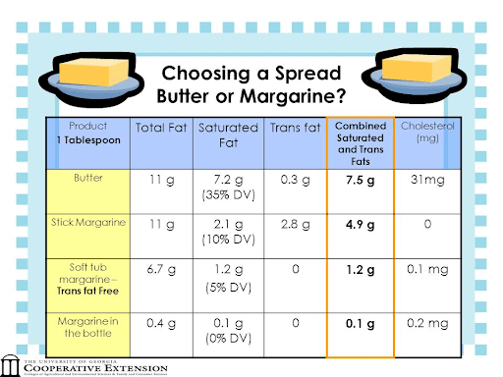

Slide 10
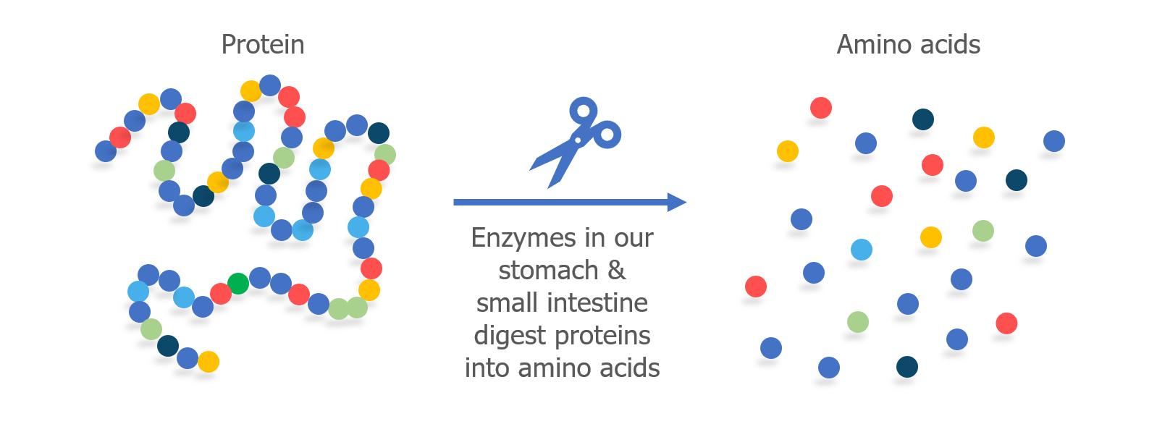
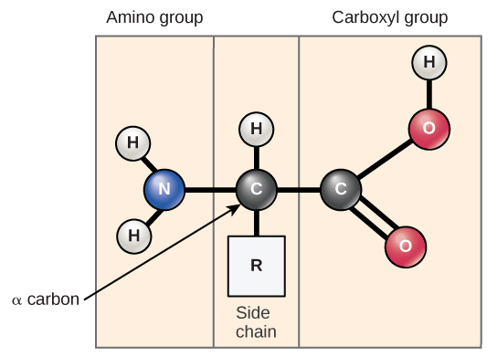
B) PROTEINS
Proteins are digested into Amino Acids. Some of these AAs may be converted to a form that may be used as a fuel (4.1 Calories/gram), but most of the time AAs are used as building blocks to rebuild proteins for tissue growth and repair.
The body uses 20 different amino
acids to build thousands of different proteins.
Structural proteins and functional enzymes

Slide 11
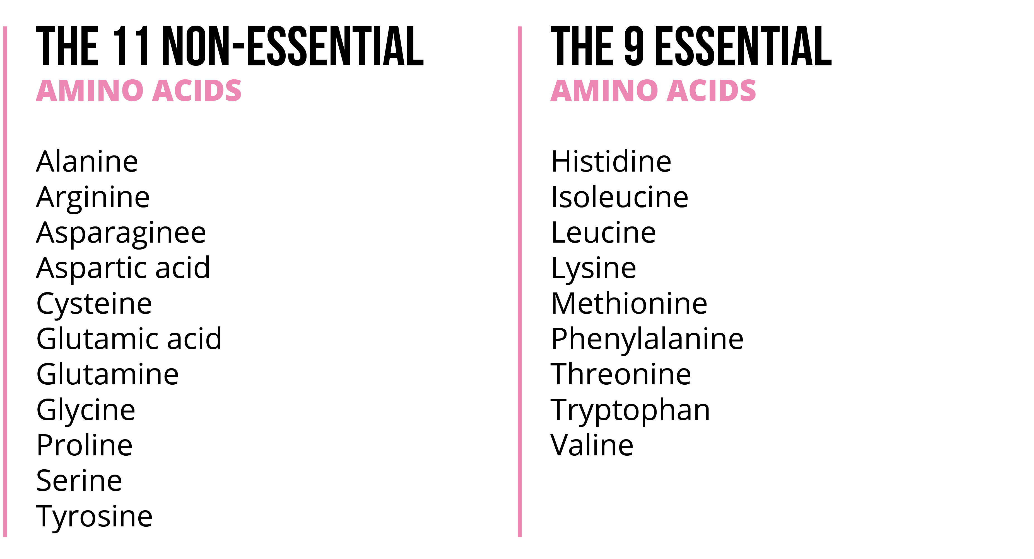
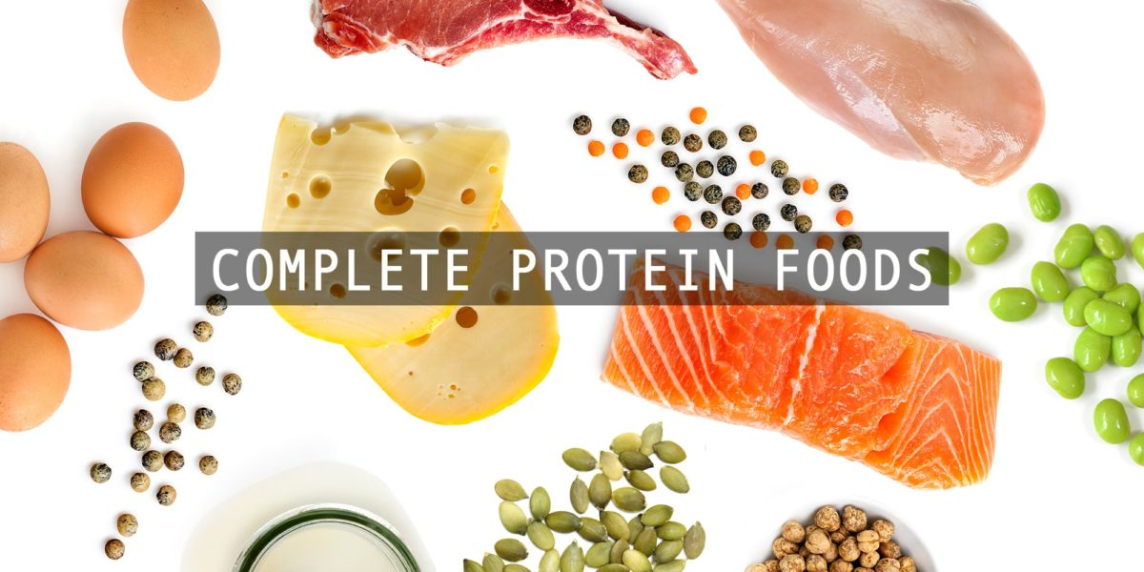
You can make the Non-Essential
AAs in your body from the Essential AAs, but you must obtain the Essentials from your diet.
Complete Proteins
have all 11 Essential
AAs in one food

Slide 12
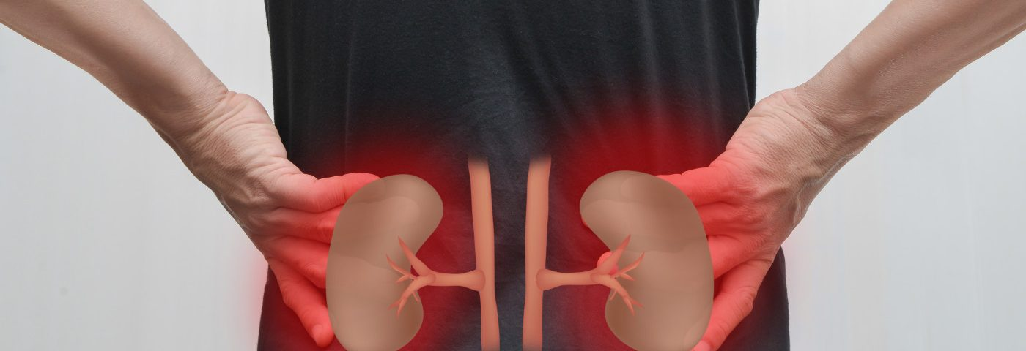
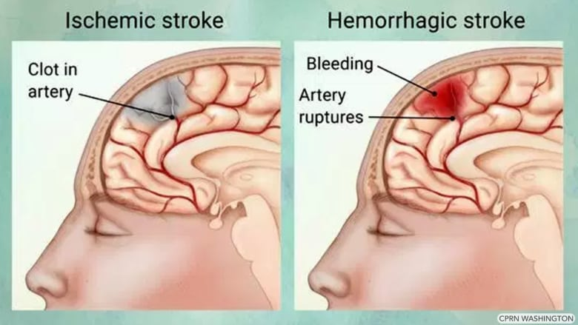
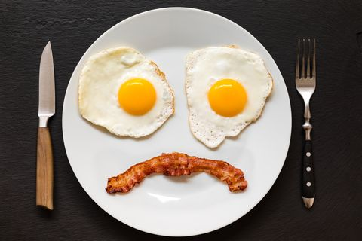
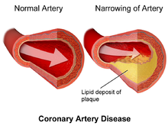
OVER CONSUMPTION OF PROTEIN
In North America and Europe it is common that much of the population will
eat 2-3 X as much protein is as required – Is this a PROBLEM?

Slide 13
