Slide 1
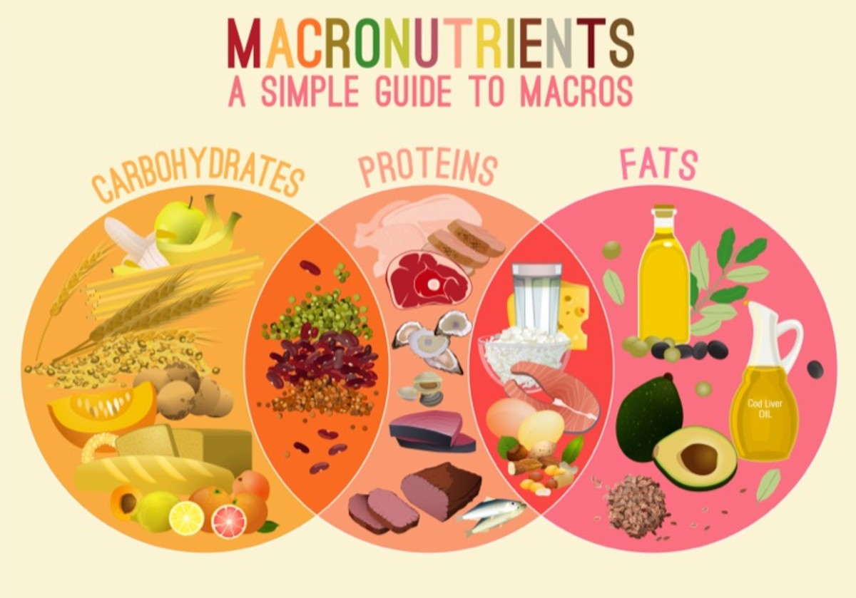
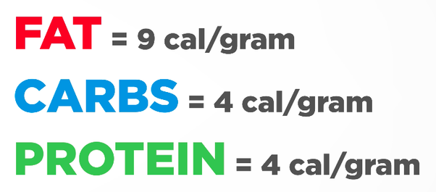
NUTRITION - Macronutrients
NUTRIENT – any substance that you MUST obtain from the food and drink you consume to stay functionally healthy
MACRONUTRIENTS – Required in large amounts

Slide 2
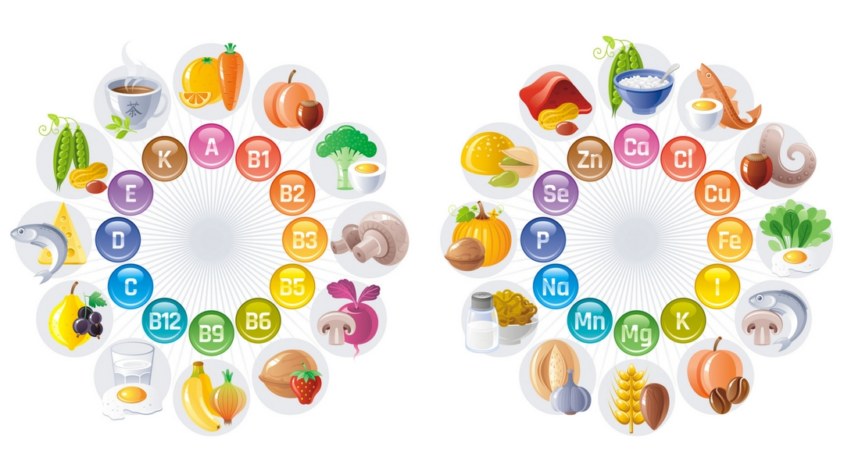
MICRONUTRIENTS – Required in very small amounts
VITAMINS
MINERALS
13
17
MICRONUTRIENTS HAVE ZERO CALORIC VALUE

Slide 3
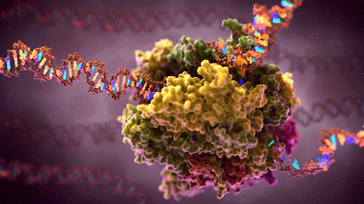
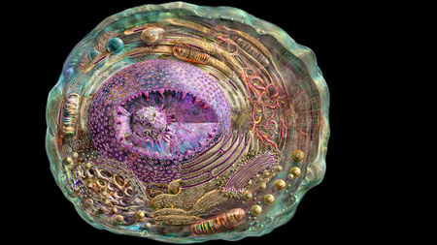
WHAT IS METABOLISM ???
The chemical processes that occur within a living organism to maintain life
All cellular reactions fit into one of two categories
ANABOLIC
CATABOLIC

Slide 4
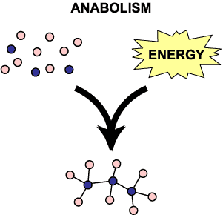
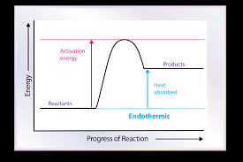
ANABOLIC Reactions : any chemical rxn that takes low energy
molecules and builds them into larger, high energy-rich molecules – Energy must be input into the bonds

Slide 5
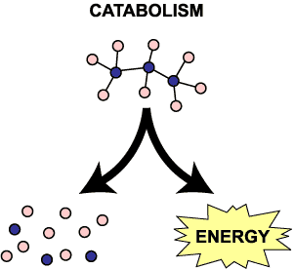
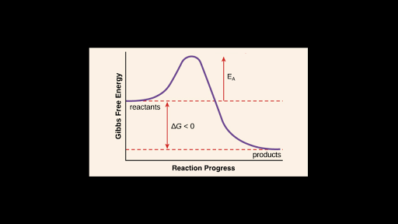
CATABOLIC Reactions : any chemical rxn that takes large, high-energy molecules and breaks them down into smaller, low energy molecules. – Energy is always released.

Slide 6
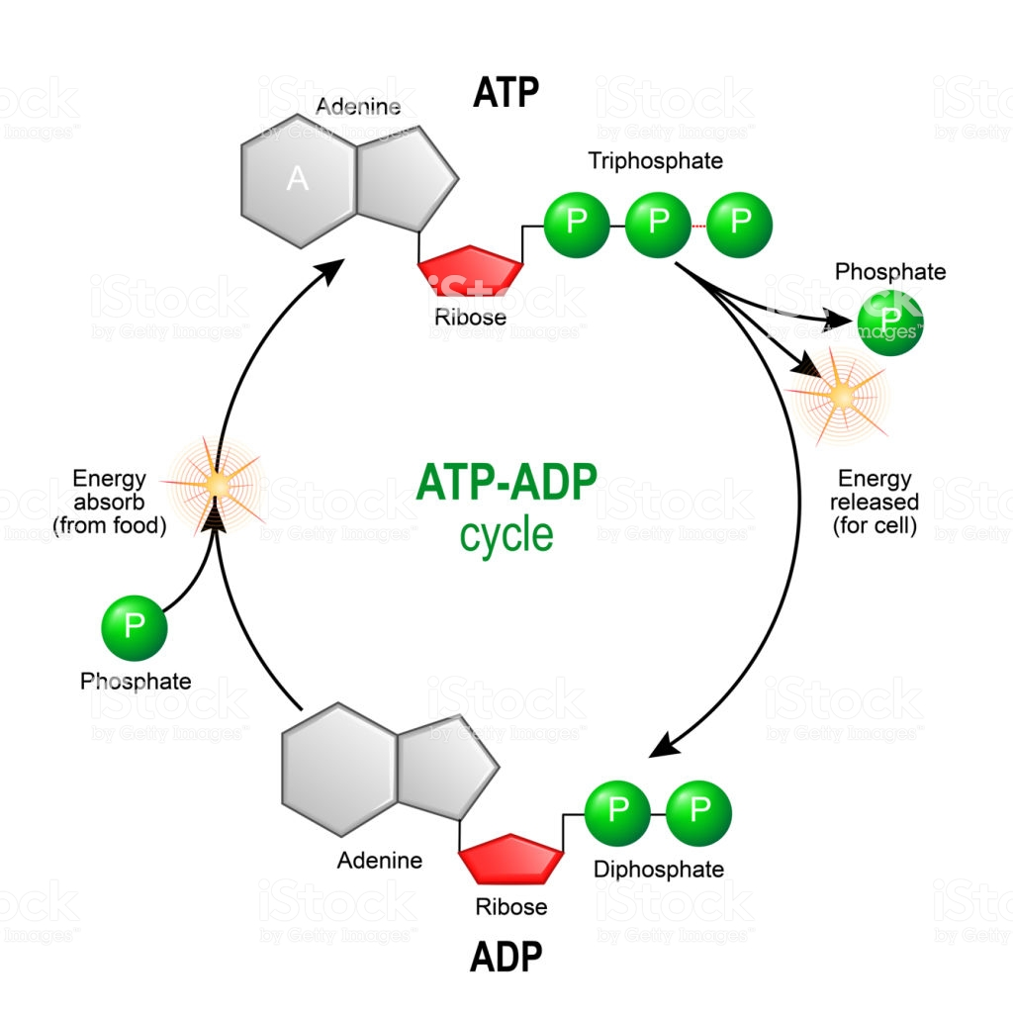
CARBOHYDRATE METABOLISM
The primary function of carbohydrates in the body is to provide our cells with energy.
We beak down the carbs we eat and convert them into the most useable simple sugar called GLUCOSE (blood sugar).
This glucose is broken down catabolically by our cells to form an energy-rich molecule called Adenosine Triphosphate - ATP
ATP is used to run
all cellular processes, muscle contraction, nerve
Impulses, cell transport etc

Slide 8
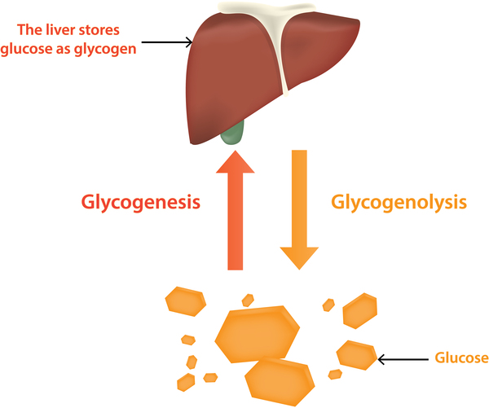
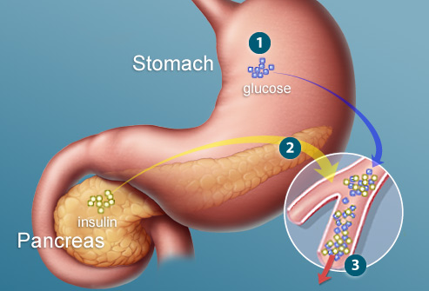
Balancing Blood Glucose Levels
When blood glucose levels are getting too high, our pancreas puts out the hormone INSULIN. Insulin travels through the bloodstream and lands on muscle and liver cells and instructs those cells to take up GLUCOSE from the blood and store it as a large polysaccharide molecule called GLYCOGEN. INSULIN lower blood sugar levels

Slide 9
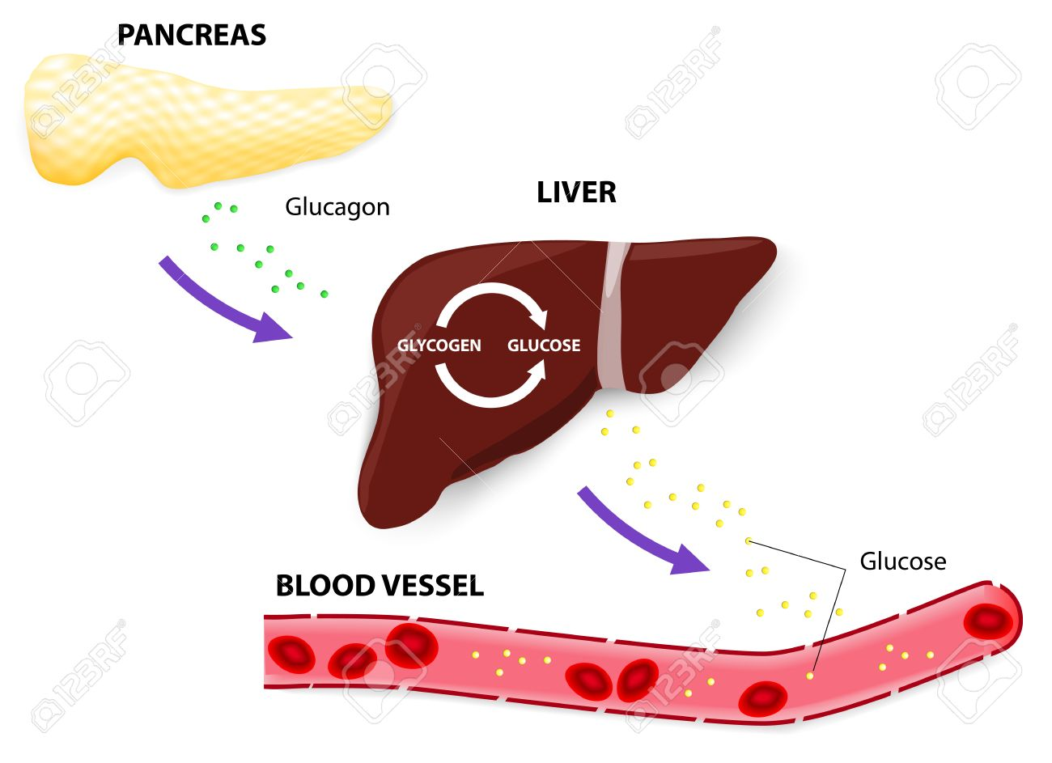
Balancing Blood Glucose Levels
When blood glucose levels are getting too low between meals, our pancreas puts out the hormone GLUCAGON. Glucagon travels through the bloodstream and lands on muscle and liver cells and instructs those same cells to break GLYCOGEN back into GLUCOSE and release the glucose back into the blood.
GLUCAGON raises blood sugar levels

Slide 10
CARBO – LOADING ??

Slide 11
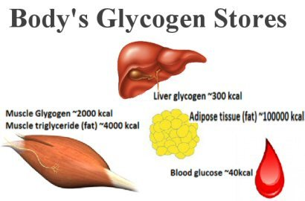
CAN EATING CARBS MAKE YOU FAT ??
When your blood sugar is high, you will store the glucose in your cells as Glycogen, but when your cells are totally full of Glycogen, you convert Glycogen into FAT
GLUCOSE ←→ GLYCOGEN ←→ FAT

Slide 12
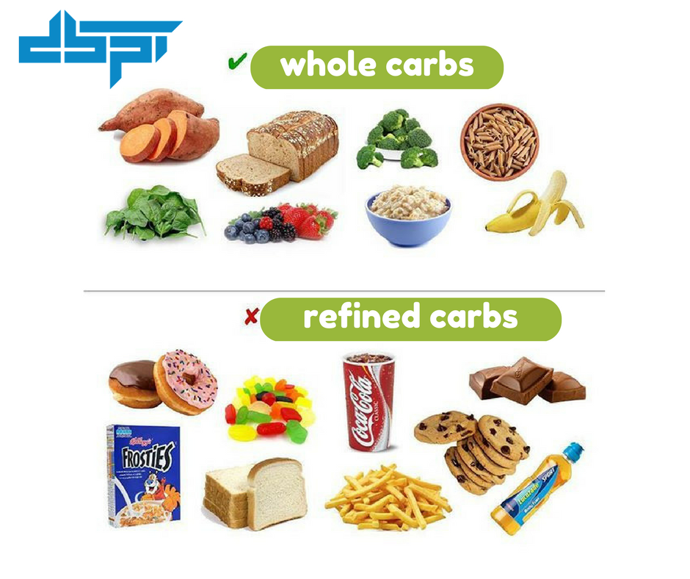
Not all CARBS are created equally
REFINED CARBS – Have a high Glycemic Index #. This is a measurement of the rate at which your body digests, absorbs and converts them into blood GLUCOSE.
WHOLE CARBS – Have a low G.I., they contain indigestible fiber which slows down the process of their conversion to blood GLUCOSE

Slide 13
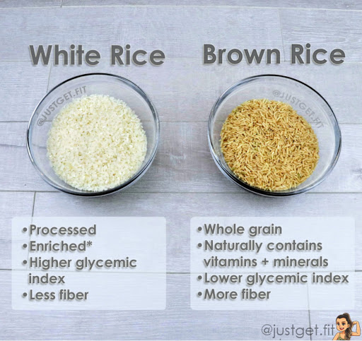
GLYCEMIC INDEX
WHITE RICE vs BROWN RICE
73
49

Slide 14
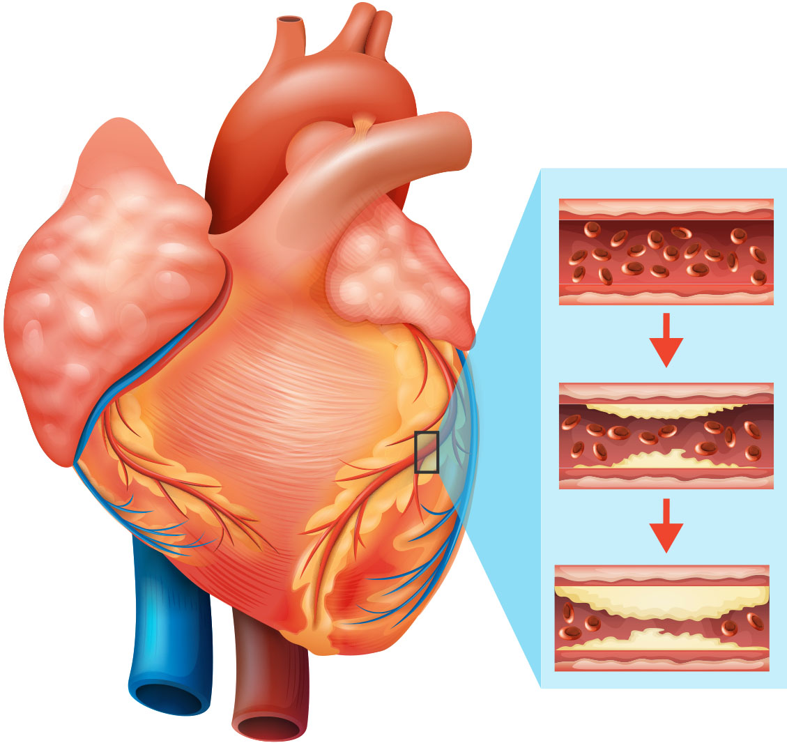
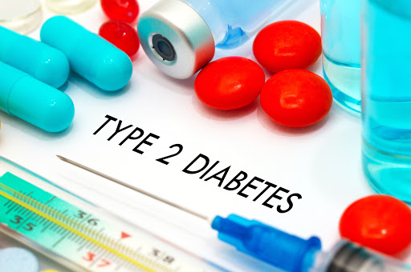
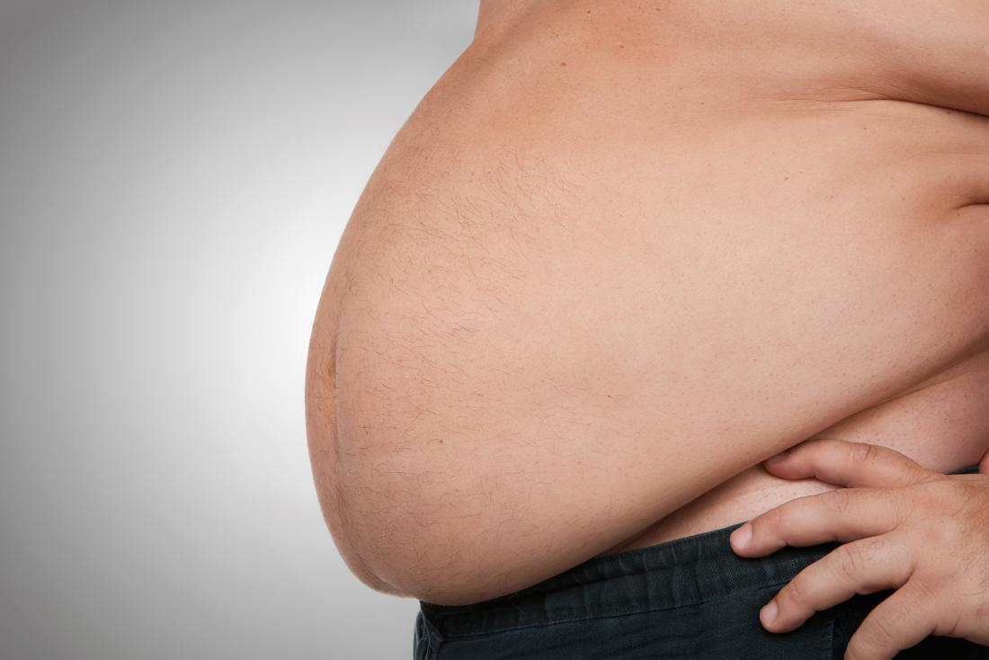
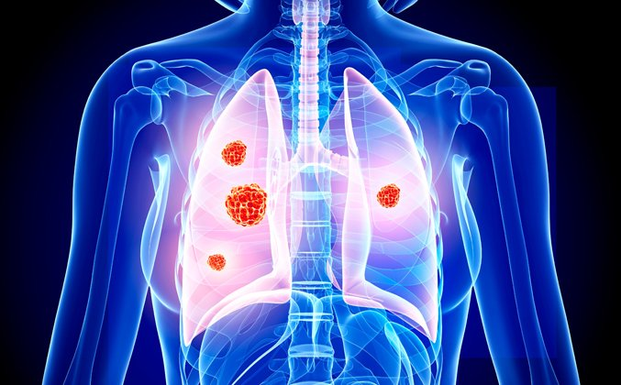
DANGERS OF BAD CARBS
HEART DISEASE
OBESITY
CANCER

