Slide 1
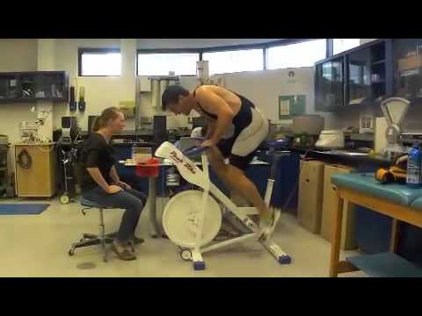
MUSCLE ENERGY SUPPLY
WINDGATE TEST

Slide 2
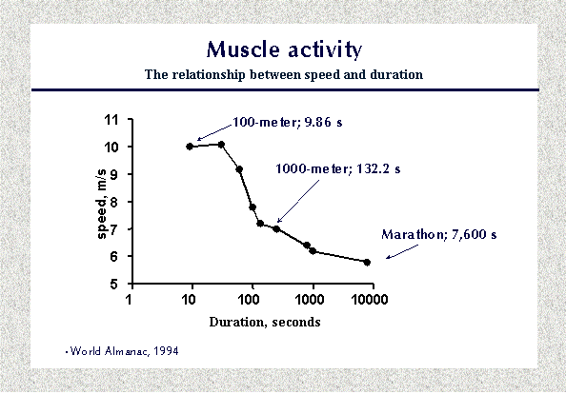
What lies behind the fact that we must reduce speed if we want to run longer?
Even the most motivated athletes are bound by this simple rule. We can see this in the following graph. Running speed is plotted against the duration of the race. Competitors running more than 30-40 seconds reduced their velocity markedly and a continual and gradual decrease occurred after about 2 minutes. Marathon runners ran approximately half as fast as sprinters.

Slide 3
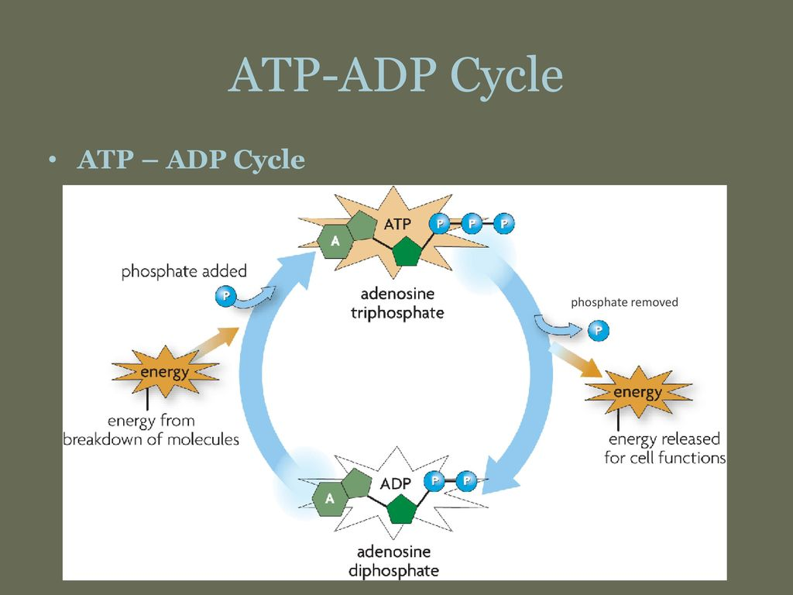
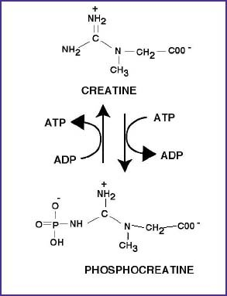
# 1
The explanation for this phenomenon is that differing energy sources are used by working muscles to access ATP, the choice being related to the rate of usage. Stored high-energy phosphates energy (ATP-ADP and phosphocreatine/creatine phosphate CP) give the most rapid regeneration of utilized ATP. There is usually about 4-6 X more stored phosphocreatine than there is stored ATP. A 100-meter sprint takes less than 10 seconds. During this very short period the driving force is stored high-energy phosphate. The runners can perform almost without breathing, using energy stored as ATP or creatine-phosphate (CP) in the active muscles.

Slide 4
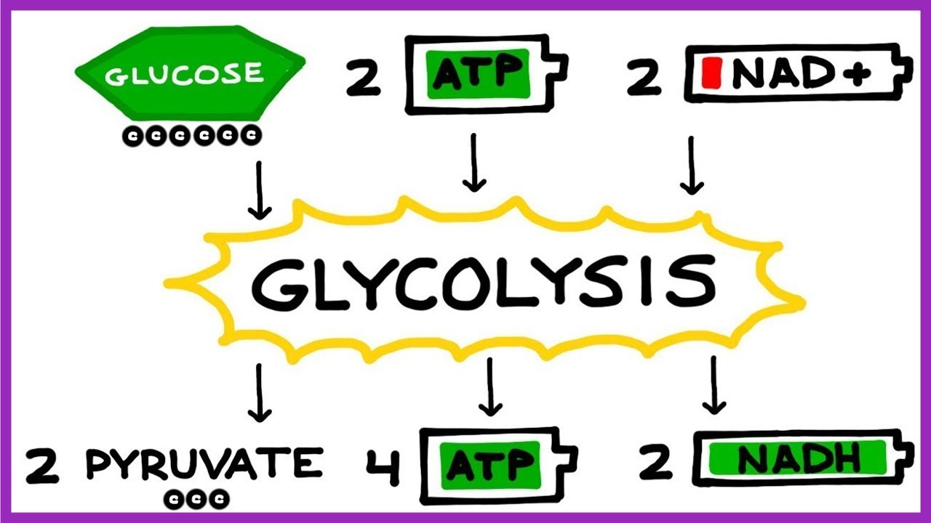
# 2
Muscle is full of Glycogen (Glucose) and it can be broken down either Aerobically (with oxygen) or Anaerobically (without oxygen) to produce ATP required for muscle activity.
GLYCOLYSIS is when energy production pathways consume GLUCOSE ANAEROBICALLY to produce ATP from ADP +P.
These metabolic pathways are extremely rapid, however, they are very inefficient and only produce 2 ATP per Glucose except. Only carbohydrates can be used for GLYCOLYSIS. This is not sustainable.
15 seconds ANAEROBIC Glycolysis 2 ATP/GLUCOSE
to 60 second

Slide 5
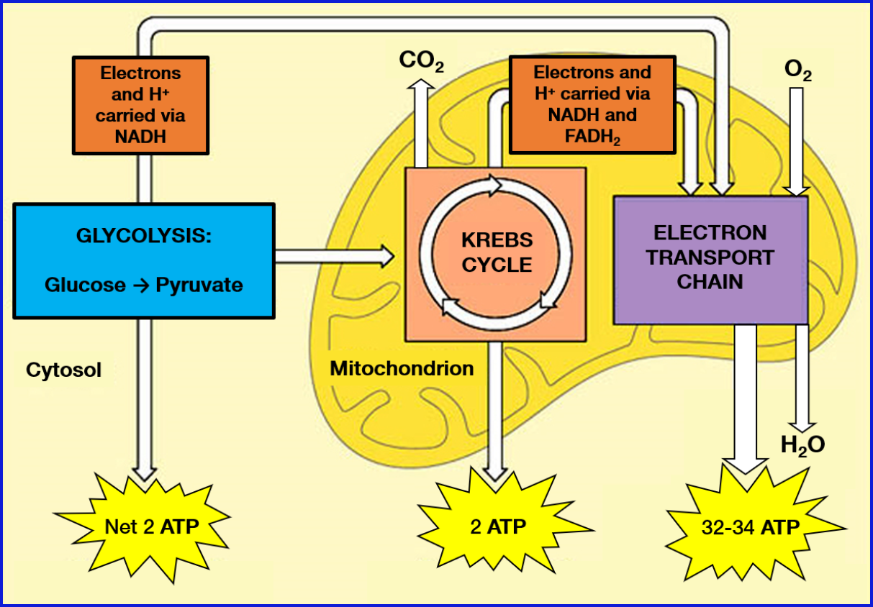
#3
Great News, our cells can use two other metabolic pathways AEROBICALLY to generate ATP. One is called the KREBS CYCLE, the other is called the ELECTRON TRANSPORT CHAIN. These pathways are very efficient allowing each GLUCOSE to generate 36 ATP. That is 18 X as efficient as Anaerobic Glycolysis. The big issue is that these two pathways must have access to OXYGEN and they are very slow… so intensity goes way down.
90 seconds AEROBIC breakdown of
and beyond Glucose → 36 ATP
Fatty Acids → ___> 100 ATP
Amino Acids → ~ 15 ATP

Slide 6
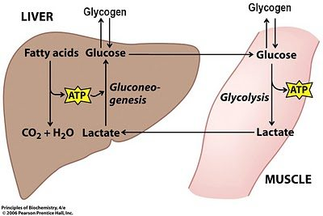
- If you keep pushing muscle to the point that oxygen delivery cannot keep up, the Aerobic Pathways shut down and we are left with only ANAEROBIC GLYCOLYSIS. Unfortunately, the PYRUVATE waste product can no longer be taken up by the KREBS cycle. As the PYRUVATE builds up it is transformed into LACTIC ACID (LACTATE). This lactic acid build up shuts down ANAEROBIC GLYCOLYSIS too. GAME OVER!

Slide 7
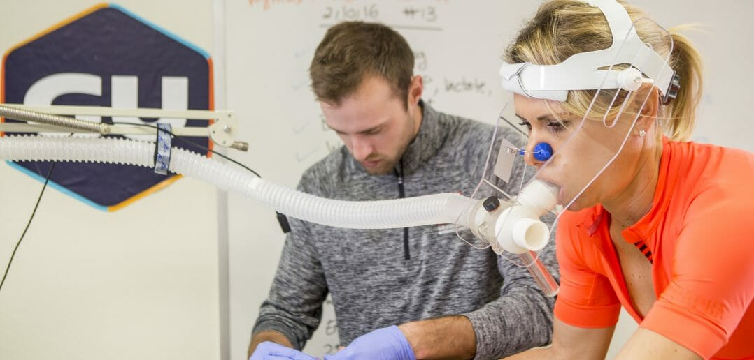
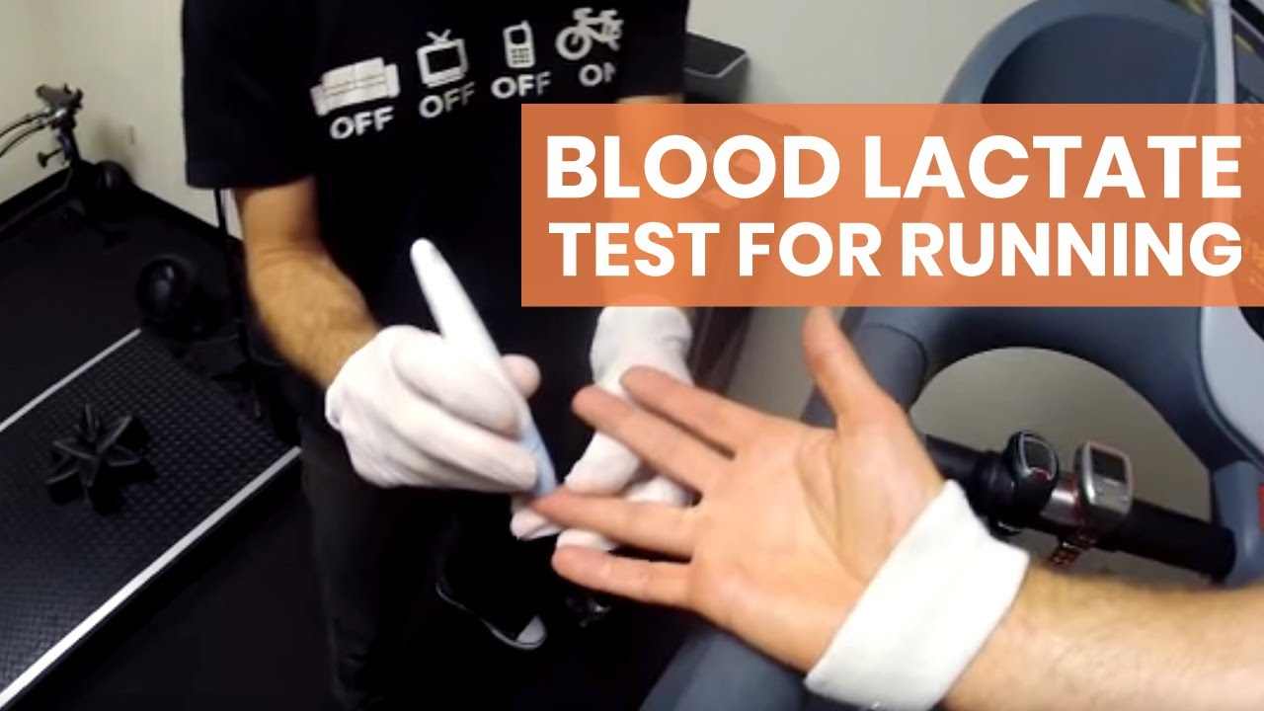
LACTATE TEST
SUMMARY VIDEO

