Slide 1
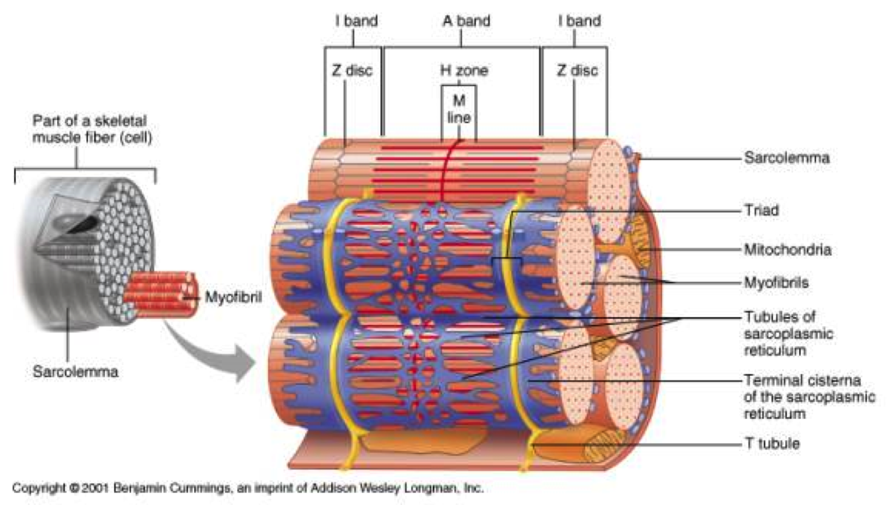
Muscle Physiology – How does this thing work?

Slide 2
Voluntary Muscular Control

Slide 3
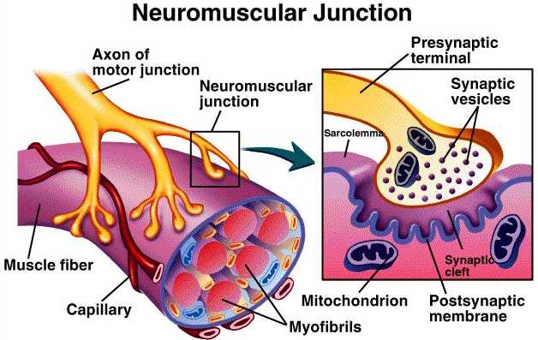
Innervating a Muscle Fiber

Slide 4
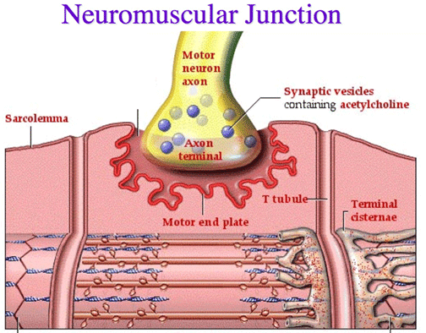
Excitation of the Sarcolemma

Slide 5
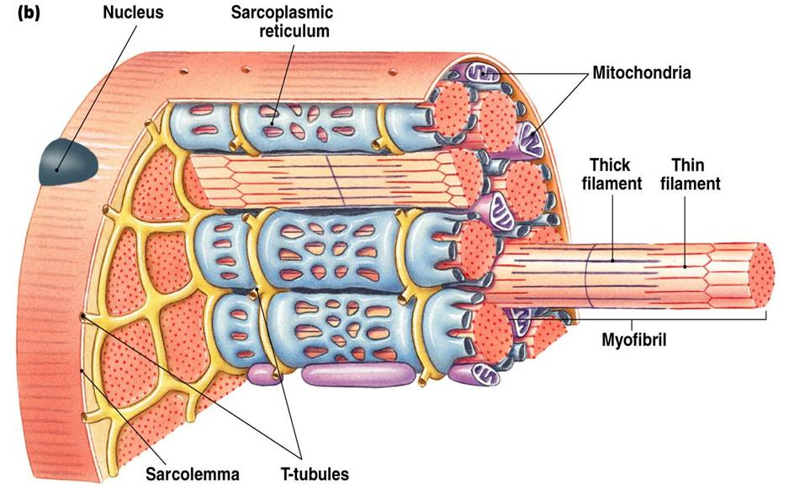
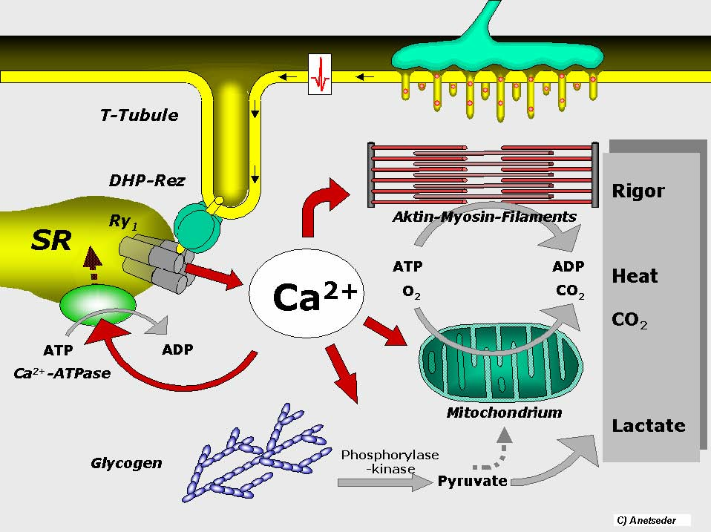
Stimulation of the Sarcoplasmic Reticulum

Slide 6
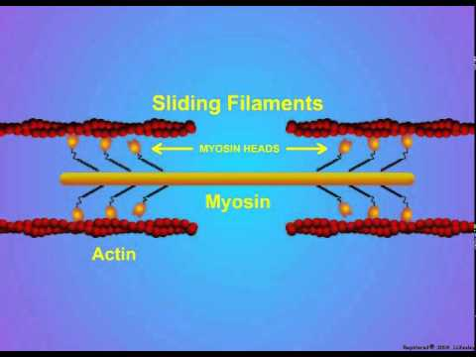
Calcium Release must occur to allow CONTRACTION – But Why?

Slide 7
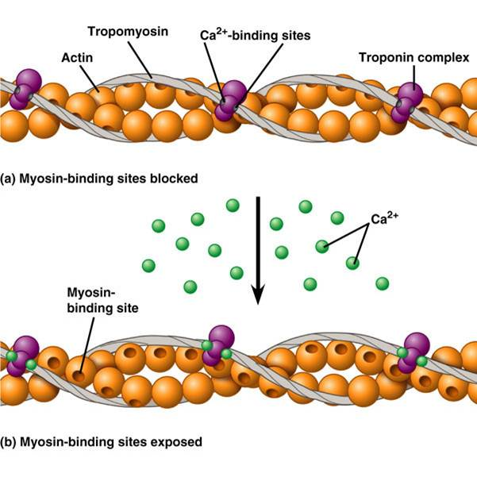
Calcium Binds onto TROPONIN and causes it to change shape which in turn causes TROPOMYOSIN to move over to expose Myosin Binding Site

Slide 8
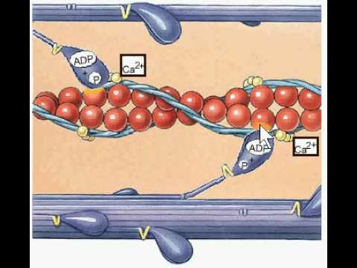
Once Myosin Binding Sites on ACTIN are exposed, Myosin Heads can bind and pull.

Slide 9
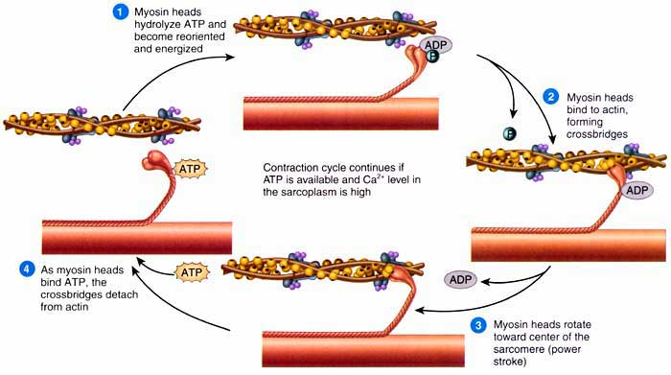
Both the process of Myosin Heads pulling and the process of Myosin Heads Detaching Requires ATP

Slide 10
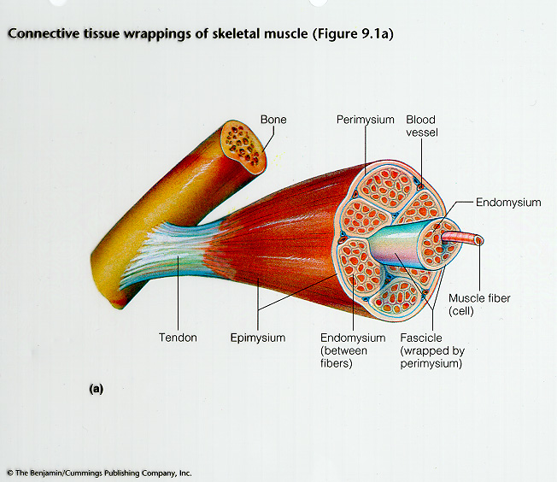
No – Not More Anatomy! - YES
FASCIA – KNOW IT !
EPIMYSIUM- encases muscle body PERIMYSIUM- encases muscle bundle (fascicle) ENDOMYSIUM – encases each muscle fiber (cell)

Slide 11
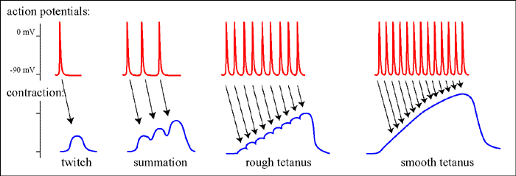
Contraction Types
All or None Law – A muscle fiber will fully contract if it reaches threshold.
TONIC CONTRACTION – Keeps your tone. Right now you are recruiting enough fibers to maintain your posture over gravity.

Slide 12
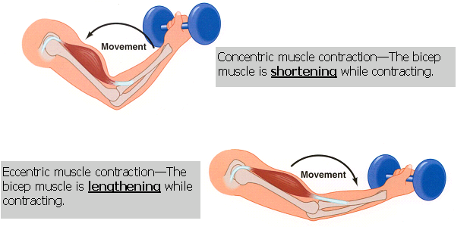
Types of Contraction
ISOTONIC- When contraction occurs the muscle shortens and movement occurs and then the muscle will relax to allow the muscle to relax and lengthen.
During shortening it is called CONCENTRIC contraction. Think “CONgregate, CONcentrate, CONverge”
During lengthening it is called ECCENTRIC contraction. It’s a mystery, but it does mean to deviate away from being concentric!

Slide 13
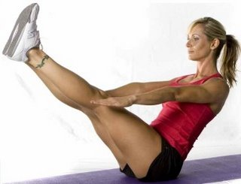
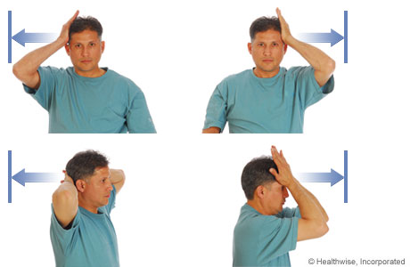
ISOMETRIC Contraction
During ISOMETRIC contraction – The muscle develops tension due to cross-bridges forming between myosin and actin, but the sarcomeres do not shorten, instead they just work to maintain their position.

Slide 14
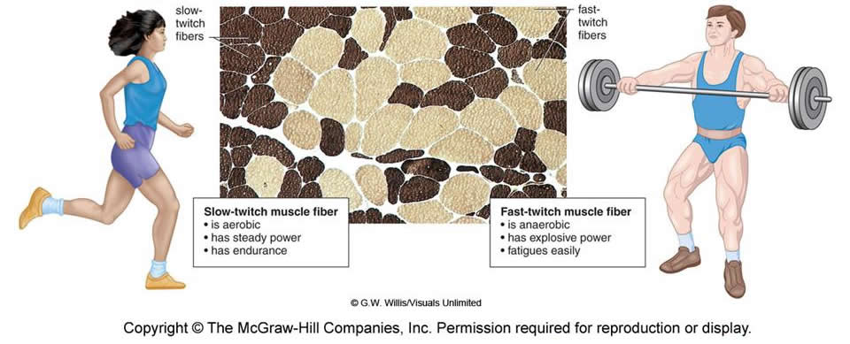
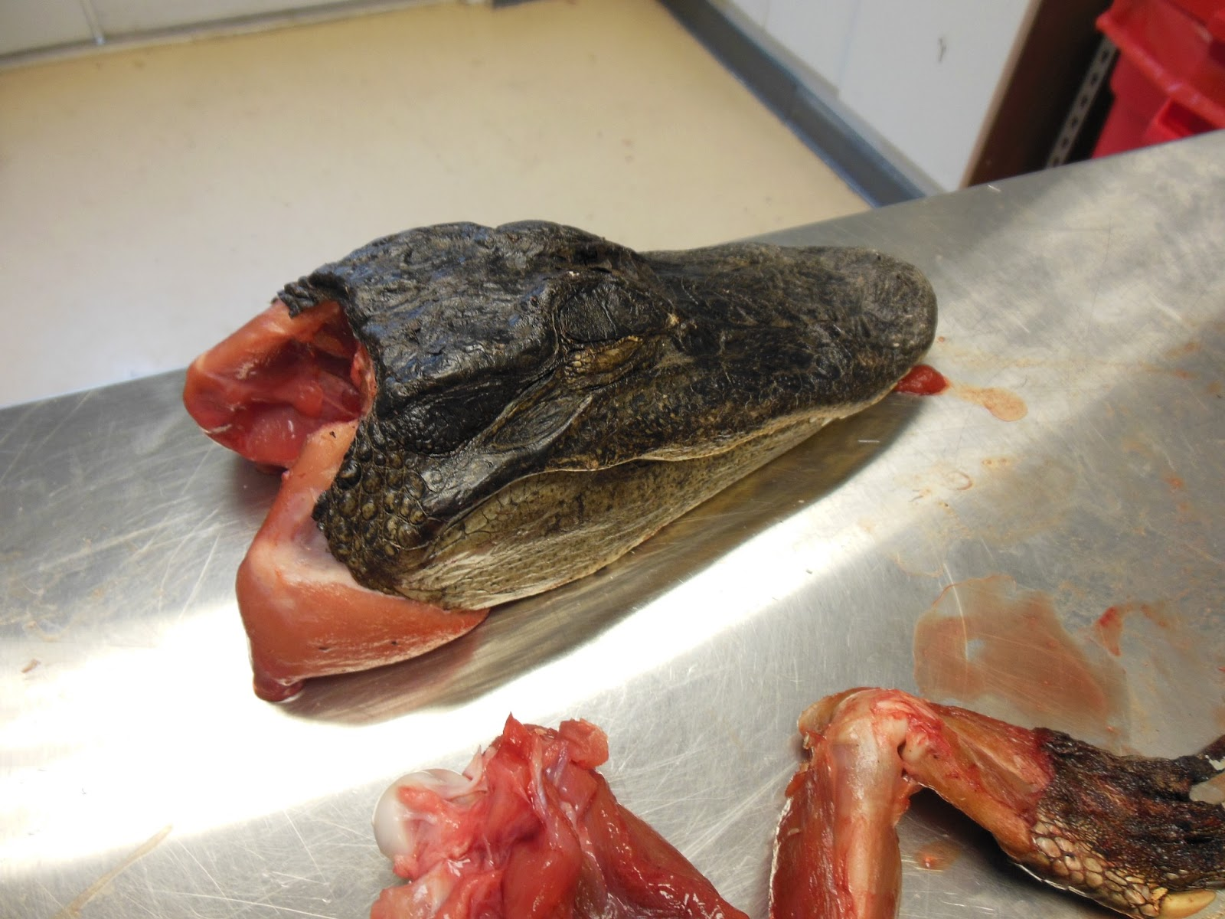
TYPES OF SKELETAL Muscle Fibers
Fast twitch are often referred to as “WHITE” while Slow twitch are often referred to as “RED”. Crocodile jaw muscle is totally pinkish white, looks nothing like a steak.

Slide 15
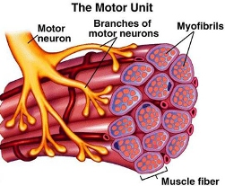
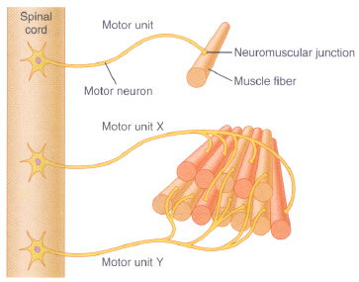
MOTOR UNIT= A motor neuron and all the muscle fibers it recruits

