Slide 1
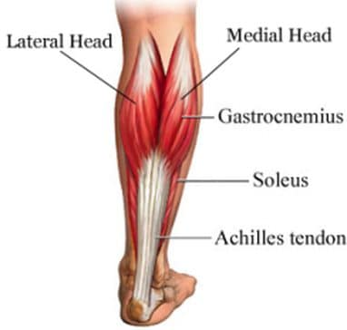
Practice Quiz
When you contract your Gastrocnemius –Calf Muscle, which bone would be considered the insertion point for the insertion tendon?
Talus
Tibia
Calcaneus
Fibula
Answer : C

Slide 2
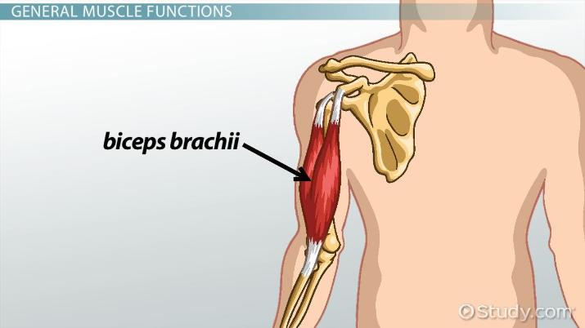
2. For the Biceps Brachii shown here, the ORIGIN tendon is attached onto the…
Scapula C) Ulna
Clavicle D) Radius
ANSWER : A

Slide 3
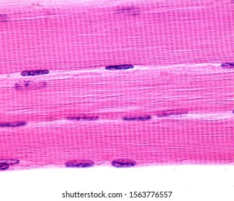
3. Give THREE different names for
The specific type of Muscle
Tissue shown here
SKELETAL Muscle Tissue
VOLUNTARY Muscle Tissue
STRIATED Muscle Tissue

Slide 4
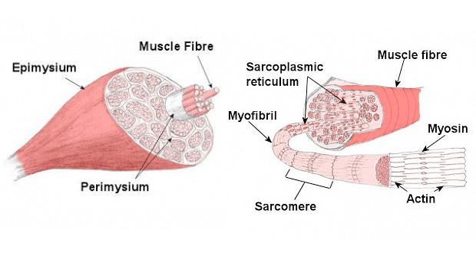
4. Place these structures in order from LARGEST structure to SMALLEST:
A) Myofibril
B) Myofilament (MYOSIN)
C) Muscle Body
D) Muscle Bundle (Fascicle)
E) Muscle Fiber
F) Myofilament (ACTIN)
ANSWER : C →D → E → A → B → F

Slide 5
5 For FLEXION at the elbow, what muscle below would be considered the PRIME MOVER (main muscle responsible)?
Deltoid – Shoulder Muscle
Triceps Brachii
Tibialis Anterior
Biceps Brachii
Sternocleidomastoids
Answer = D

Slide 6
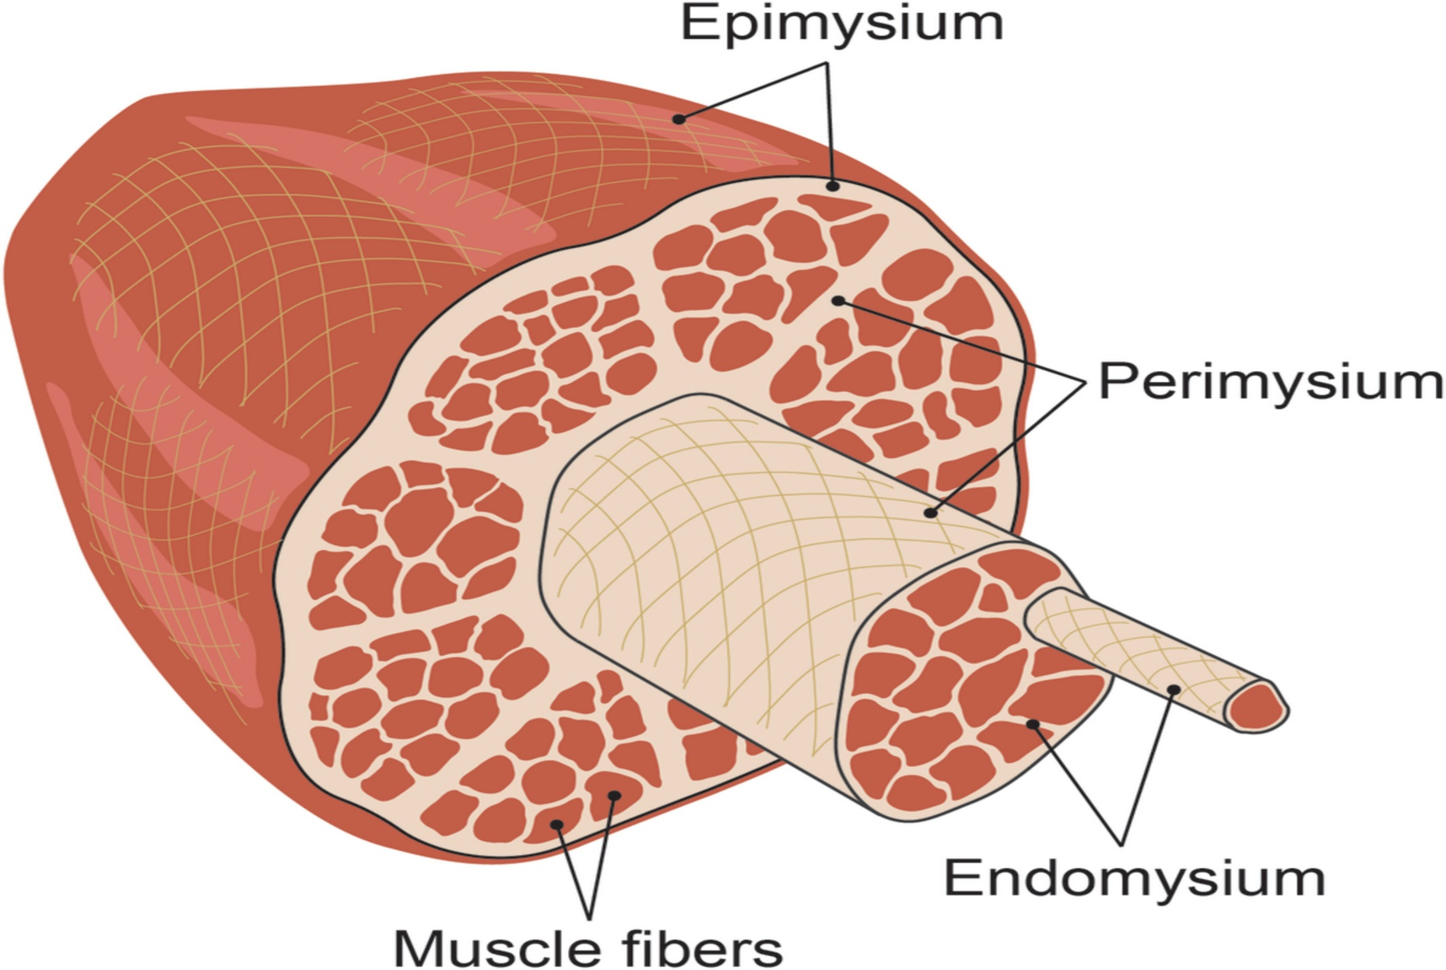
6 & 7 - KNOW YOUR FASCIA
A = PERIMYSIUM
A
B
B= ENDOMYSIUM

Slide 7
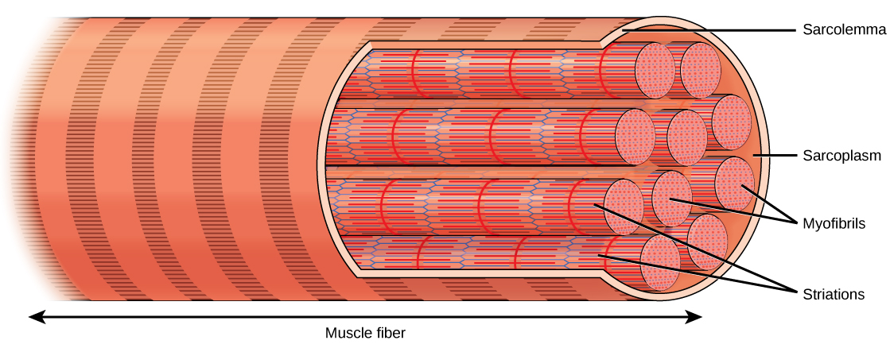
5. WHICH STRUCTURE BELOW IS THE SMALLEST/THINNEST STRUCTURE?
MYOSIN B) MYOFIBRIL C) FASCICLE D) ACTIN E) MUSCLE FIBER
D - ACTIN
MUSCLE CELL

Slide 8
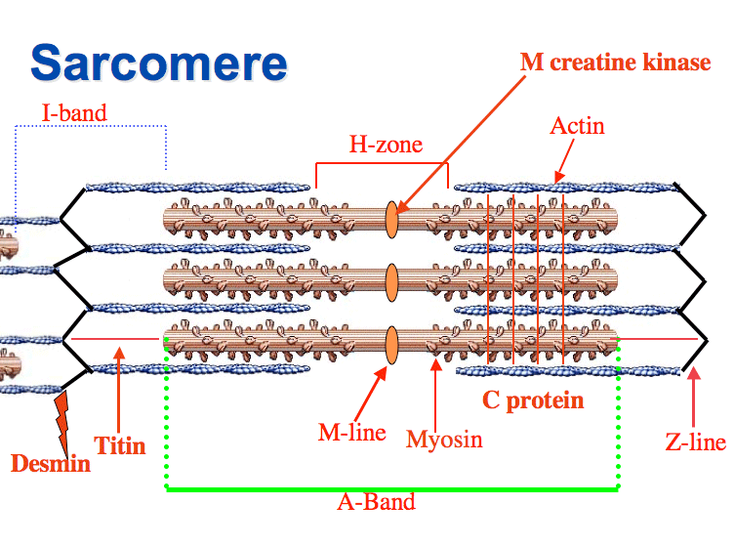
Sarcomere Practice Quiz
#5 - Region
#6 - Region
#4 - Myofilament
#7 - Anchroing
#1 - Myofilament
#3 - Structure
#2 – Region

Slide 9
ANSWERS
#1 – MYOSIN
#2 – A-Band
#3 – Z- Line
#4 – Actin
#5 – I- Band
#6 - H-Zone

