Slide 1
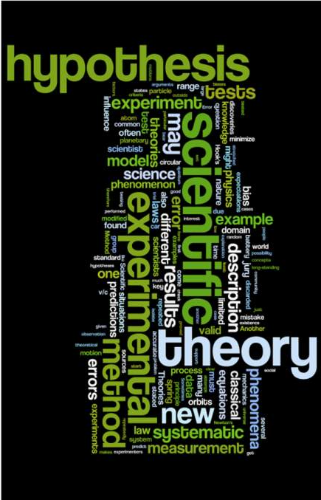
THE SCIENTIFIC METHOD
What’s your hypothesis?

Slide 2
What is the Scientific Method?
The Scientific Method is the backbone to every science experiment. It is a methodical framework to solve problems and determine TRUTHFUL answers in a step-by-step logical format.

Slide 3
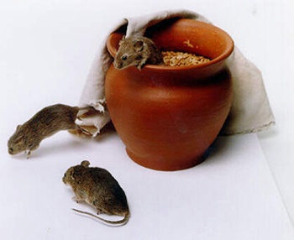
Why Do We Need It?
Have you ever had two friends who attended the same event give you completely different reports of what happened?
Everyone has different beliefs, values, and perceptions of the world. While these differences are what make us each unique, they make it difficult to determine what is true and what’s not.
Scientists over centuries have faced this same issue, so to solve the problem they created the Scientific Method.

Slide 4
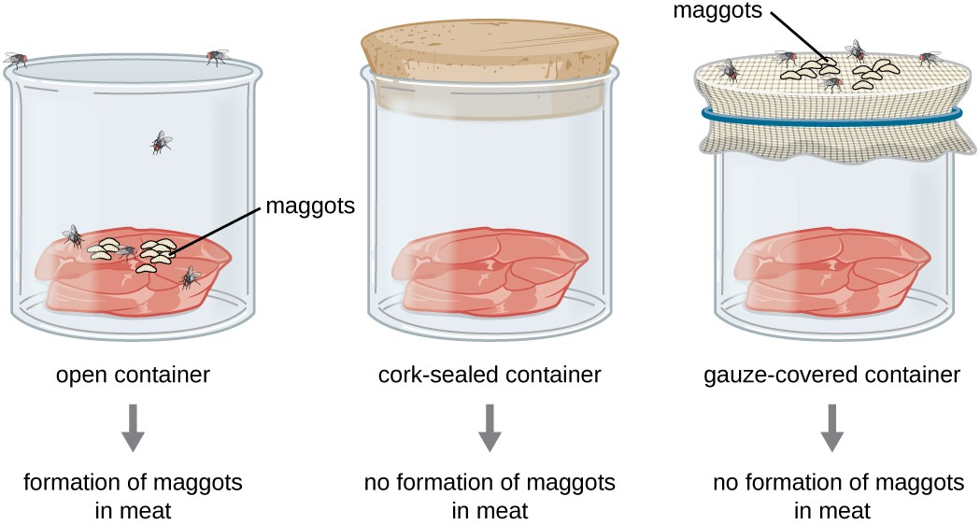
ABIOGENESIS ??

Slide 5
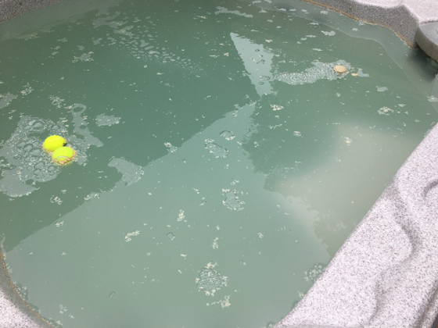
Do You Already Use It?
You probably use the scientific method in everyday life without even realizing it.
If you have a flashlight in your car and it doesn’t light up when you flick the switch, what reasoning might you come up with as to why it won’t work?
You go out to your hot tub and you open the cover and the water is murky and you notice a not so pleasant smell. Any thoughts?

Slide 6
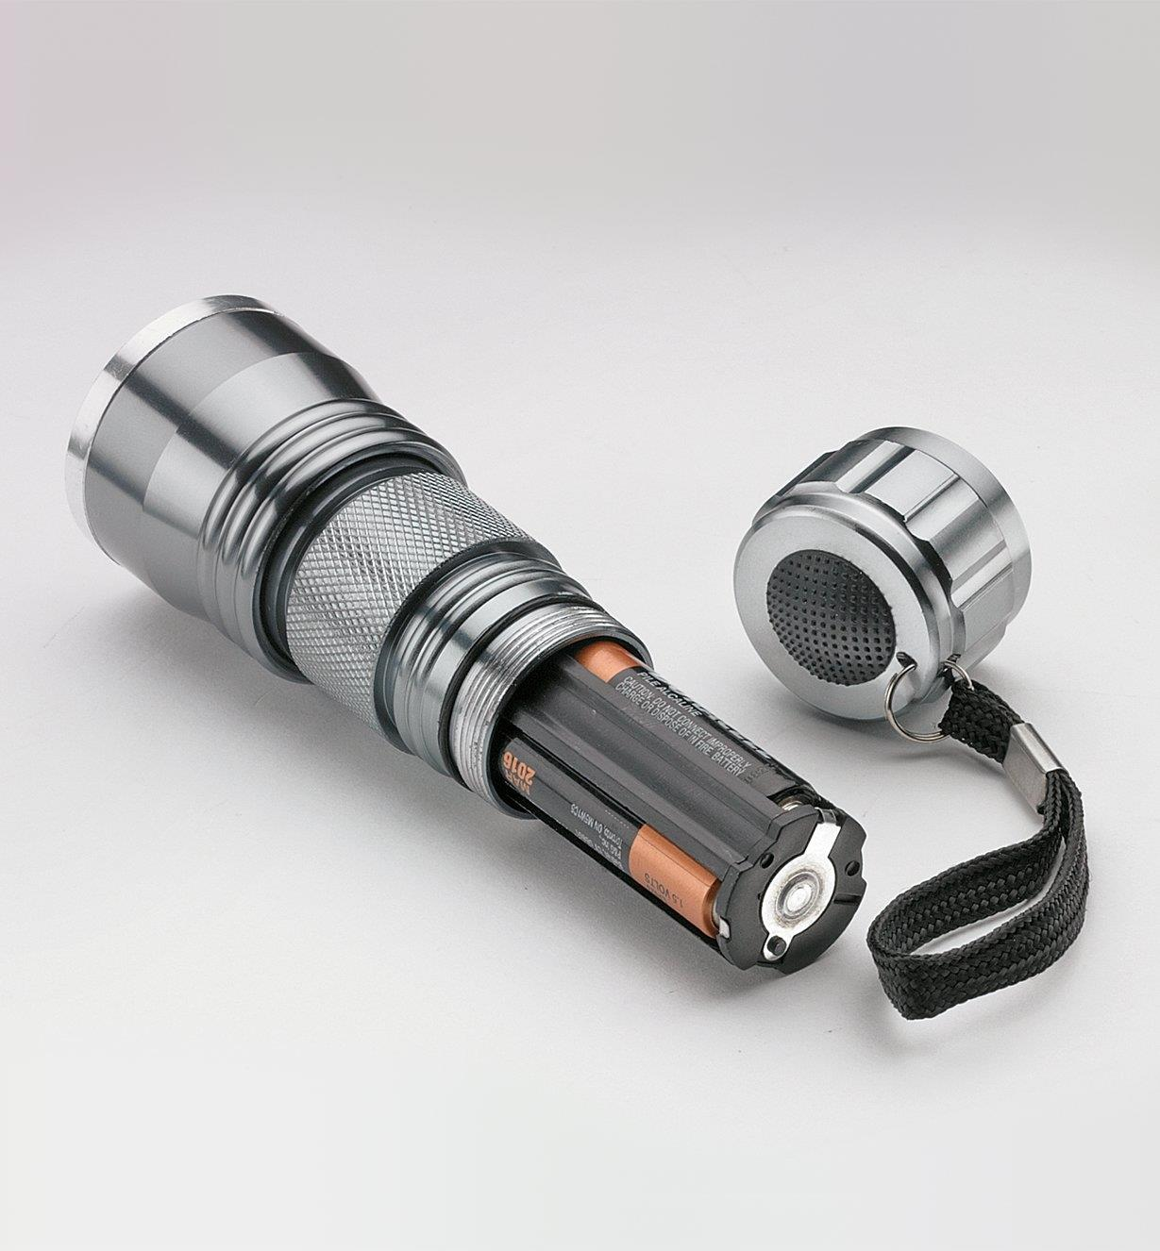
With your flashlight, you reflected back on previous experience and your already existing knowledge and you form a HYPOTHESIS – An educated guess as to what might be the problem and a possible answer. You also would state that educated guess – “If I add batteries, there will be power to light the bulb”
You would then conduct an EXPERIMENT (test) to see if your Hypothesis is correct. During this experiment, you would only change one key factor during the test. You would not, replace the bulb, put in new batteries and replace the switch on the battery all at the same time.
- If you only changed the batteries and tried then found that the flashlight worked, you would then draw a CONCLUSION based on your experiment. In this case your Hypothesis was supported by your experiment. If the flashlight did not work after putting in new batteries, you would state that your data/results/observations did not support your Hypothesis

Slide 7
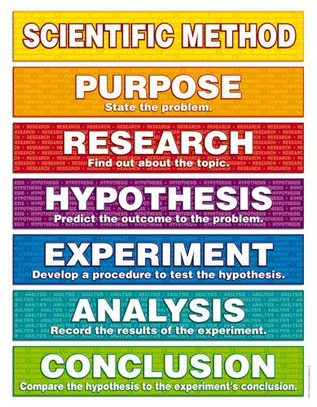
Scientific Method Steps
State the Problem - Also known as the Purpose
Research the Topic
State your Hypothesis
Experiment – Test your Hypothesis
Analyze your Data
Draw a Conclusion

Slide 8
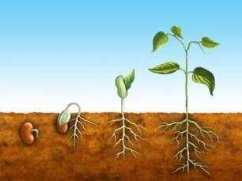
1. Purpose
State the problem that you are attempting to solve.
Be specific and avoid broad statements, the more specific your problem the easier you will find a starting point to solve it.
Ex: Broad Statement – “In what conditions do plants grow best?”
This statement is so general that it is almost impossible to design an experiment.
Ex: Specific Statement – “Do bean plants grow better in direct sunlight, indirect sunlight, or shade?”
This statement has narrowed down the problem to one plant and one factor determining its growth, making the problem one easily solved through experimentation

Slide 9
2. Research
After stating your problem, it is important to research your topic.
This allows you to form an intelligent Hypothesis.
Document your research well by citing all sources used to formulate your ideas.
Use a variety of sources; databases, books, webpages, newspaper articles, journals.

Slide 10
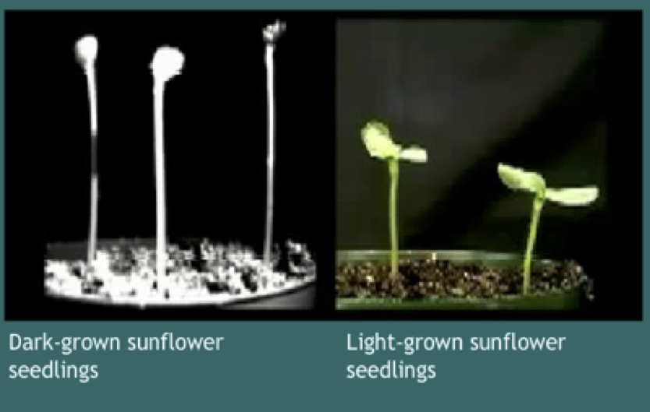
3. Hypothesis
A Hypothesis is an educated guess about the outcome of your experiment, based on your knowledge and research conducted.
Your hypothesis should be a clear and simple statement. (Not a question)
It should only state what you think your results will be, not why you think you will get those results.
Example: “Bean plants will grow better in direct sunlight than in indirect sunlight or shade.”
It is understood that your hypothesis is an educated guess, so it is unnecessary to say, “I think that” or “I believe” etc. in your hypothesis.
Use the words “if” and “then” to create your statement.

Slide 11
What If My Hypothesis is Wrong?
Guessing incorrectly does NOT make your experiment wrong!
Do not change your hypothesis if it turns out to be incorrect. Changing your hypothesis defeats the purpose of the scientific method.
Your hypothesis can be right or wrong, it’s all a part of the scientific method.

Slide 12
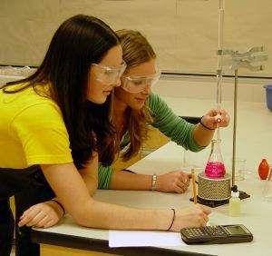
4. Experiment
Write a procedure to follow, number each step so that others are able to repeat your experiment by reading the procedure.
Control your variables
A variable is anything that can change during an experiment. So each time you test everything should be the same except the one variable that you are testing.
Independent Variable (IV): The variable that is controlled or manipulated by the experimenter.
Dependent Variable (DV): The variable that is measured by the experimenter.
Control Group (CG): The group that is not exposed to the independent variable.

Slide 13
Practice
A group of students were given a short course in speed-reading. The instructor wondered if a monetary incentive would influence performance on a reading test taken at the end of the course. Half the students were offered $5 for obtaining a certain level of performance on the test, the other half were not offered money.
Independent Variable (IV): Monetary incentive ($5 or no money). (This is the manipulated variable.)
Dependent Variable (DV): Performance on reading test. (This is the variable that can be measured by the experiment.)
Control Group (CG): $0, no monetary incentive group. (This group was not affected by the IV.)

Slide 14
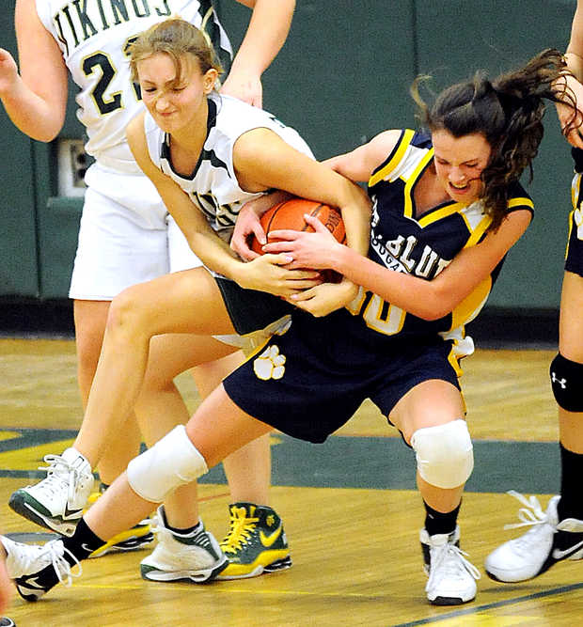
Now Try It Again!
A researcher is studying the effect of sleep on aggression, thinking that less sleep will lead to more aggression. She has some people sleep 6 hours per night, some people sleep 3 hours per night and some people sleep as much as they want. She then monitors aggressive behavior during basketball games among participants.
Independent Variable (IV): Letting some people sleep only 3 hours, and others only 6 hours. The researcher manipulates this variable.
Dependent Variable (DV): Aggression (or aggressive behavior). The experimenter is monitoring (i.e., measuring) aggressive behavior.
Control Group (CG): The people that got to sleep as much as they wanted. This is the group that was not exposed to the independent variable.

Slide 15
5. Analysis
Record the results/data of the experiment.
This is done in a data table or chart.
Organize data well so that finding results and trends is easier.
Take thorough and accurate measurements during the experiment so that the data is valid.
Find associations and trends in your data. Make connections about the experiment and your results.

Slide 16
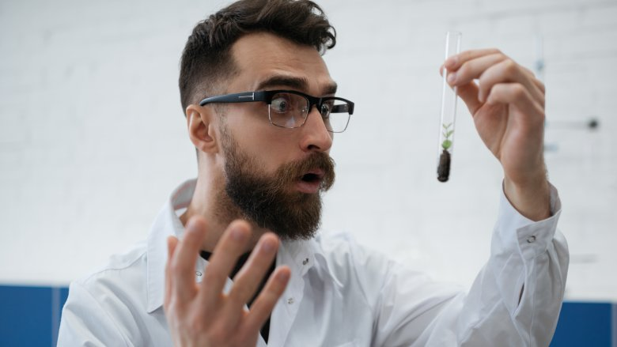
6. Conclusion
Compare the Hypothesis to the Experiment’s Data/Results.
State if your data supported or if it did not support your hypothesis.
Name any errors that could have been made during the experiment or results that could have affected your outcome.

Slide 17
Now you are an expert on the Scientific Method!

