Slide 1
Skeletal System Introduction
Skeletal Functions
Bone Shapes
Macro-Anatomy
Micro- Anatomy
Bone Growth

Slide 2
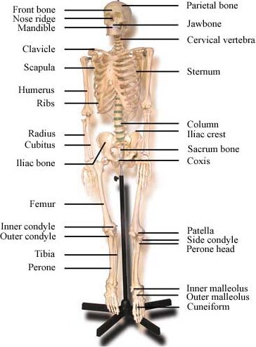
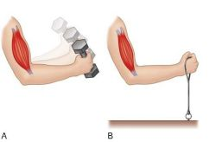
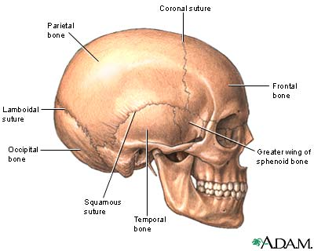
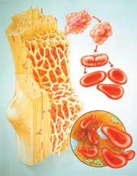
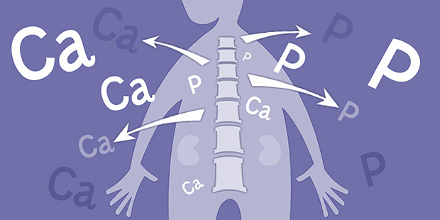
Skeletal Functions
Structure/Support
Protection
Movement
Mineral Storage
Hemopoieses

Slide 3
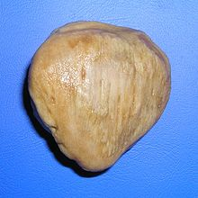
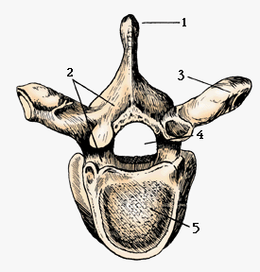
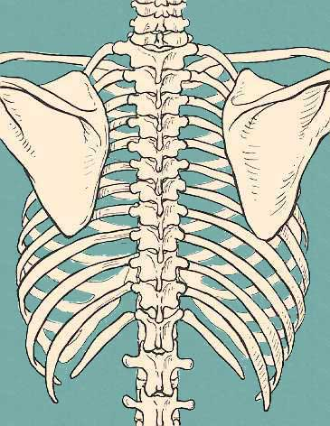
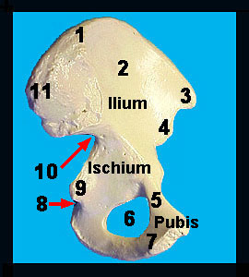
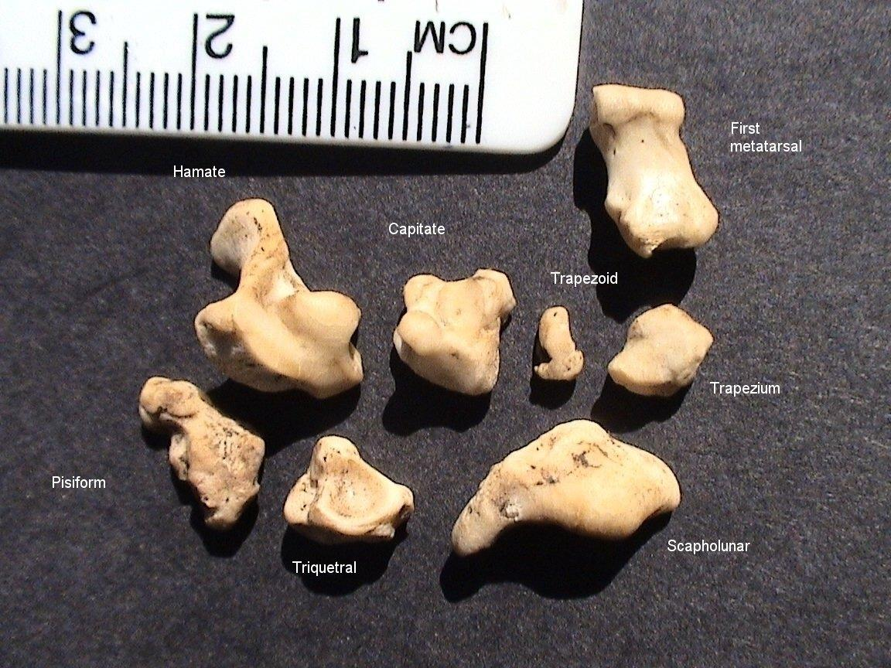
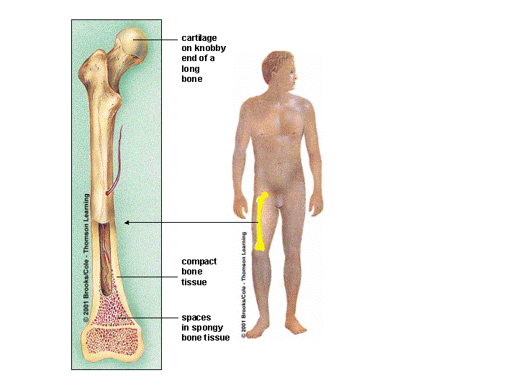
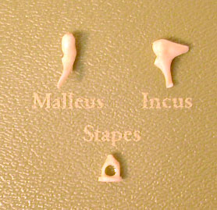
BONE SHAPES
- Long Bone
- Short Bone
- Irregular
- Flat bone
-Sesamoid bone

Slide 4
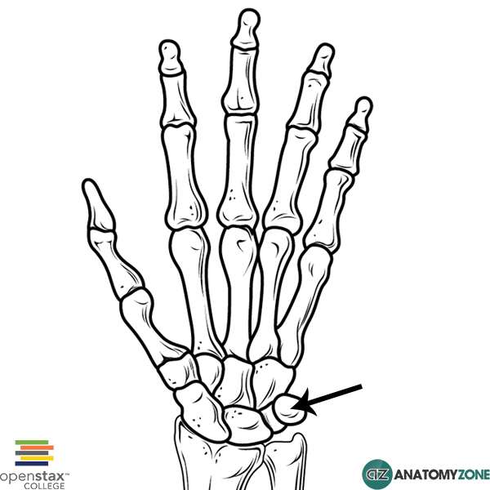
Another Sesamoid Bone
The PISIFORM – a carpal bone

Slide 5
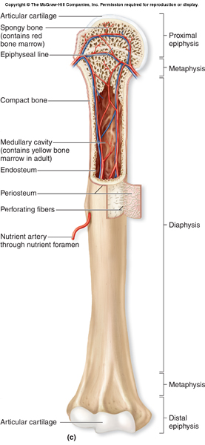
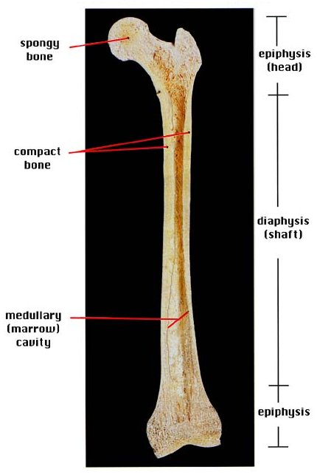
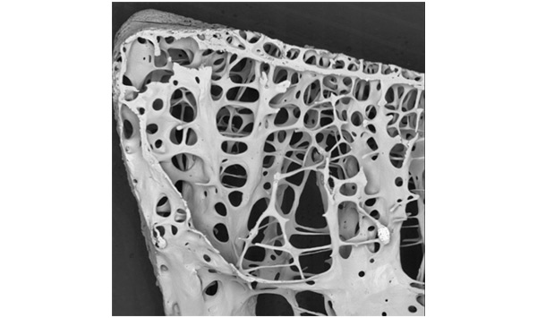
LONG BONE MACRO-ANATOMY

Slide 6
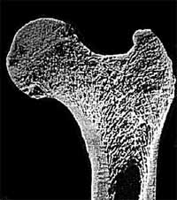
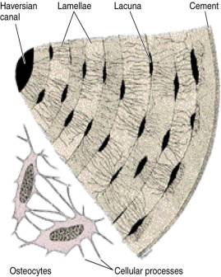
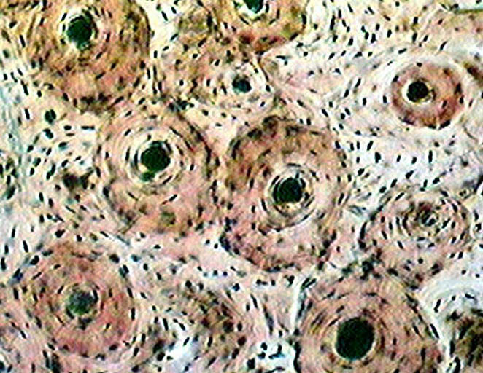
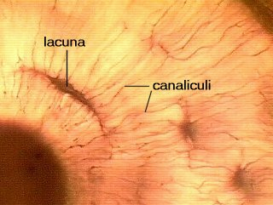
BONE Micro-Anatomy

Slide 7
BONE GROWTH

Slide 8
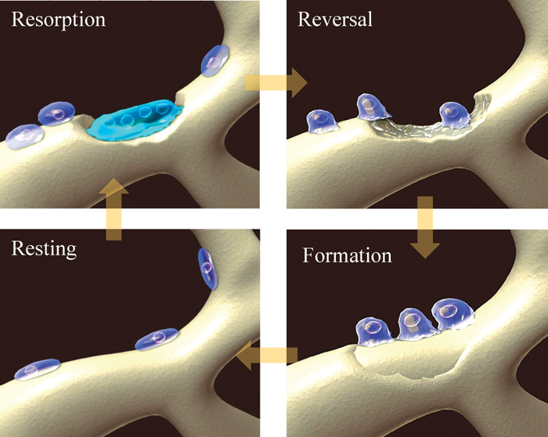
BONE CELLS
OSTEOBLASTS – Are cells that lay out calcified matrix and Build new bone tissue
OSTEOCYTES – When osteoblasts cement themselves into a lacuna and become mature functioning bone cells
OSTEOCLASTS – Are cells that Clear out and remove older bone matrix and free up the minerals

