Slide 1
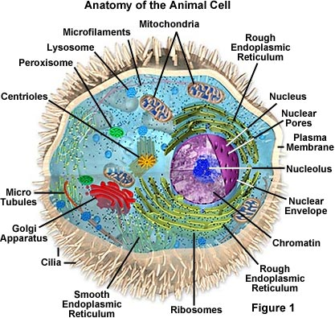
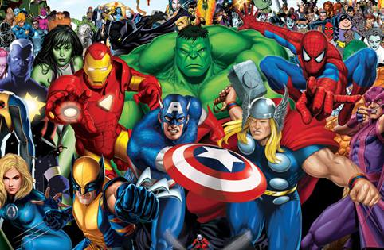
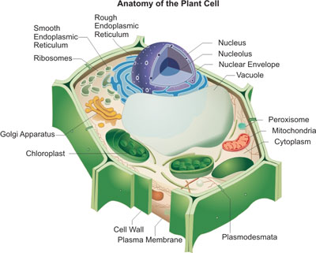
CELLS and their SUPERHEROES

Slide 2
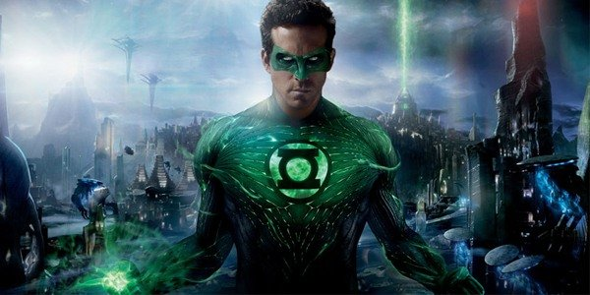
Identify my alter-ego in the
cell (organelle/structure) and explain why
GREEN LANTERN

Slide 3
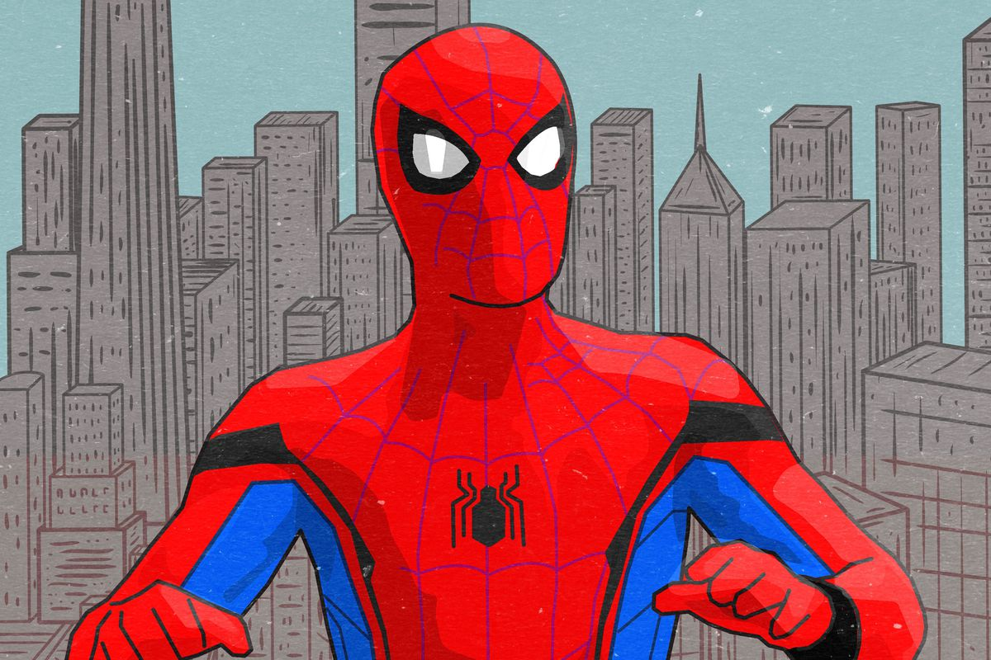
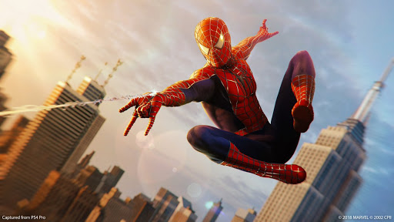
Identify my alter-ego in the
cell (organelle/structure) and explain
SPIDERMAN

Slide 4
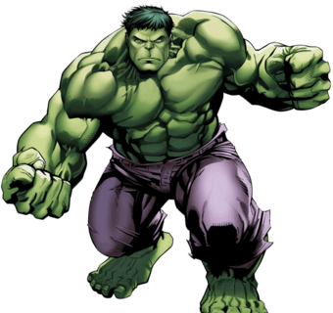
Identify my alter-ego in the
cell (organelle/structure) and explain why
HULK

Slide 5
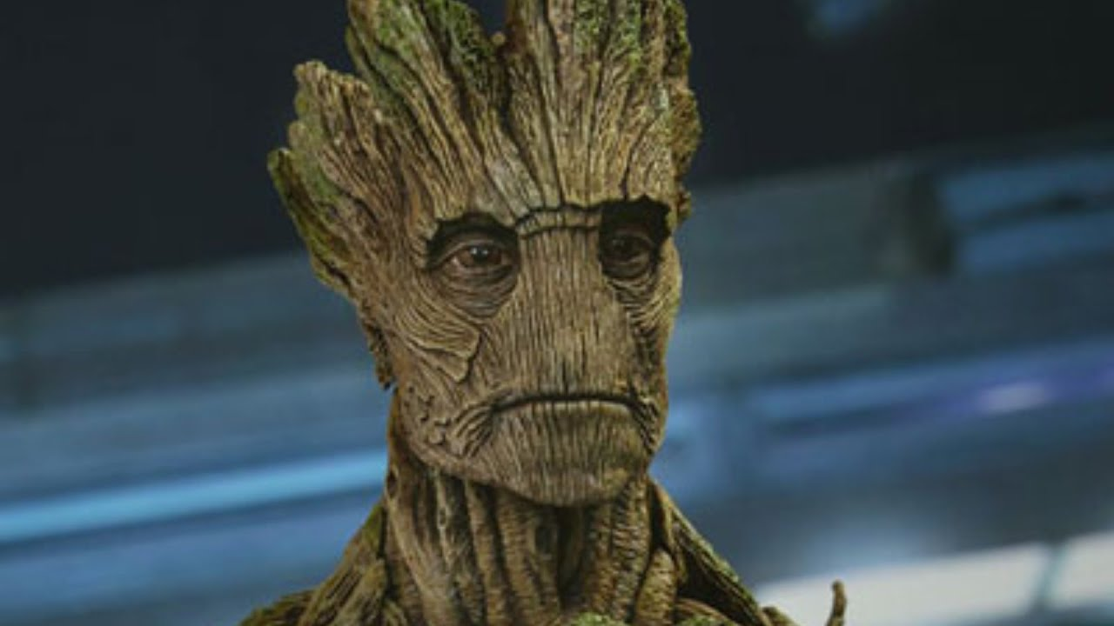
Identify my alter-ego in the
cell (organelle/structure) and explain why
GROOT

Slide 6
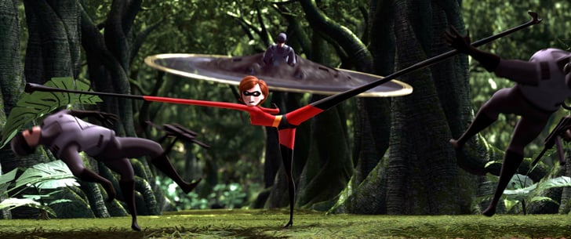
ELASTIGIRL

Slide 7
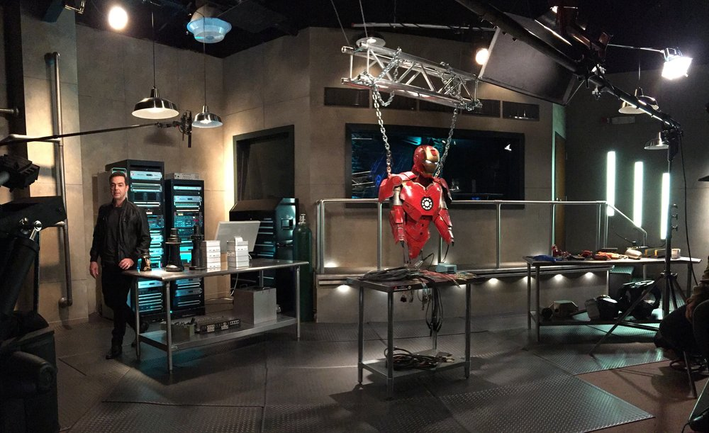
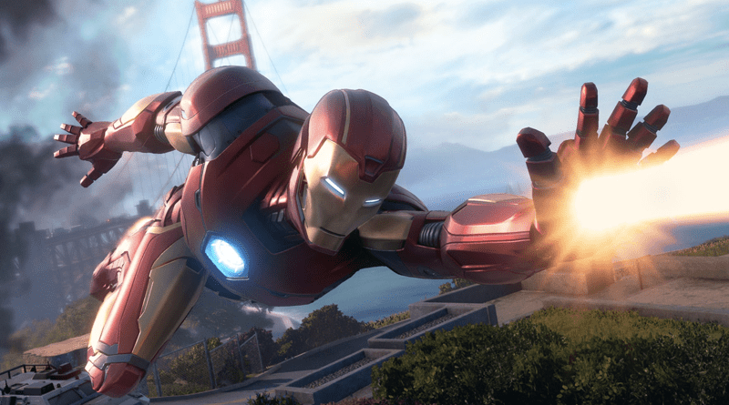
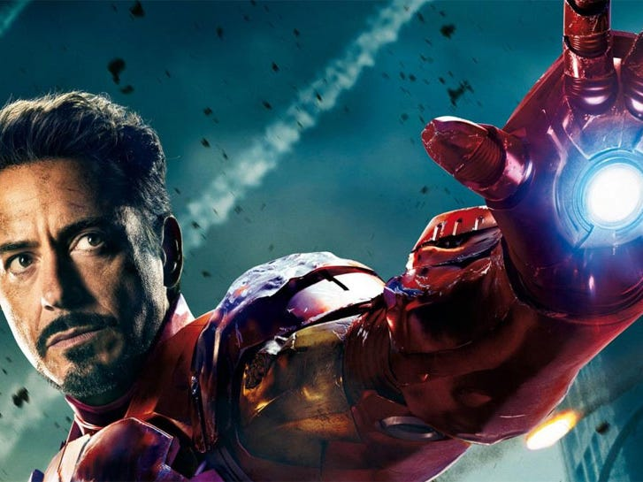
Identify my alter-ego in the
cell (organelle/structure) and explain
IRONMAN

Slide 8
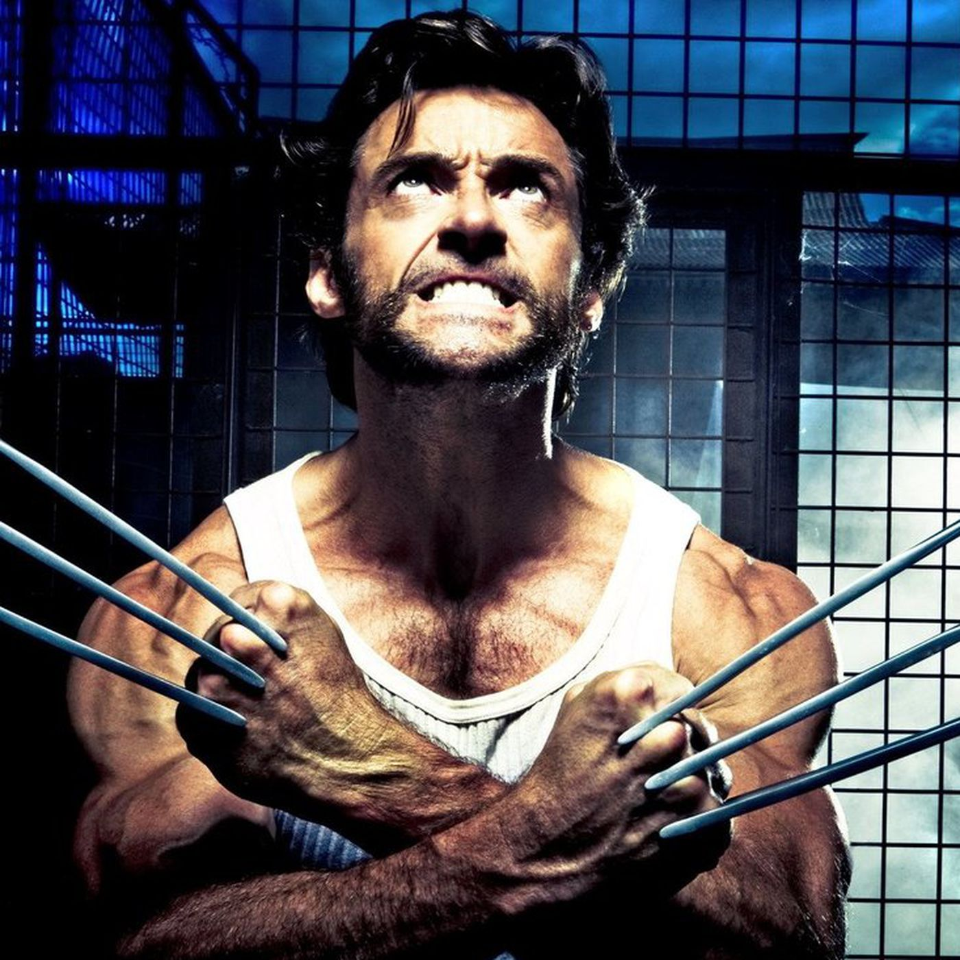
WOLVERINE

Slide 9
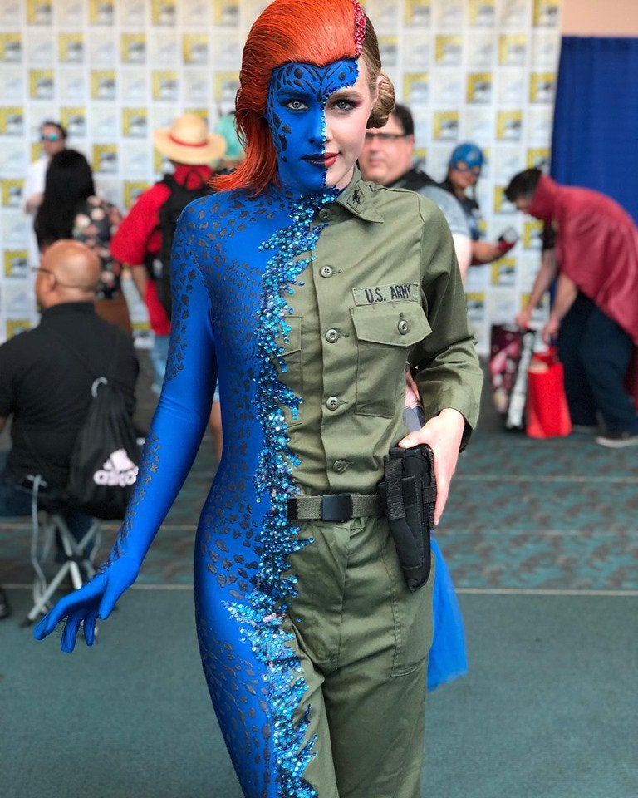
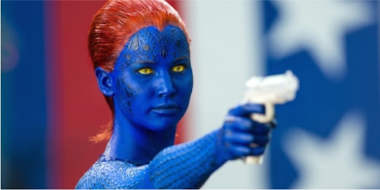
MYSTIQUE

Slide 10
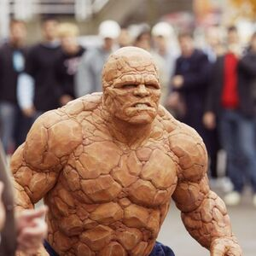
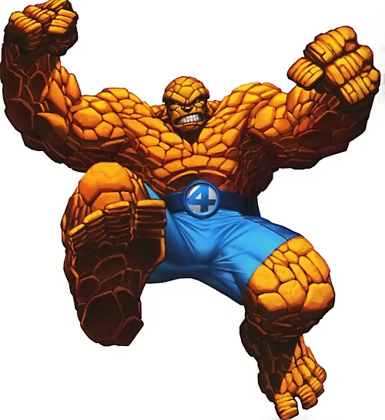
THE THING

